Slide 1
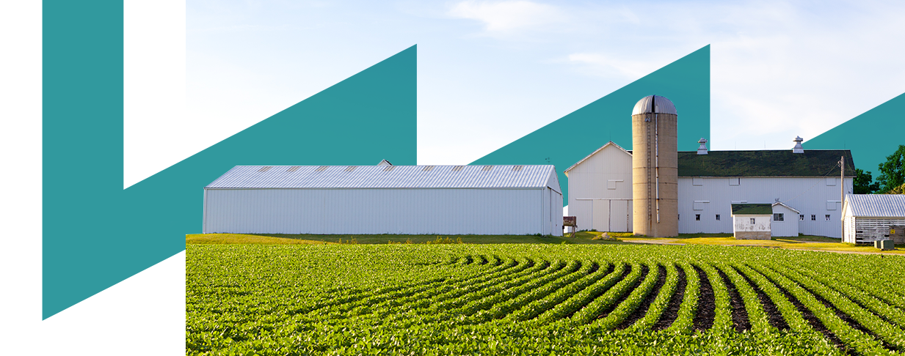











Introduction to the Circular Economy
Towards a Sustainable Agro-Food Industry.
Capacity Building Programmes in Energy Efficiency.
This project has received funding from the European Union’s H2020 Coordination Support Action under Grant Agreement No.785047.

Slide 2
‘
‘
Circular Economy
What is the Circular Economy?
From waste to recourse
Every is talking about Circular Economy... But really very few know exactly what it means.
Most people think that the Circular Economy refers only to waste management... But this is only a small part.
Probably, if they knew the actual content of the Circular Economy, very few would support it.
Fuente: De la gestión de residuos a la economía circular. EIMA2016 Encuentro Iberoamericano sobre Desarrollo sostenible. Vicente Galván López.

Slide 3
Linear consumption model
Natural raw material
Products
Waste

Slide 4
Linear consumption model
Natural raw material
Products
Waste
Results:
Creating added economic value pnly in the first part of the chain.
Significant increase in the types of materials/waste produced.
Technification and cost increase in the waste management process.
Dilution of responsabilities.
Decrease in the percentage of recovery and the absolute chain recycled, with the consequent increase in landfill shipments.

Slide 5
Linear consumption model
Natural raw material
Products
Waste
Global crisis-change:
20% of the population consumes 80% os the resources, while have to servive with the remaining 20%.
The “globalization of the energy model and westem lifestyle is NOT posible, we would need the existence of several Earth-raises to sustain it.

Slide 6
Linear consumption model
Natural raw material
Products
Waste
A Forgotten Factor: THE EARTH
IT IS NOT AN ISLAND SYSTEM (It does not exchange material or energy with the environment).
IT IS NOT AN OPEN SYSTEM (Exchange material and energy with the environment).
IT IS A CLOSED SYSTEM (Exchange energy but not material with the environment).
“The EARTH is finite (its mass remains constant)”

Slide 7
‘
‘
¿What is the solution?
Circular Economy

Slide 8
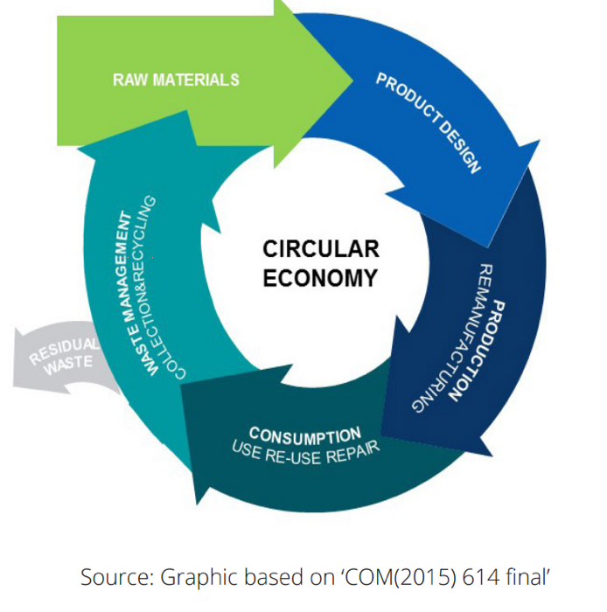
Circular Economy

Slide 9
Principles Circualr Economy
Waste is food | All products must be able to be disassembled / degraded and their components / materials reincorporated into natural or industrial cycles with minimum energy consumption.
Diversity is strength | Natural and anthropic systems are more resistant and resilient the greater their diversity of components and interactions between them.
Energy from renewable sources | All energy used in natural and industrial processes must come from renewable sources.
Systems thinking | In the design of any system, all linear and non-linear relationships between its internal components and external elements must be identified and evaluated.

Slide 10
Principles Circualr Economy
Property model | The use of products and services does not require acquiring ownership of them.
Services better tan products | The service provided by an object must prevail over its ownership. Transformation of manufacturers from vendors to service providers.
Recycling is Good, but not enought | Recycling does not prevent consumerism, nor the associated impacts.
Prices should reflect the real costs: | Real prices should direct the consumption of goods and services towards those that are integrated into a circular economy.

Slide 11
Circular Economy
Linear and nonlinear relationships.
Reinstate natural and human cycles
Long duration.
Use close to its natural state.
Minimize quantities.
Proximity to origin.
Identification and separation of waste
Service better than product.
Repair.
Energy from renewable sources.
Prices reflect costs.
Global impact balance

Slide 12
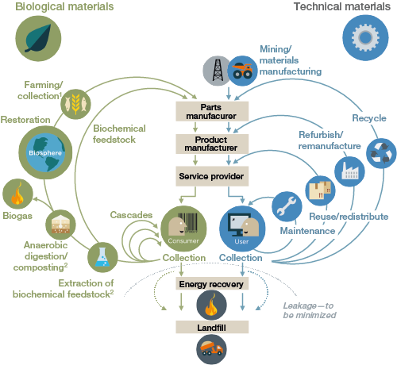
Economía Circular
This is the last of the strategies.
1st act on smaller circles and on the design of products/services
Fuente: EMF (Fundación Ellen MacArthur, 2015. “Hacia una economía circular”.

Slide 13


Circular Economy: Examples
  Example of using recycling as a strategy to close cycles:
  Ecovative Design is a US company that produces packaging materials from fungi and agricultural waste.
  When using biological materials, packaging materials can be returned to the soil as a nutrient after use.
  Example of redistribution as a strategy to close cycles
  FLOOW2 offers an online platform that allows organizations to share equipment that is currently underutilized.
  Sharing the use of equipment and machinery can be seen as a form of redistribution. In addition, because the exchange decreases the need for companies to purchase equipment, the total amount of materials stagnant in them is reduced.
  The platform is currently in operation in Belgium, the Netherlands and Germany, with a strong global expansion plan.
  Example of a combination of several strategies for closing cycles
  Turntoo offers lighting as a service, instead of selling lighting. Together with the Philips lighting company, Turntoo has developed a smart lighting system "pay per lux".
  Users pay a fixed periodic fee for the use of lighting, while Philips remains the owner of the lights and has the obligation to repair and maintain them.
  At the end of the agreement or when the lights have reached the end of the period of use, Philips will reuse or recondition it.

Slide 14
Mejora o selección del embalaje para minimizar el impacto ambiental.
Impulsión de la implementación:
Packaging Europe afirma que los problemas regulatorios siguen siendo factores importantes, pero ahora con una mayor presión tanto de los consumidores como de los reguladores.
EUROPEN subraya que el factor clave es el coste: "Lo que hagamos en términos de prevención, en la reducción de paquetes a lo largo de toda la cadena de valor, está reduciendo, por un lado, el factor de coste; y, por otro lado, la huella de CO₂, que es indirectamente un factor de coste".
Los principales impulsores son el coste creciente de las materias primas y las preocupaciones sobre la seguridad del suministro.

Slide 15
Business Benefits of the Circular Economy

Slide 16

Business Benefits of the Circular Economy
Better exposure to rising and volatile resource prices
Non-renewable natural resources are increasingly scarce due to declining stocks, increasing demand, due to rising welfare levels, and the growing world population. This translates into an increase in resource prices.
By adopting circular economy strategies and practices, companies can reduce the amount of materials they require for their production or to meet the needs of their customers.
In this way, they reduce their exposure to the risk of the increase and volatility of resource prices.
Fuente: DG Environment. KPMG.

Slide 17

Business Benefits of the Circular Economy
Circular thinking stimulates innovation
The concept of circular economy provides inspiration for companies to increase the efficiency of their resources.
It provides a new point of view to observe the business model and operations of a company.
Looking through this new point of view can provide new knowledge and stimulate innovation.
Example: In the search for ways to reduce the amount of materials used in construction, the Dutch construction company BAM invented new construction materials made of plastic waste.
Fuente: DG Environment. KPMG.

Slide 18

Business Benefits of the Circular Economy
Create a green image
Consumers, businesses and governments are increasingly aware of the environmental impact of the products they use.
Therefore, they are more in tune with sustainability when making their purchase decisions.
By adopting circular economy strategies and practices, companies can reduce the environmental footprint of their products and, therefore, differentiate themselves from their competitors..
Fuente: DG Environment. KPMG.

Slide 19

Business Benefits of the Circular Economy
Opens up new markets and opportunities to grow
Circular solutions can also create new markets or niches.
Example: In the textile industry there are several companies that produce threads from discarded garments or textile waste. Since consumers are looking for sustainable clothing, it grows in a separate market that exists alongside the regular textile market.
Fuente: DG Environment. KPMG.

Slide 20

Business Benefits of the Circular Economy
Increased customer loyalty and more stable revenue streams.
Becoming more circular can be facilitated by adopting a different business model.
For example: continuing to own the manufactured products instead of selling it (charging for washing instead of selling washing machines) helps to recover the parts and materials of the product at the end of the period of use.
The adoption of such business models has the benefit of increasing customer loyalty and providing more stable revenue streams.
One disadvantage is that such models generally require more pre-financing.
Fuente: DG Environment. KPMG.

Slide 21
Circular Economy
The Circular Economy must transform the waste sector into a resource industry:
Key role: resource industry (materials and products).
Working together all the agents involved.
Partners and alliances between different actors and stakeholders (win-win strategy).
Need for contacts and lobbying.
Country-specific barriers: require different types of action in Europe.
Public-private partnership.
Need for R&D positioning.

Slide 22
Summary
Waste no longer exists.
Biological materials are renewable, technological materials are not, and therefore must be recycled.
Try to reuse all products, if that is not possible, parts of the product and if that is not possible, recycle the materials.
First repair, then reuse, remanufacturing and finally recycling.
Making use of renewable energy.

Slide 23
Towards a sustainable agro-food industry. Capacity building programmes in energy efficiency.

