Slide 1
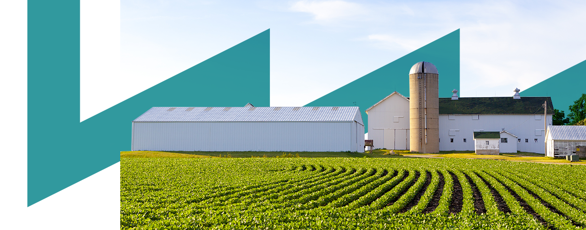











Energy Efficiency in
Electrical processes
Gema Millán
Inmaculada Fraj
Towards a Sustainable Agro-Food Industry.
Capacity Building Programmes in Energy Efficiency.
This project has received funding from the European Union’s H2020 Coordination Support Action under Grant Agreement No.785047.

Slide 2
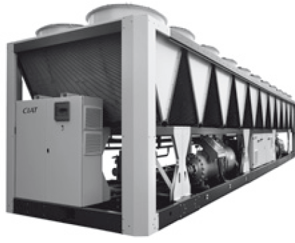
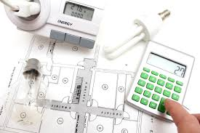

Energy Efficiency in cooling production
Energy Efficiency in engines
Energy Efficiency in electric transformers
CONTENTS
01
02
02
03
02

Slide 3
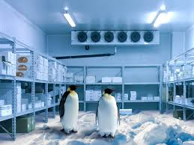
01
Energy Efficiency in Cooling production
Source: CIAT
Source: NOVOFRI

Slide 4
01
Energy Efficiency in Cooling production
Possible cool demand processes:
Storage of vegetables and fruits (temperature from 0ºC to 20ºC).
Fermentation process in wineries (temperature from 20ºC to 30ºC)
Wine stabilisation (temperatures near to the freezing -4ºC approx.)
Pellets cooler in fodder dehydration (temperature from 5 ºC to 35 ºC)
Cooling, salting in slaughterhouse (temperature from -3 ºC to 6 ºC)
Drying/Ripening in slaughterhouse (temperature from 6 ºC to 26 ºC)
Storage juices extraction, purée (temperature 4 ºC to 25 ºC)
Sterilizer cooler in tomato concentrate (temperature 35 ºC to 38 ºC)
Cooling in milk production (temperature 4 ºC)
Cooling, incubation in yoghurt production (temperature 40 ºC to 45 ºC, 12-15 ºC)
Oreo and Maturation in cheese production (temperature 16 ºC - 10 ºC)
Storage in Dairy production (temperature 5 ºC)

Slide 5
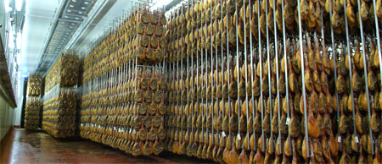
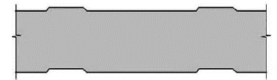
01
Energy Efficiency in Cooling production
When cool production is analyzed it is necessary to evaluate the improvement measures in two areas:
Cooling cycle (devices)
Walls and surfaces of refrigeration chambers
Efficiency energy in wall chamber surfaces:
The most used material is polyurethane panel
Insulating foam
Metallic plates
The final product is joined during the manufacturing process and, as a result, it is formed as a single component.

Slide 6
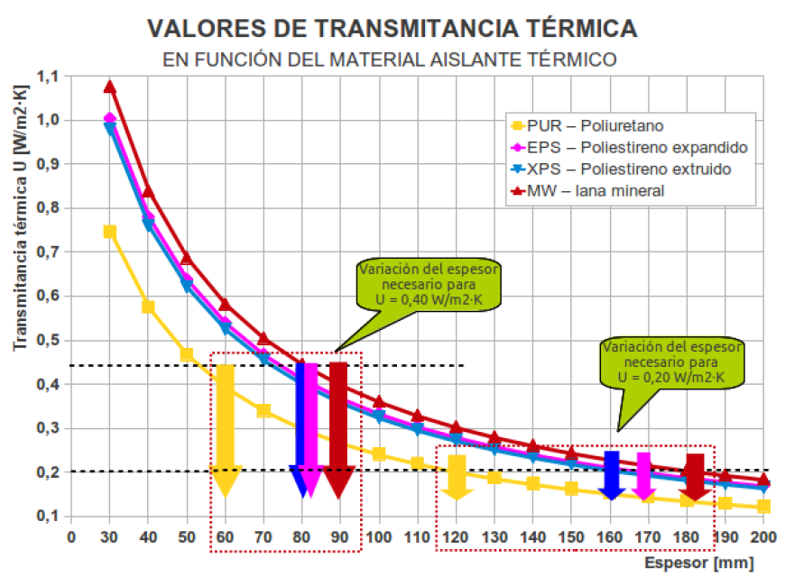
01
Energy Efficiency in Cooling production
Efficiency energy in wall chamber surfaces:
The polyurethane panel is the insulation with a low thermal coefficient with values lower than 0,025 W/mºK measured at 10ºC.
Thermal transmittance with different materials
The thickness differences to obtain the same thermal transmittance using different materials

Slide 7
01
Energy Efficiency in Cooling production
Efficiency energy in wall chamber surfaces:
From 2010, the entire panel must have a CE label according the UNE-EN 14509:2007 standard on this label, the following thermal properties must be shown:
Thermal conductivity (W/mºK) → it is a property of the material
Thermal transmittance (W/m²ºK) → it is a property of the final product
As an example, in Spain, according to the requirements of the RD138/2011, it is established that the heat flow through the wall chamber must be:
  < 15 W/m² (7ºC ≤ temperature inside < 20ºC)
  < 8 W/m² (0ºC ≤ temperature inside < 7ºC)
  < 6 W/m² (temperature inside < 0ºC)

Slide 8
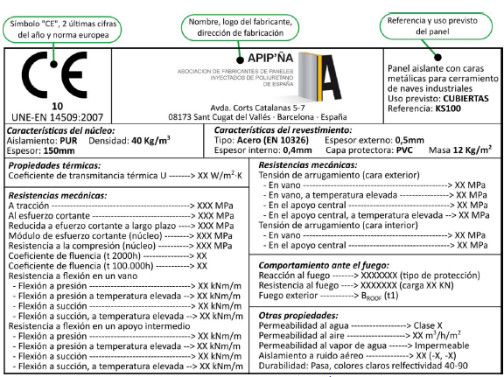
01
Energy Efficiency in Cooling production
Efficiency energy in wall chamber surfaces:
Thermal properties

Slide 9
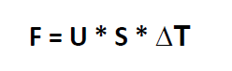
01
Energy Efficiency in Cooling production
Efficiency energy in wall chamber surfaces:
To evaluate the heat flow, the following expression can be used:
Where:
F → heat flow (W/m²)
U → thermal transmittance (W/m²ºK)
S → surface (m²)
ΔT → temperature difference from exterior to interior
Thermal losses will determinate the power of cooling devices.

Slide 10
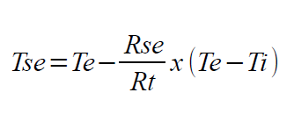
01
Eficiencia Energética en producción de frío
Efficiency energy in wall chamber surfaces:
Condensation problems on the outside of the walls
T_{se} = exterior surface temperature
T_{e} = exterior ambient temperature
T_{i} = interior ambient temperature
R_{se} = thermal resistance exterior surface
R_{t} = thermal resistance (1/U)
Example:
Exterior temperature = 23ºC
Humidity = 72 %
Interior temperature = -18ºC
U panel = 0,20 W/m²ºK
T_{se} = 22,6 ºC
Wet bulb temperature = 19,4 ºC
Because the temperature of the wet bulb is less than T_{se} there will be no condensation.

Slide 11
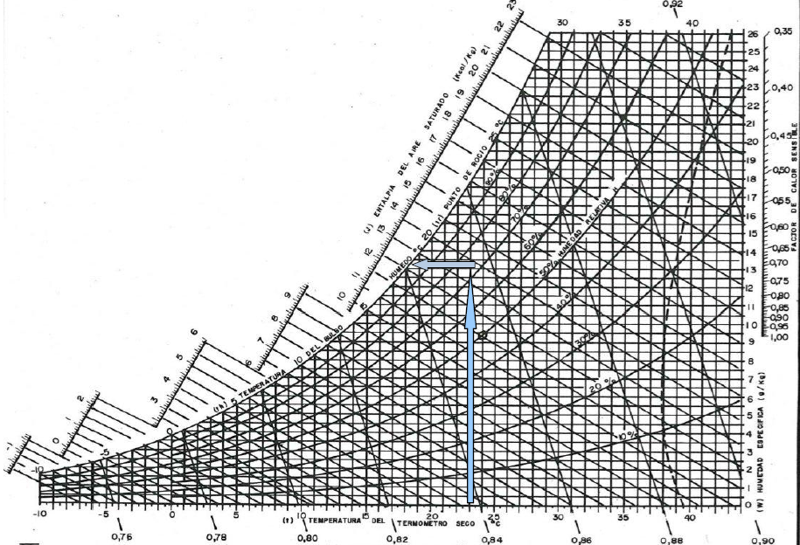
01
Energy Efficiency in Cooling production
Efficiency energy in wall chamber surfaces:
Condensation problems on the exterior side in the walls

Slide 12
01
Energy Efficiency in Cooling production
Efficiency energy in wall chamber surfaces:
Some recommendations:
At least 100 mm thick in panel for temperatures above 0ºC and 200 mm below 0ºC
Isolating the floor of the chamber is very important (remember that a typical value of U-thermal in the ground is four times greater than the value of a panel).
Avoid problems of condensation on the walls using adequate insulation.
Verify constructive solutions.

Slide 13
01
Energy Efficiency in Cooling production
Energy efficiency in cold chambers:
Improve the insulation of the refrigerator.
Install automatic doors and fast access.
Install a conditioned antechamber, to avoid the entry of untreated air.
Program the loading and unloading of the refrigeration chambers appropriately, so as not to open them too frequently.
Use insulated containers to move merchandise from the refrigeration chamber to trucks.

Slide 14
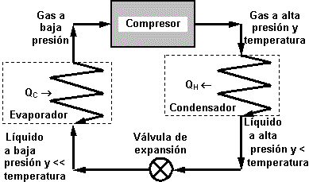
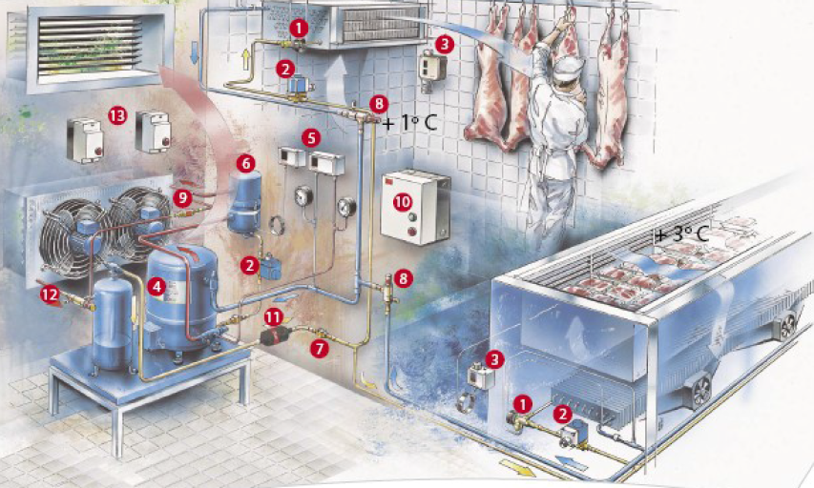
01
Energy Efficiency in Cooling production
1.- expansion valve
2.- solenoid valve
3.- temperature control
4.- compressor
5.- pressure control
6.- oil separator
7.- fluid control
8.- evaporator pressure regulator
9.- pressure valve
10.- control system
11.- dehydrate filter
12.- pressure condensation regulation
13.- protections engine start

Slide 15
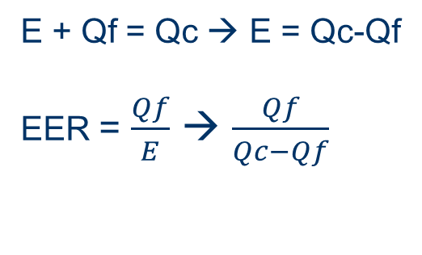
01
Energy Efficiency in Cooling production
Efficiency energy in cooling systems:
The refrigeration compression, within the refrigeration cycle, consists of passing through a closed circuit a refrigerant fluid that operates at two pressures, from the lowest to the highest.
The result is that the fluid absorbs heat in one space and supplies it in another.
The energy performance is measured by the Energy Efficiency Ratio (EER)
In case the system also produces heat, there is another coefficient of performance called COP (coefficient of performance).
Qc (hot area)
Cooling device
E = electricity
Qf (cool area)

Slide 16
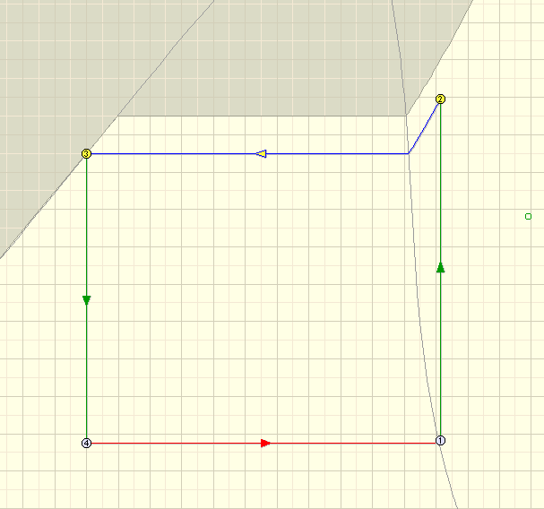
01
Energy Efficiency in Cooling production
Qc
condensator
expansion valve
compresor
T
evaporator
Qf
liquid
vapor
2
3
1-2 → compression
2-3 → heat transfer from the fluid to the exterior through the condenser
3-4 → pressure lost
4-1 → heat transfer from the interior to the fluid through the evaporator
exterior temperature
interior temperature
4
1
Vapor – liquid mixture
s

Slide 17
01
Energy Efficiency in Cooling production
Efficiency energy in cooling systems:
To improve the EER, it is possible to have several stages in the compression process
condensator
1
x
1-x
evaporator

Slide 18

01
Energy Efficiency in Cooling production
Efficiency energy in cooling systems:
Inverter technology:
The air conditioners equipped with inverter have a frequency inverter that incorporates an adjustable electric inverter to control the speed of the motor and, therefore, the compressor and the cold exit,
Eliminating stop-start cycles increases efficiency,
A constant temperature,
It adapts to the demand,
Equipment life is extended.

Slide 19
01
Energy Efficiency in Cooling production
Efficiency energy in cooling systems:
Energy efficiency in compressors:
1.- Replacement of compressors with more efficient ones with variable loads.
2.- Installation of multistage compressors.
To produce different pressures to supply the demand of cold at different temperatures.
3.- Heat recovery of cold compressors.
To cover the thermal demands of low temperature for other uses (Heating and hot water) in the same installation.
4.- Centralized control of the compressors group
Decentralized system: Each chamber has its own compressor
  Good control of workload. (Each chamber can be turned on/off according to need)
  Low energy efficiency in small compressors
  Centralized system. All compressors in the same area, and the refrigerant is transported to each point of consumption.
  Better energy efficiency in large compressors
  Remote control

Slide 20
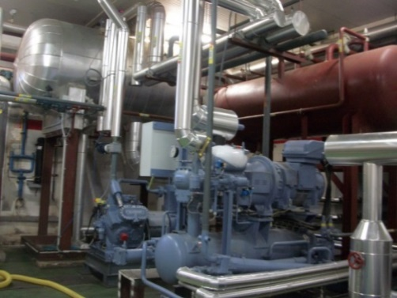
01
Energy Efficiency in Cooling production
Efficiency energy in cooling systems:
Energy efficiency in compressors
5.- Equipment for obtaining floating head pressure
Reduce head pressure and allow it to fluctuate with environmental conditions by using a frequency inverter to modulate compressors and condenser fans and electronic expansion valves (energy savings of 15-30 %).
6.- Equipment to improve the control of the system with the operation of the compressors
Adjust the suction pressure as much as possible, keeping the cabinets at the correct temperature, using an electronic pressure regulator (energy savings of 6%).

Slide 21
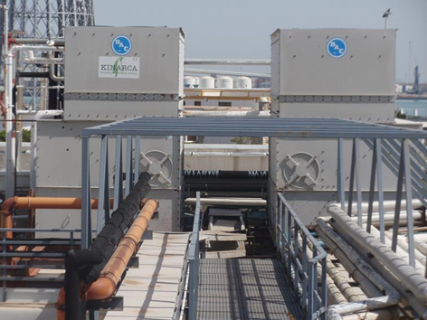
01
Energy Efficiency in Cooling production
Efficiency energy in cooling systems:
Energy efficiency in evaporators:
The elimination of frost that covers the evaporator’s exchange surface (low energy consumption) through a heated fluid (not electric) or a hydrophobic treatment of the surface of the evaporators (new technology),
Control of defrosting periods,
Design an appropriate size of evaporators,
Use of evaporative condensers instead of air-cooled condensers (savings of 5%).
Energy efficiency in condensers:
Adjust to reduce the condensing temperature as low as possible.
Design an appropriate size of condensers,
Recovery of heat from the condensers for other uses: to cover the thermal demands of low temperature for other uses (heating, preheating of hot water, preheating of the ventilation air supply).

Slide 22
01
Eficiencia Energética en producción de frío
Temperature control in air-conditioned installations:
Installation of temperature control systems (thermostats).
Creation the On/Off protocol
Installation of cold storage systems:
Good option where the demand for cold is only at specific times.
Reduction of cooling capacity. When energy is cheaper and there is no demand for cold, it is stored cold and consumed later, when there is a maximum demand for cold.

Slide 23
01
Energy Efficiency in Cooling production
Efficiency energy to improve cooling systems:
Use high efficiency fans in the condenser and evaporator,
Install antifreeze devices on the surface of the heat exchanger to keep it optimal,
Install a humidity sensor to activate, if necessary, the anti-humidity heaters.

Slide 24

01
Energy Efficiency in Cooling production
General improvements in industrial cold production
1.- keep the condenser clean and keep the heat exchanger of the evaporator dry,
2.- keep the maintenance of both the compressor and the motor well,
3.- To keep the amount of cold fluid in the circuit,
4.- Check that the insolation is adequate,
5.- Make sure that the doors are closed,
6.- Design refrigeration chambers away from heat sources,
7.- In case there are several refrigeration units, install them together.
The condenser should be installed in the shade to reduce air temperatures for condensation.

Slide 25
02
Energy Efficiency in Engines
Classification of electric motors:
They are classified according to the type of current that is necessary for its operation.
  Direct Current (DC)
  Alternating Current (AC)
In electric motors of alternating current the electromagnetic field can be generated in two ways:
  By means of alternating current (asynchronous machines)
  Using direct current (synchronous machines)
The most commonly used motors are asynchronous AC

Slide 26
02
Energy Efficiency in Engines
In general, the induction motors are lighter and have less inertia, so it is easier to adapt the rotation speed according to the demand. In addition, these type of engines are cheaper and their performance is higher.
On the other hand, DC motors have been commonly easier to control, however, in recent years, advances in power electronics have made it possible to control the rotation speed of AC motors.
PROPERTY | COMPARATION
Weight | Induction Engines < Direct Current Engines
Inertia | Induction Engines < Direct Current Engines
Maintenance | Induction Engines < Direct Current Engines
Performance | Induction Engines > Direct Current Engines
Control | Usually easier in M.C.C but power electronics made it will be possible in M.I
Cost | Induction Engines < Direct Current Engines

Slide 27
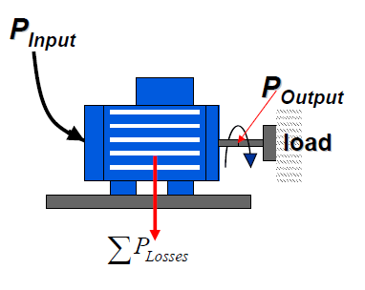
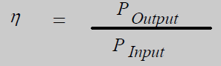
02
Energy Efficiency in Engines
Performance definition:
The performance of an electric motor is defined as the result of dividing the mechanical output power by the electric input power.

Slide 28
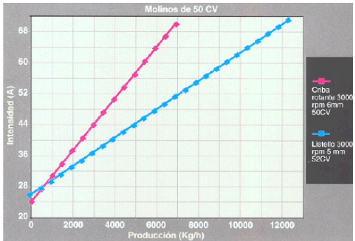
02
Energy Efficiency in Engines
Performance definition:
The performance is not constant and will be higher the higher the output power
But the higher the output power there will also be higher energy consumption.

Slide 29
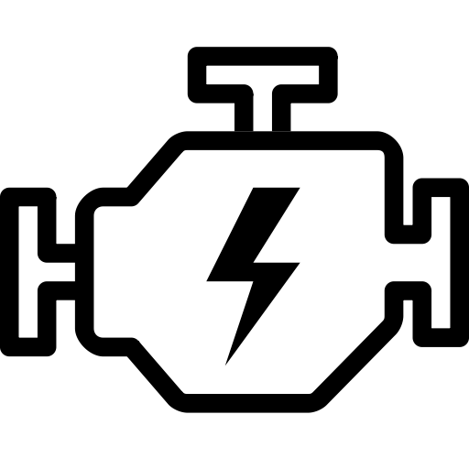
02
Energy Efficiency in Engines
What are the opportunities to save energy in electric engines?
1.- Take an inventory of the installed electric motors with the following methodology:
Identify the engines and the associated process (pumping, ventilation, drives…)
Identify the electrical characteristics: power, demand current, voltage, power factor, operation regime.
Knowledge of the number of hours the engine operates
Load or demand factor
Maintenance program
Consumption as possible (meter or grid analyzer for measurement)

Slide 30
02
Energy Efficiency in Engines
What are the opportunities to save energy in electric engines?
2.- Correct selection of the engines:
It is very common to see oversized engines, which makes the nominal power too high compared to what is needed to cover the needs.
Oversizing causes:
An increase in losses,
An increase in installed power,
A reduction in the electric power factor (cos φ),
A global reduction in energy efficiency in processes.

Slide 31
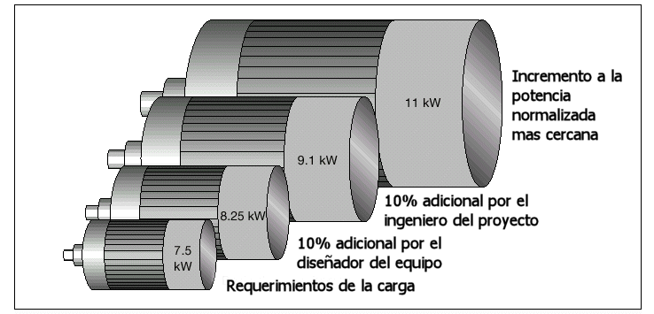
02
Energy Efficiency in Engines
What are the opportunities to save energy in electric engines?
2.- Correct selection of the engines:
Power increase to the nearest standard
Higher energy consumption required
Power increase of 10 % by the engineer
10% power increase per according to the device design
Real requeriments

Slide 32
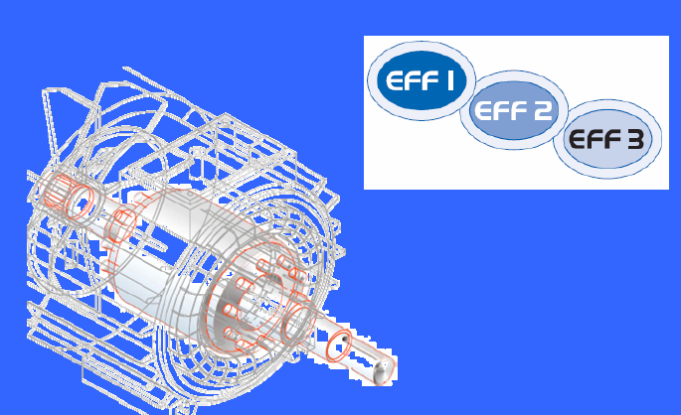
02
Energy Efficiency in Engines
What are the opportunities to save energy in electric engines?
3.- Replace old engines with new ones with high efficiency.
Classification
EFF1: High efficiency engines
EFF2: Improved efficiency engines
EFF3: Standard engines
Manufacturers agree to differentiate their devices from others.
Europe: EN-IEC 60034-2 for powers in the range of (1,1 kW – 90 kW) for 2 and 4 poles with voltage 400 V and 50 Hz

Slide 33
02
Eficiencia Energética en motores
What are the opportunities to save energy in electric engines?
3.- Replace old engines by new ones with high efficiency:
At present, the requirements of the EN 60024-30 standard published by the European Commission classify energy efficiency in engines of 0,75 kW – 375 kW of 2, 4 and 6 poles.
IE1: Engines with a standard efficiency. Similar to EFF2.
IE2: High efficiency engines, similar to EFF1.
Classification
IE3: More energy efficient motors. Losses are reduced by 15 %.
IE4: Super premium efficiency motors.

Slide 34

02
Energy Efficiency in Engines
Legislation:
EU MEPS (European Minimum Energy Performance Standard).
In July 2009 the European Commission’s legislation was published, which establishes the eco-design requirements for engines.
In June 2011, engines from 0,75 kW to 375 kW will be required to be of minimum efficiency of IE2.
From 2015 the minimum performance of engines from 7,5 kW to 375 kW will be IE3.
From 2017 this obligation will be extended to engines from 0,75 kW to 5,5 kW.

Slide 35
02
Energy Efficiency in Engines
Legislation:
IEC 60034 | CEMEP
IE4 Super premium efficiency
IE3 premium efficiency
IE2 high efficiency | EFF1
IE1 standard efficiency | EFF2
The IEC 60034 legislation is broader than EU MEPS because it includes all types of engines (explosive atmosphere, brake motors).

Slide 36
02
Energy Efficiency in Engines
What are the opportunities to save energy in electric engines?
3.- Replace old engines by new ones with high efficiency.
Characteristics of the motors of high energy efficiency:
More surface conductors so the resistance is smaller and losses by the Joule effect
(Losses = I2*R) will decrease
Use of steel with better magnetic properties.
Ventilation losses are reduced due to better design.
They operate at lower temperatures
They better resist the voltage variation and the existence of harmonics
The power factor is higher
They are quieter
The duration of the operation is greater

Slide 37
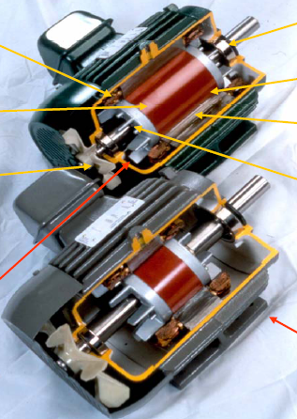
02
Energy Efficiency in Engines
What are the opportunities to save energy in electric engines?
3.- Replace old engines by new ones with high efficiency.
Transmission is optimized
Less losses in the copper of the stator
Optimized length
Longer rotor
Smaller fan
Less losses in the copper of the rotor
High efficiency engine
Standard engine

Slide 38
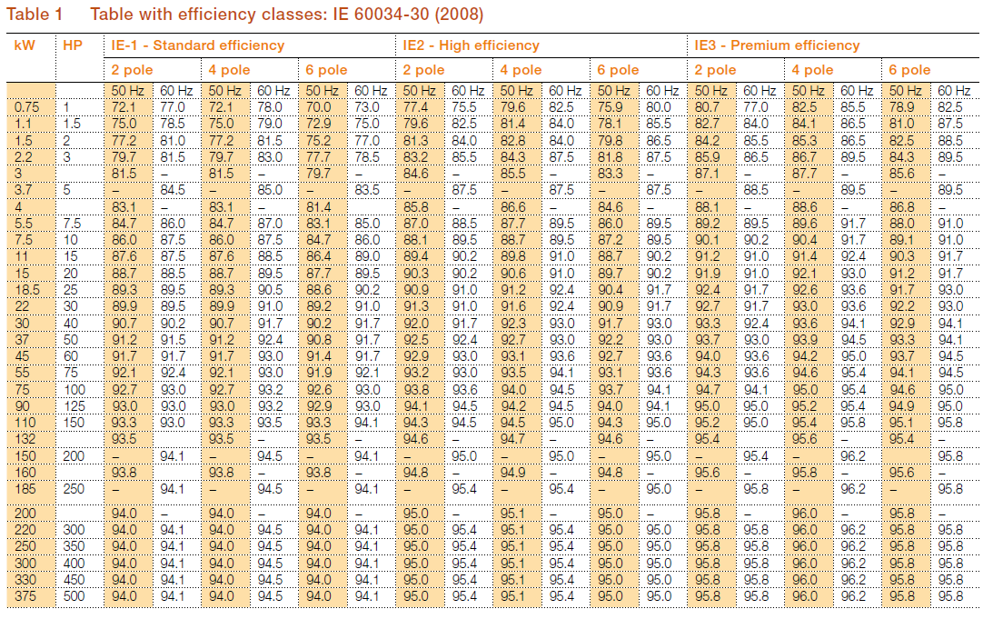
02
Energy Efficiency in Engines
What are the opportunities to save energy in electric engines?
3.- Replace old engines by new ones with high efficiency.

Slide 39
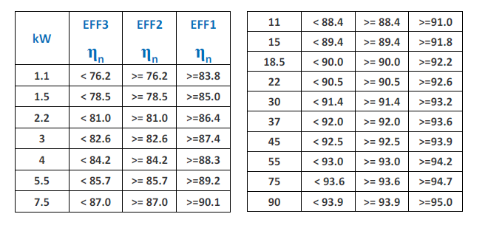
02
Energy Efficiency in Engines
EU CEMEP classification for engines with 4 poles:

Slide 40
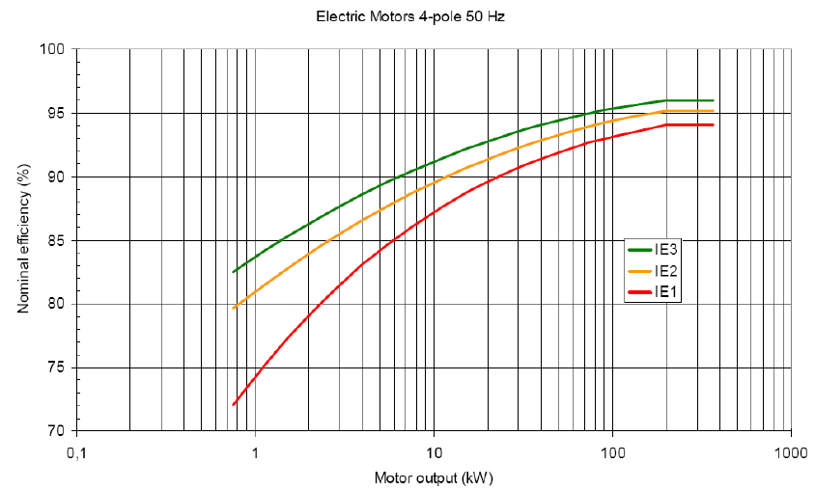
02
Energy Efficiency in Engines
Classification by means IEC 60034-30:

Slide 41
02
Energy Efficiency in Engines
What are the opportunities to save energy in electric engines?
3.- Replace old engines by new ones with high efficiency.
High efficiency engines are recommended in the following cases:
When older engines have to be repaired or replaced,
In new installations,
If the engines have more than 4.000 hours of annual operation
In some processes where the engines work at a constant speed and with maximum power.

Slide 42
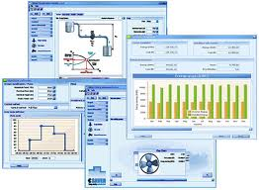
02
Energy Efficiency in Engines
What are the opportunities to save energy in electric engines?
4.- Install Variable Frequency Drive – VFD
The objective is to modify the engine speed to ensure that it is always operating in optimal conditions.
Evaluating the potential savings of installing a variable frequency drive is difficult, so the best way is to use the manufacturer’s software:
  Omron → Esaver
  Schneider electric → Eco 8

Slide 43
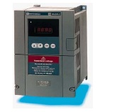
02
Energy Efficiency in Engines
What are the opportunities to save energy in electric engines?
4.- Install Variable Frequency Drive
There are devices such us pumps, fans, elevators, compressors or conveyor belts, which operate with variable load.
It is interesting that these devices can modify the rotation speed of the motor so that it always works in optimal conditions and does not require more power.
The viability of this device depends on:
  Engine power
  Number of operation hours
  Charge or load
Profits:
  Saving up to 40 % of energy
  Longer life of all components
  Less noise

Slide 44
02
Energy Efficiency in Engines
What are the opportunities to save energy in electric engines?
4.- Install Variable Frequency Drive
These engines operate at constant speed when connected to the electric grid, however, they are ready to operate at variable speed if they are connected to a frequency inverter.
There is a high potential for energy savings, since the energy depends exponentially on the speed, so that when it is reduced, the energy demand is too low.

Slide 45
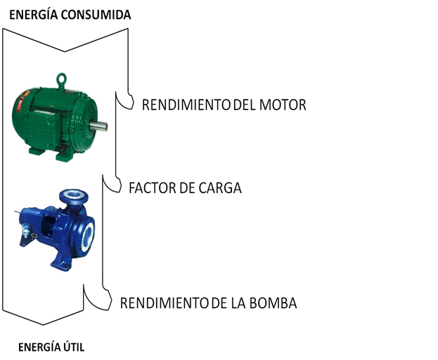
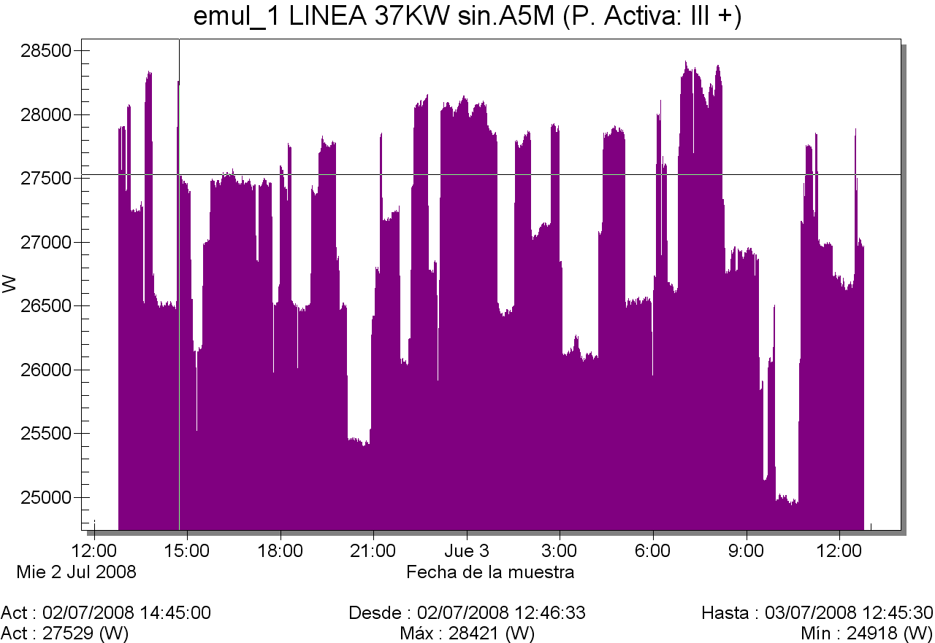
02
Energy Efficiency in Engines
What are the opportunities to save energy in electric engines?
4.- Install Variable Frequency Drive
Used Energy
Engine Performance
Load Power
Pump Performance
Useful Energy
It shows that, during 24 hours a day, an engine with 37 kW, the real power demanded is an average of 26,5 kW. The daily energy consumption is 625 kWh, so this value is 133.750 kWh.

Slide 46

02
Energy Efficiency in Engines
What are the opportunities to save energy in electric engines?
4.- Install Variable Frequency Drive
Energy consumption reduction
Current consume
Energy consumption with variable frequency
Variable frequency and an additional energy saving function
Energy savings of 6 %.
Energy saving implementing an additional saving energy function 22 %.
Payback time 0,9 year

Slide 47
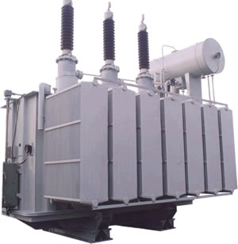
03
Energy Efficiency in Electric Transformers
A transformer can operate at full load or with little load.
The load level is defined as the speed between the input current that is absorbed by the transformer and the value it would absorb under nominal conditions

Slide 48

03
Energy Efficiency in Electric Transformers
If the “C” value is 0,75 < C < 1 the efficiency of the transformer is OK,
If the “C” value is C < 0,75 the transformer is oversized so the performance is lower,
If the “C” value is C > 1 the transformer is of insufficient size so the operating conditions are not correct,
The problems is knowing how to evaluate the “C”
Measurement by means of the grid analyser.

Slide 49
Towards a sustainable agro-food industry. Capacity building programmes in energy efficiency.

