Slide 1
Role Play: Communication & Cooperation in EnMS
Towards a Sustainable Agro-Food Industry. Capacity Building Programmes in Energy Efficiency.
This project has received funding from the European Union’s H2020 Coordination Support Action under Grant Agreement No.785047.

Slide 2
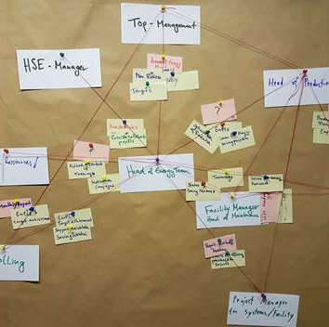
Results
Pin Board Documentation with how the process should be organised from the perspective of the employees
“White Cards“ and “Cords“: People (Energy Team) and interaction
“Yellow Cards“: Topics that they need to discuss
“Red Cards“: Suitable Plattforms
The Pin Board is a good Input for the Management to adapt communi-cation process of Energy Management System to the natural communication process in the company

Slide 3
Meet Your Colleagues – Speeddating Round
Discuss with each of your assigned colleagues the following topics:
What are the key topics you should discuss regularly regarding EnMS? (Yellow cards)
Which means of communication are suitable ((existing/new) regular meetings, notice, regular report, e) for the relevant information? (Red cards)
How often/at which intervals should you communicate?
Present your results to the group:
Which means of communication did you choose?
Is there already a specific topic (machine design, energy saving action) which you will track?

Slide 4
Who should participate?
Where is our "energy-efficient staff"?
Display your energy organization chart on the board!
Management
Energy Manager
Servicing / Maintenance
Production Manager
Quality/HSE Representative
Plant designing
Shift Management
Production planning
…
Electrician
Locksmith
…

Slide 5
Assign the tasks to the roles and complete what is missing!
Plant Design
Measuring
Concept
Repair
Management
Maintenance
…
…
Efficient
operation
Determination
of laws
Maintenance
of
documents
Action Plans
External
companies
Instruction
Energy
evaluation
Monitoring
…
…
Training
Meter
Maintenance
Produktions-
Planung
Define
Energy
Targets
Suggestion
system

Slide 6
Summary results of the day

Slide 7
From whom do I get the information?
Check the organisation chart to see which employees are involved in the completion of the respective task or in the exchange of information and draw the connecting line!
Towards a Sustainable Agro-Food Industry. Capacity Building Programmes in Energy Efficiency.

Slide 8
Results
Pin Board Documentation with how the process should be organised from the perspective of the employees
“White Cards“ and “Cords“: People (Energy Team) and interaction
“Yellow Cards“: Topics that they need to discuss
“Red Cards“: Suitable Plattforms
The Pin Board is a good Input for the Management to adapt communi-cation process of Energy Management System to the natural communication process in the company

Slide 9
Towards a sustainable agro-food industry. Capacity building programmes in energy efficiency.

