Slide 1












Workshop
Best Practice achieved by Monitoring and Benchmarking
Towards a Sustainable Agro-Food Industry.
Capacity Building Programmes in Energy Efficiency.
This project has received funding from the European Union’s H2020 Coordination Support Action under Grant Agreement No.785047.

Slide 2

Best-Practice Examples: How the Food Industry can profit from proper Monitoring and Benchmarking on behalf of baseline models

Slide 3
Best Practice Examples from Monitoring and Benchmarking
System Boundaries | Best Practice
Dryers | Process Optimisation from Benchmarking; Energy Efficiency Surveilance; Impacts of Energetic Optimisation
Packaging | Quantification of Energy Efficiency advantage of two alternative packaging lines (Benchmarking); Efficiency Surveilance
Combined Heat and Power Plant | Energy Efficiency Surveilance; Identification of optimisation possibilities regarding Maintenance
Air Compressing Station | Identification of optimisation possibilities regarding operations
Heat Recovery at Air Compression | Energy Efficiency Surveilance in Heat Recovery, Evaluation of Impacts of Optimisation
Training Unit developed by ÖKOTEC

Slide 4
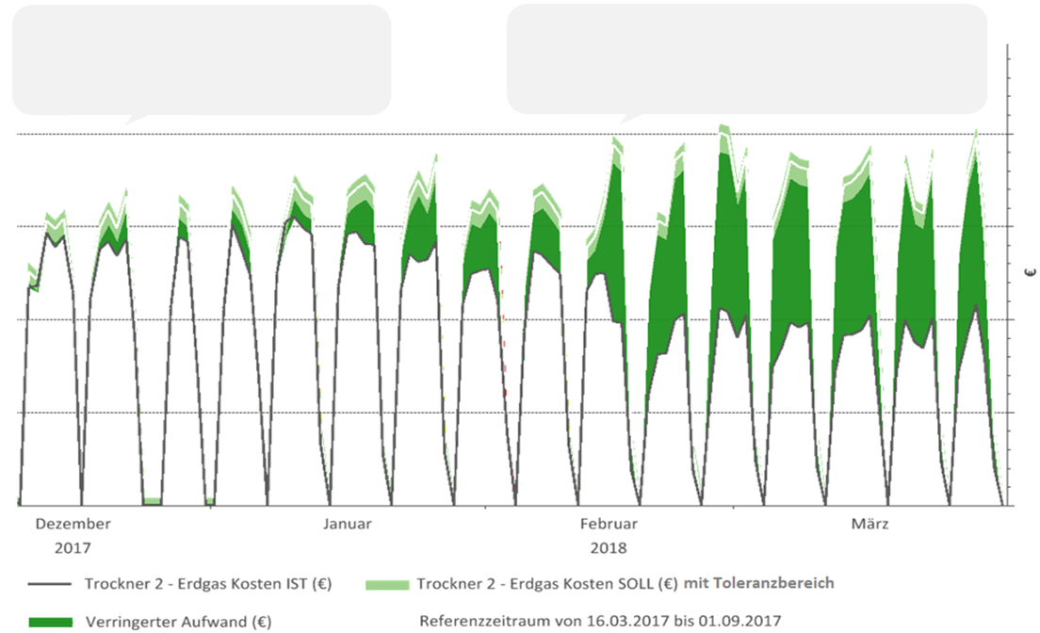
Exact Evaluation of Energy Cost savings of a dryer optimisation
Reduction of Tempe- ratures in Heating phase
Optimisation of drying process in the second drying phase
The Effects of the measure can be quantified and investment decisions regarding transfer to the other dryers can be made.
Energy Cost Reduction
Source of Diagram: ÖKOTEC EnEffCo

Slide 5
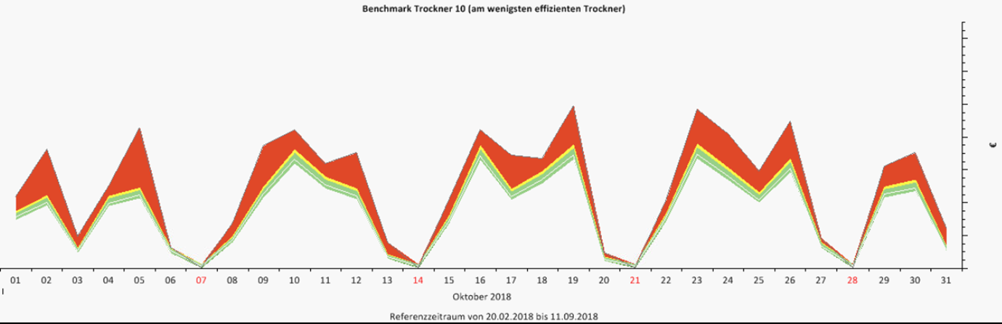
Benchmarking of dryers
Source of Diagram: ÖKOTEC EnEffCo
Savings potential
There are 8 different dryers in the company. Having developed Baselines for eachdryer, it can be simulated what one dryer would consume if it would have performed the production task of another dryer
The diagram shows the energy cost advantage of the most efficient dryer in comparison the the dryer, which was actually used to perform the drying task.
Comparing of all the 8 dryers, an energy efficiency ranking can be realised. On basis of that, a process optimisations can be performed (primary usage of the most efficient dryers)
Actual Energy Costs
Bench-mark

Slide 6
Best Practice Examples from Monitoring and Benchmarking
System Boundaries | Best Practice
Dryers | Process Optimisation from Benchmarking; Energy Efficiency Surveilance; Impacts of Burner-Optimisation
Packaging | Quantification of Energy Efficiency advantage of two alternative packaging lines (Benchmarking); Efficiency Surveilance
Combined Heat and Power Plant | Energy Efficiency Surveilance; Identification of optimisation possibilities regarding Maintenance
Air Compressing Station | Identification of optimisation possibilities regarding operations
Heat Recovery at Air Compression | Energy Efficiency Surveilance in Heat Recovery, Evaluation of Impacts of Optimisation
Training Unit developed by ÖKOTEC

Slide 7
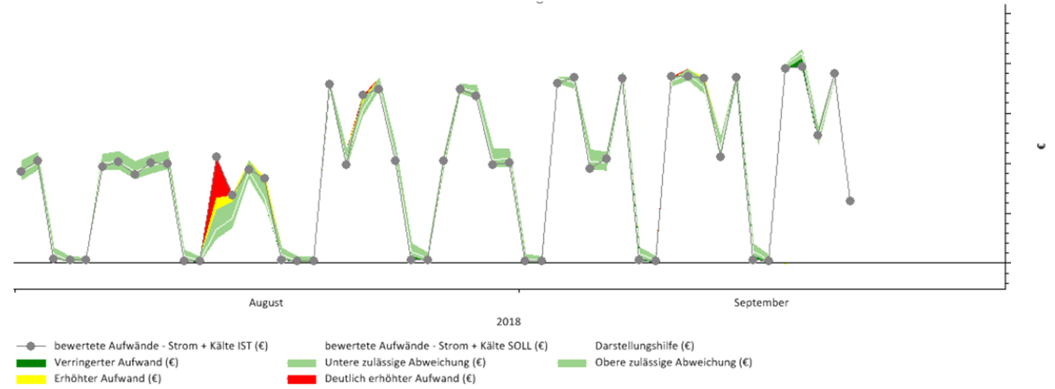
Energy Surveilance of a Packaging line
Tolerance area (depending on model quality)
Source of Diagram: ÖKOTEC EnEffCo
Unexpected high consumption
The diagram shows the Surveilance of Energy Costs of a drying line on a daily basis by comparing the baseline to actual energy cost values.
In August, there was an unexpected peak in Energy costs and the Energy Manager received an early warning E-Mail by the Energy Surveilance system.
He could react at once and noticed, that the controls were wrongly set during maintenance. He could intervene and avoid high Energy costs, that would have occured if the mistake would not have been noticed.

Slide 8
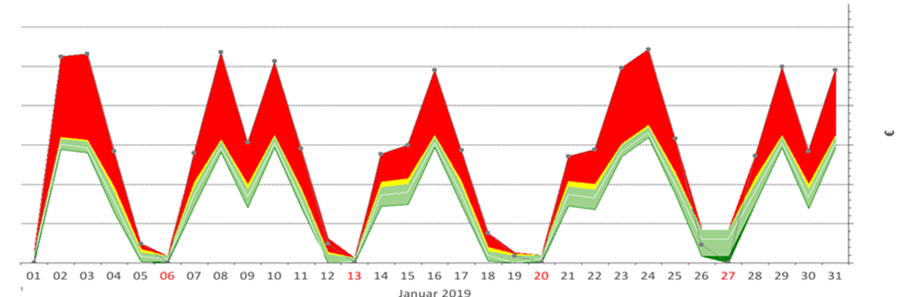
Benchmarking of Packaging lines
Source of Diagram: ÖKOTEC EnEffCo
Savings potential
The company went further. It has a second packaging line performing the same task, but applying a different technology. Having baselines for each of the packaging lines, a comparison is possible by benchmarking.
The benchmarking results shows, that one of the packaging lines works much more efficient than the other. For each day the savings potential can be evaluated, if not the less efficient packing line, but the efficient packaging line would have ferformed the packaging task.
On behalf of that, better capacity planning ist possible. Further, a solid investment decision can be made regarding the replacement of the less efficient packaging line

Slide 9
Best Practice Examples from Monitoring and Benchmarking
System Boundaries | Best Practice
Dryers | Process Optimisation from Benchmarking; Energy Efficiency Surveilance; Impacts of Burner-Optimisation
Packaging | Quantification of Energy Efficiency advantage of two alternative packaging lines (Benchmarking); Efficiency Surveilance
Combined Heat and Power Plant | Energy Efficiency Surveilance; Identification of optimisation possibilities regarding Maintenance
Air Compressing Station | Identification of optimisation possibilities regarding operations
Heat Recovery at Air Compression | Energy Efficiency Surveilance in Heat Recovery, Evaluation of Impacts of Optimisation
Training Unit developed by ÖKOTEC

Slide 10
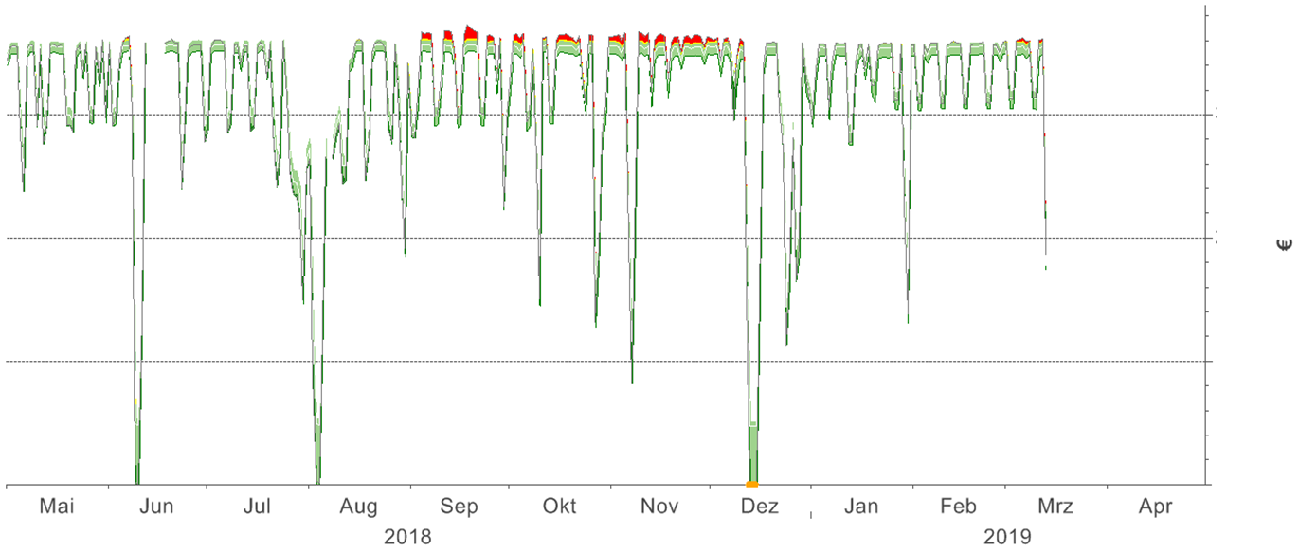
Predictive Maintenance of a Combined Heat and Power plant
Source of Diagram: ÖKOTEC EnEffCo
A company has a large CHP which it maintains on a regular basis. During monitoring it was identified, that sometimes the Energy Costs increase already longer times before planned maintenance. In other cases, energetic maintenance was carried out before actually Energy Costs increased.

Slide 11
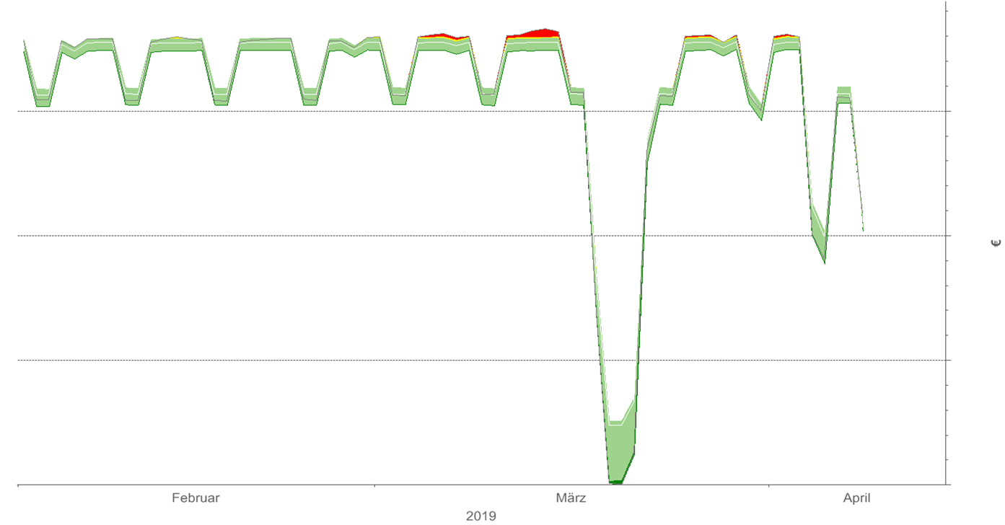
Predictive Maintenance of a Combined Heat and Power plant
Source of Diagram: ÖKOTEC EnEffCo
Now an early warning system is in place informing the Energy Manager about energy costs increase, so he can perform maintenance when it is actually needed.

Slide 12
Best Practice Examples from Monitoring and Benchmarking
System Boundaries | Best Practice
Dryers | Process Optimisation from Benchmarking; Energy Efficiency Surveilance; Impacts of Burner-Optimisation
Packaging | Quantification of Energy Efficiency advantage of two alternative packaging lines (Benchmarking); Efficiency Surveilance
Combined Heat and Power Plant | Energy Efficiency Surveilance; Identification of optimisation possibilities regarding Maintenance
Air Compressing Station | Identification of optimisation possibilities regarding operations
Heat Recovery at Air Compression | Energy Efficiency Surveilance in Heat Recovery, Evaluation of Impacts of Optimisation
Training Unit developed by ÖKOTEC

Slide 13
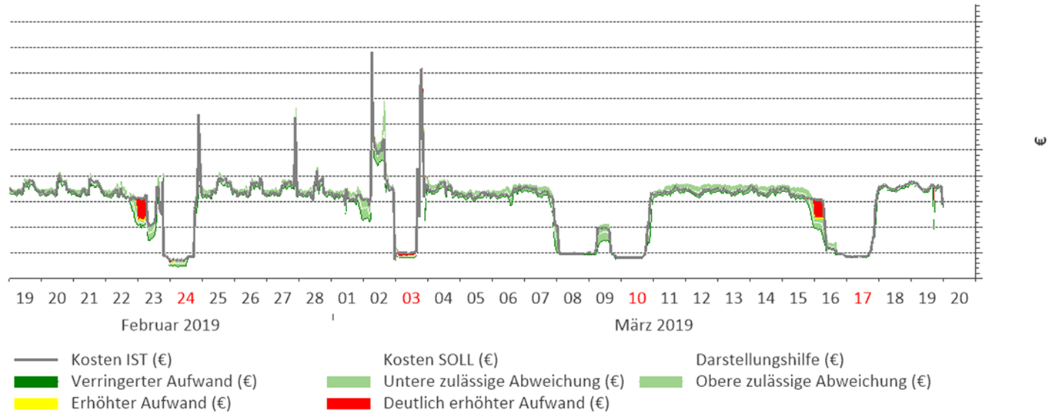
Monitoring of a large air compressing station
Source of Diagram: ÖKOTEC EnEffCo
On behalf of monitoring, a company noticed that on weekends the energy costs of an air compression station were higher than expected. This regarded phases were low amounts of compressed air were produced after times of high production.
After analyses it became clear, that optimisation in controls could avoid this bevior. Nowing the saving potentials of Energy Costs, the company could perform an investment evaluation of additional controls.

Slide 14
Best Practice Examples from Monitoring and Benchmarking
System Boundaries | Best Practice
Dryers | Process Optimisation from Benchmarking; Energy Efficiency Surveilance; Impacts of Burner-Optimisation
Packaging | Quantification of Energy Efficiency advantage of two alternative packaging lines (Benchmarking); Efficiency Surveilance
Combined Heat and Power Plant | Energy Efficiency Surveilance; Identification of optimisation possibilities regarding Maintenance
Air Compressing Station | Identification of optimisation possibilities regarding operations
Heat Recovery at Air Compression | Energy Efficiency Surveilance in Heat Recovery, Evaluation of Impacts of Optimisation
Training Unit developed by ÖKOTEC

Slide 15
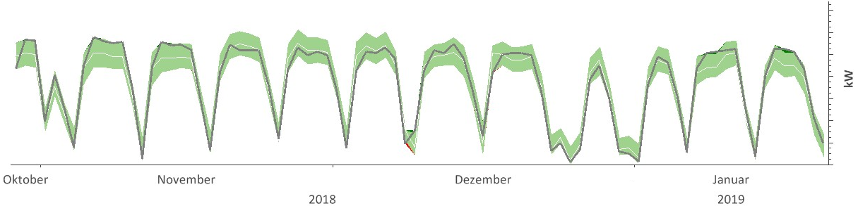
Evaluation of better heat recoverage from an air compressor
Source of Diagram: ÖKOTEC EnEffCo
Light Green: Tolerance area, depending on quality of the baseline model
Dark Grey Line: Heat that was actually recovered
kW heat recovery
White Line: Heat thas would have been expected to be recoverd according under actual conditions (Baseline)
During Monitoring of the heat recovery of an air compressor station, a company identified possibilities to enhance heat regeneration

Slide 16
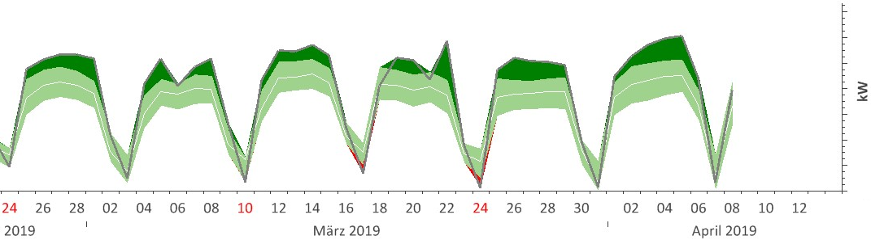
Evaluation of better heat recoverage from an air compressor
Source of Diagram: ÖKOTEC EnEffCo
Dark Green: Securly evaluated gain in heat recoverage
kW heat recovery
After Realisation, the effects could be evaluated. Now, knowing the effects of the measure, the company can transfer it other air compression units.

Slide 17
Towards a sustainable agro-food industry. Capacity building programmes in energy efficiency.

