Slide 1
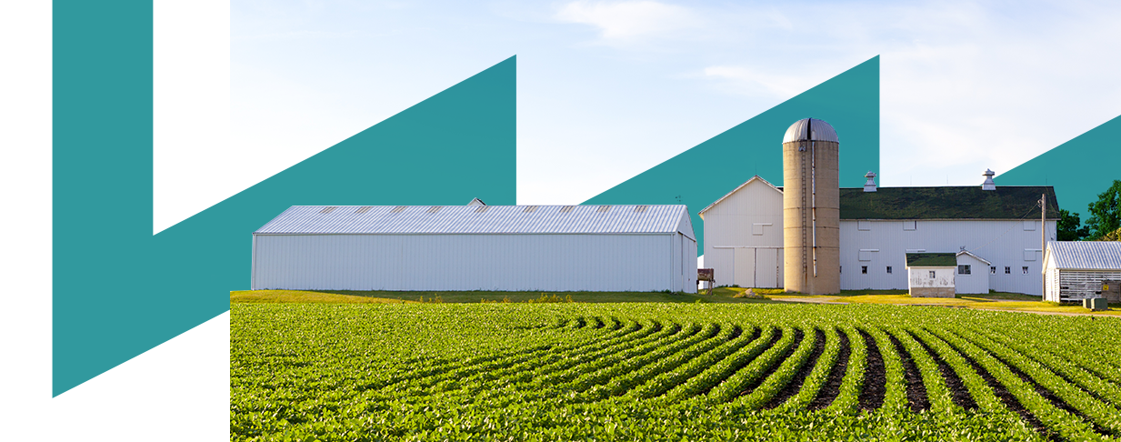











Energy efficiency:
Introduction of the Energy efficiency in the company
Towards a Sustainable Agro-Food Industry.
Capacity Building Programmes in Energy Efficiency.
This project has received funding from the European Union’s H2020 Coordination Support Action under Grant Agreement No.785047.

Slide 2
Energy management
Why do you need a company to make an effective use of energy?
Effective
Regulatory control and establishment of limits (energy regulation, CO2 emissions, ...).
Can be a customer requirement.
To increase market value mercad.
Energy
The cost of energy can be managed
Corporate responsibility.
Social pressure.

Slide 3
Energy management
Benefits for your company
Cost savings and improvement of competitiveness.
More information in your company.
  Strategic planning and opportunity for improvement.
Risk reduction
Motivation for employees
Image

Slide 4






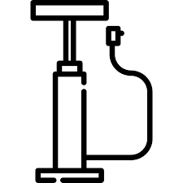

Energy efficiency in industrial energetic uses:
The energy consumption and associated costs are related to technical and human factors.
To analyze the use of energy in your company, it is necessary to consider the following points:
Lighting system
Industrial refrigeration
Electric drives
Process heating
Compressed air systems
Steam production
Pumping
Office equipment

Slide 5
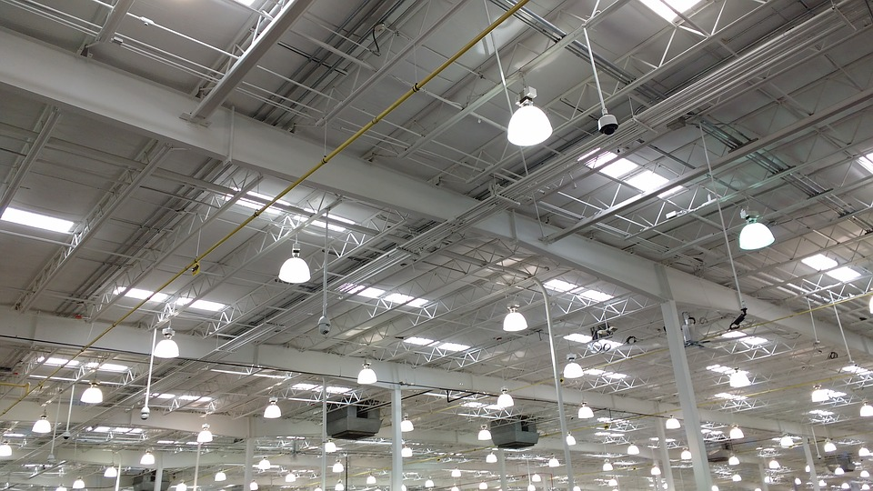
Lighting system

Slide 6
Energy efficiency in industrial energetic uses:
Natural light
Investments:
Maximize the use of natural light.
Reduce artificial lighting to minimum levels.
Install timers and / or presence sensors (10% to 20% savings) in services, corridors, basements, garages ...
Install drivers for the use of daylight in each area that receives natural light.
Replace the electromagnetic coils of fluorescent tubes with more efficient electronic ballasts.
Switch to efficient lighting.
Turn off the switch
Turn off the lights if they are not needed and in areas that are not occupied.
Divide the lighting so that there are different switches is to control different sections.
Together, these investments can reduce energy consumption and costs up to 45%.
Light colors
Choose light colors for the interior walls of the building.
The darker the colors, the more artificial light will be needed.

Slide 7
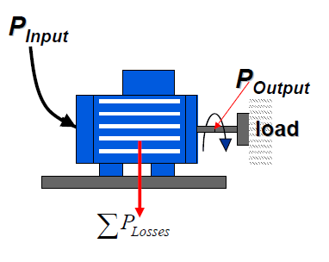
Energy efficiency in industrial energetic uses:

Slide 8

Electric drives
Take an inventory
Take an inventory of the installed electric motors with the following methodology:
Identify the engines and the associated process (pumping, ventilation, drives…);
Identify the electrical characteristics: power, demand current, voltage, power factor, operation regime;
Knowledge of the number of hours the engine operates;
Load or demand factor;
Maintenance program;
Consumption as possible (meter or grid analyzer for measurement).
Correct selection of the engines
It is very common to see oversized engines, which makes the nominal power too high compared to what is needed to cover the needs
Replace old engines
VFD:
Replace old engines with new ones with high efficiency.
Install Variable Frequency Drive.
The objective is to modify the engine speed to ensure that it is always operating in optimal conditions.

Slide 9
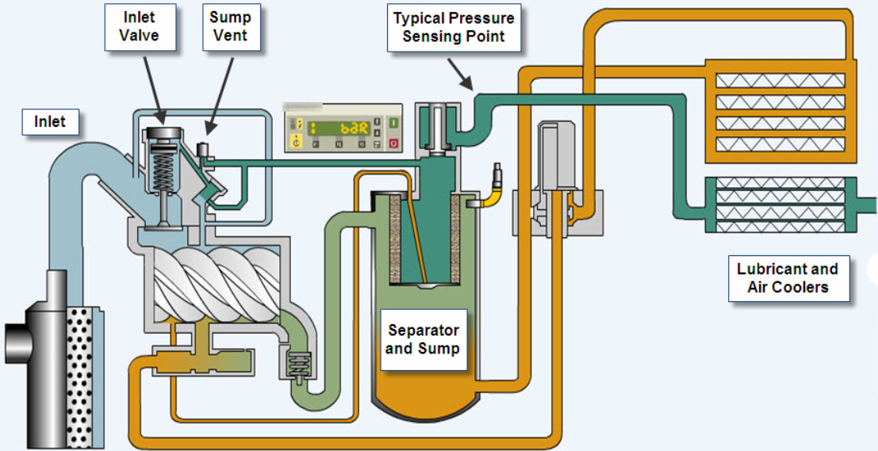
Compressed Air

Slide 10
Compressed Air
Dryer
Regulation
Install more dryers performing.
Check regularly the pressure drops of the driers.
Respect the periodicities of maintenance.
If necessary, call in a refrigeration specialist qualified for the maintenance of the cold circuit.
Avoid regulations by throttling of the suction air
Avoid the no-loads of air compressor.
Install an electronic variation speed to adapt production to the real need of compressed air.
Install a management system and regulation of compressors cascade according to the need of air
Heat Recovery
Compressed Air Network
Close the not used network’s parts.
Closing the network to limit the gaps pressure at the end of the network
Filters
Pneumatic Tools
Look for and seal leaks regular (at least once a year).
The leaks are responsible for a significant waste, frequently around 40 to 50% of the overall consumption.
Replace tools if possible pneumatic power tools. The price of the pneumatic kWh is 20 times higher than the price of the electric kWh.

Slide 11
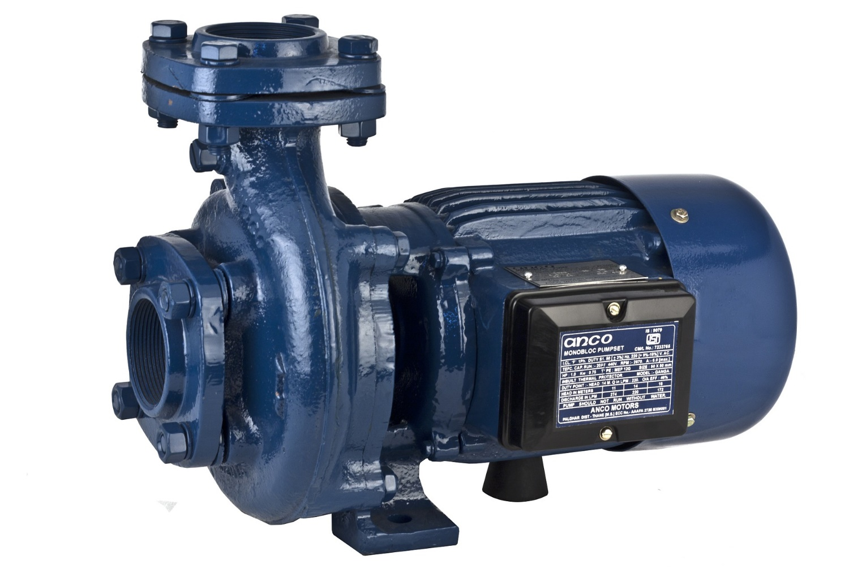
Pumping
Pumps
Valves
Replace or modify pumps oversized.
Choose the pump according to the needs of the system
Apply a coating that reduces friction inside the wheel and the volute centrifugal pumps
Restore internal tolerances shoes
Identify the pumps in cavitation
Install electronic speed variation when it allows to increase the energy efficiency of the pumping system.
Stop the pumps when they do not need to be Operating. Do not pump for nothing.
Valves
Recover the rejected heat by the compressor for space heating or water production hot.
About 80% of electric power compressor is transformed into heat.
Process
Put in place a monitoring system for the entire network.

Slide 12
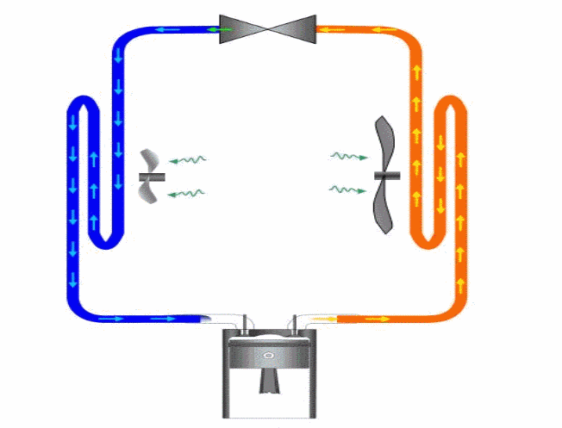
Industrial Refrigeration

Slide 13
Industrial Refrigeration
Speed variation
Storage
Distribution
Install speed variation on at least one of the compressors
For screw compressors, privilege the regulation of power by speed variation rather than by drawer.
Install a cold buffer storage if necessary. It is also possible to size the decoupling bottle so that she can eventually play a storage role.
Regulate the flow of refrigerant fluid by electronic speed variation on the secondary distribution pump.
Regulate the coolant flow on the primary circuit versus flow on the secondary circuit.
Compressors
Heat recovery
Insulation & Defrost
For low temperatures, use two-stage cycles or cycles to economizer.
Install power compressors judiciously tiered to cover better the whole range of powers called.
Install a recovery system heat on the cold group
For screw compressors: recover the heat on the oil circuit.
Up to 25% rejected heat can be valorized at a temperature of 50 - 60 ° C.
Check the state of the cold circuit insulation and repair if necessary.
Adopt a strategy adequate and powerful of defrosting
Evaporator
Lightning
Cold room openings
Prefer large sized evaporators to reduce pinching.
10% more surface is 1°C won, so 2 to 3% of the energy consumed.
Set up protection's effective openings (curtains with straps, air curtains, quick-open doors).
Set up buffer locks and decrease openings / closures of the area.
Inlets can be responsible for 20 to 40% of the balance sheet refrigeration system.
Lighting is a contribution of heat
Set up efficient lighting systems in the cold rooms

Slide 14
Process heating
burner
hhot water
Cool water
gases output
fuel input
Gas circuit

Slide 15
Process heating
1 ° C temperature increases = The energy saving approximately 6%
Measures without cost
Thermal isolation
Adjust the temperature of rooms and boilers
Thermal insulation in boilers, hot water tanks and water pipes.
High efficiency boilers
Condensing boiler: designed to utilize the latent heat released by the condensation of the water vapor.
About 109% efficiency
Up to 40% savings compared to conventional boilers
Clean the boiler
1 mm of soot = 50 ° C smoke temperature = loss of performance of 4% -8%
Other measures
Place a temperature control on the heating system.
Choose hot air instead of hot air systems
Recover the heat from the ventilation and reuse it.
Reduce the zones to heat.
Large consumers of electricity and thermal energy should consider cogeneration.
It is advisable to use solar collectors to heat the water

Slide 16
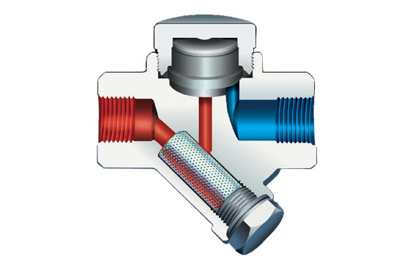
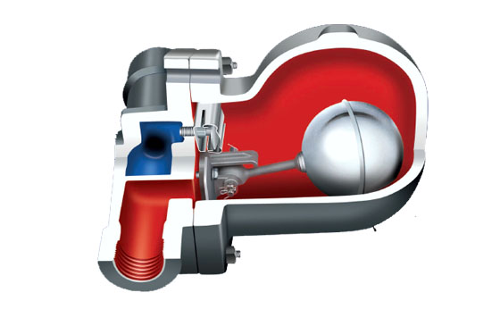
Steam production
Thermodynamic
With float

Slide 17
Steam production
Heat Recovery
Steam Trap
Install a recovery system heat lost during purges, you can save between 1 and 4% of energy.
Check the traps regularly.
In installations where the traps are not frequently checked, 30% of them can be defective and run away.
Regular monitoring can lower this rate to 5%.
Steam Network
Repair leaks regularly. A single leak of 3.18 mm diameter on a steam network at 7 bar causes a loss of € 3,900 / year.
Driving with insulation wet gives way 30 times more only when it is dry.
Supply of Water
A supply of water not insulated can lose up to 70% of its thermal energy.
Economizer
Economizer
Install an economizer to preheat the water supply of a steam boiler.
Energy savings of 2 to 5% are possible.
If possible, reduce the pressure of the network. If there are regulators at the entrance of all consumers, a network high pressure is not necessary.

Slide 18
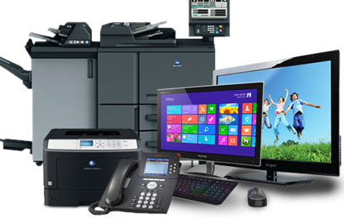
Office equipment

Slide 19
Office equipment
Computers
Other tips
The most important consumption of the office.
Computers and monitors with the "ENERGY STAR" condition hibernate automatically when they are not used and almost all vendors sell them.
Both computers and monitors in hibernation consume approximately 15% of their maximum power of use.
Turn off the computer when it is not in use (at night or on weekends). There are timers that turn off the equipment at certain times of the day.
If the computer has to be on during the night or during weekends, save money by turning off the monitor.
The energy saving features have to be established by the user in many products. Check the configuration periodically or each time you install new equipment to ensure that the power saving mode is on.
Screen protectors do not save energy. Its purpose is to extend the useful life of the screen.
Laser printers consume more energy than inkjet printers. Color printers use more energy than those that only print in black and white.
Laptops consume much less than a PC.
Photocopiers and printers
"ENERGY STAR" photocopiers can reduce the annual electric cost of photocopiers by up to 60%.
Photocopiers that allow double-sided or duplex copies help save energy and reduce the cost of paper.
FAX
The fax needs to be available 24 hours a day, therefore, it has a great potential to save energy.
It can hibernate up to 15 to 45 watts or less when not in use, and can save approximately 50% in its annual energy cost.

Slide 20

Thanks For Your Attention!
This project has received funding from the European Union’s H2020 Coordination Support Action under Grant Agreement No.785047.

Slide 21
Towards a sustainable agro-food industry. Capacity building programmes in energy efficiency.

