Slide 1
Awareness in Energy Efficiency:
Kick-off training – General employees
Towards a Sustainable Agro-Food Industry. Capacity Building Programmes in Energy Efficiency.
This project has received funding from the European Union’s H2020 Coordination Support Action under Grant Agreement No.785047.

Slide 2
Energy Efficiency
¿What is?
It refers to the use of
Energy saving is based on the way
people act to use less energy (for
example, using natural light
instead of artificial light to
reduce electricity consumption).
technologies that require a smaller
amount of energy to achieve the
same performance or perform the
same function
Energy efficiency focuses on technology, equipment or machinery used in buildings.
Steeep: Support & training for an Escellent Energy Efficiency Performance

Slide 3
Energy Efficiency
¿Why it is important?
02
High Energy dependence from abroad
01
The Global Energy Consuption is Growing
The Cost of Energy is Increasing
03
04
Climate
Change
Source: Steeep: Support & training for an Escellent Energy Efficiency Performance

Slide 4
Energy Efficiency
Consequences of energy consumption
The consumption of fossil fuels poses major problems: depletion of reserves, energy dependence, supply difficulties and pollution.
The main environmental problem of the current energy consumption worldwide is the greenhouse effect.
The use of private vehicles, heating and even our electricity consumption are responsible for the emission of CO2 into the atmosphere. Each household is responsible for producing up to 5 tons of CO2 per year.
Renewable energies are not exhausted when we consume them because they are renewed naturally. They also have a very reduced environmental impact.
Families, with their behavioral patterns, are decisive to ensure that energy resources are used efficiently.

Slide 5
Energy Efficiency
Energy Policy of the EU
The Energy Union is a reality and the EU has set course to become a climate neutral economy, whilst maintaining its global competitiveness and creating growth and jobs.
The European Union's energy policy (April 2019) will aim to:
Energy Security
The internal energy market
Enhanced resilience of the European energy system by preventing and managing gas crises
Making the grid fit for an increased share of renewable energy
Putting the consumer at the heart of the energy market
Market coupling - reduced and more equal energy costs for consumers throughout Europe

Slide 6
Energy Efficiency
Energy Policy of the EU
Energy Efficiency
Decarbonisation
New energy efficiency target of at least 32.5% by 2030
New energy performance of buildings rules aiming at decarbonisation of building stock by 2050
Clearer and simpler energy efficiency labelling rules help households save almost €500 per year
Between 2014 to 2020, €18 billion from the European structural investment fund are allocate to energy efficiency
There are 900.000 jobs in the energy efficiency sector in Europe today •
€2.5 billion Horizon 2020 funding for the period 2018-2020 to decarbonise the EU’s building stock
The EU was instrumental in brokering the Paris Agreement and making it operational
The EU has put in place a comprehensive legislative framework to achieve at least 40% emission reduction by 2030
New renewable energy target of at least 32% by 2030
4 million ‘green jobs’ in the EU today, 1.4 million jobs in the renewable energy sector
Decarbonisation strategy “clean planet for all” for a climate neutral Europe in 2050
17.5% of final energy consumption in Europe came from renewable energy in 2017

Slide 7
Energy Management
“
Energy Management has to do with the systematic use of management tools and technology to improve the energy performance of an organization. To be fully effective, it needs to be integrated, proactive and should encompass energy purchases, energy efficiency and renewable energies.
Carbon Trust Energy Management Guide
”

Slide 8
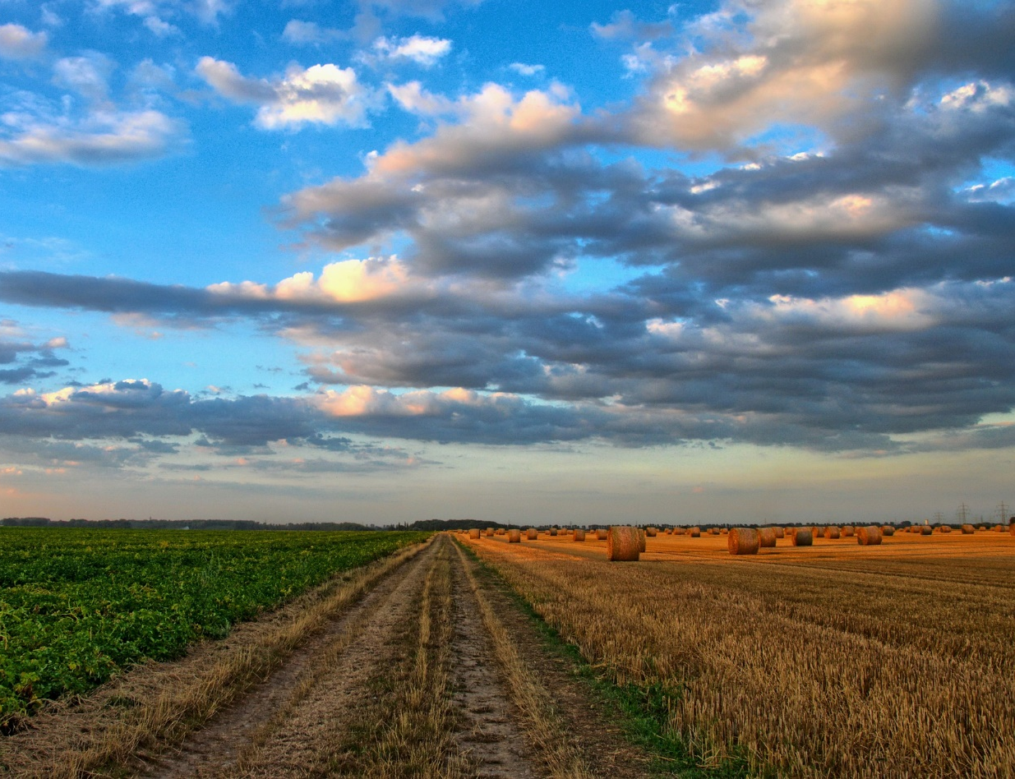
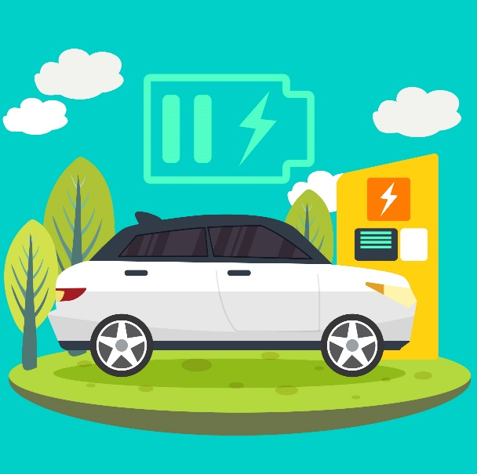
Energy Efficiency in different fields
TRANSPORT
Change of mobility
Urban planning
Infrastructure
Changing prices
Fuels
Irrigation
Building insulation
Lighting
AGRICULTURE
INDUSTRIES
Industrial refrigeration
Steam
Compressed Air
Pump system
CONSTRUCTION
Heating and air conditioner systems
Thermal insulation
Smart technology systems
Zero energy building

Slide 9
Energy, consumption and energy supply
Every time we consume more energy: at the current rate it will only take 35 years to double the world energy consumption and less than 55 years to triple it.
The sectors of housing and transport have been those that have increased their consumption in recent years.
Europe has an average external energy dependence of 50%.
The main source of energy for energy consumption is oil and its derivatives (gasoline, diesel, butane and propane).
Renewable energies are not exhausted when we consume them, since they are renewed, naturally. In addition, they have a practically zero environmental impact.
Source: “Guía Práctica de la Energía. Consumo Eficiente y Responsable”. IDAE Instituto para la Diversificación y Ahorro de la Energía

Slide 10
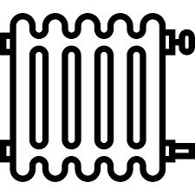
The heating and hot water installations
The basis of savings in air conditioning is good insulation.
The heating represents almost half of the energy we spend at home.
The roofs and windows of buildings lose most of the interior heat in winter and win heat in summer.
The individualized heating and hot water meters allow savings of between 20% and 30%.
Each area of our home needs a heating temperature and it is important to adjust it.
Source: “Guía Práctica de la Energía. Consumo Eficiente y Responsable”. IDAE Instituto para la Diversificación y Ahorro de la Energía

Slide 11
The heating and hot water installations
The systems with accumulation are the most recommended for the supply of sanitary hot water.
Solar thermal energy is ideal for the preparation of domestic hot water.
The best way to make energy improvement proposals and control spending is to analyze and compare energy costs annually.
With good maintenance and a good regulation system will achieve total savings of more than 20% in common services.
In general, electric heating systems and domestic hot water are the least recommended from the energy point of view.
Source: “Guía Práctica de la Energía. Consumo Eficiente y Responsable”. IDAE Instituto para la Diversificación y Ahorro de la Energía

Slide 12
The heating and hot water installations
Curiosities
1
There are low cost measures, or no cost, that can reduce our energy expenditure between 10% and 40%.
2
Small improvements in insulation can lead to energy and economic savings of up to 30% in heating and air conditioning. A 3 cm layer of cork, fiberglass or polyurethane has the same insulating capacity as a one-meter thick stone wall.
3
Through a simple glass, the energy contained in 12 kg of diesel is lost for every m2 of surface area during the winter.
4
An open tap consumes around 6 liters per minute. In the case of the shower, this consumption increases up to 10 liters per minute.
Source: “Guía Práctica de la Energía. Consumo Eficiente y Responsable”. IDAE Instituto para la Diversificación y Ahorro de la Energía

Slide 13
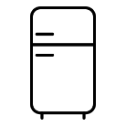
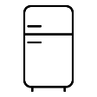
Home appliances
The equipment with energy labeling class A, A + and A ++ are the most efficient and can save us a lot of money in the electric bill throughout its useful life.
A++
Do not choose appliances that are larger or more powerful than you need.
The roofs and windows of buildings lose most of the interior heat in winter and win heat in summer.
Air conditioning: in summer, place the thermostat at a temperature of 26ºC.
The refrigerator and the television are the appliances of greater global consumption, although they have unit powers much lower than other appliance.
Source: “Guía Práctica de la Energía. Consumo Eficiente y Responsable”. IDAE Instituto para la Diversificación y Ahorro de la Energía

Slide 14
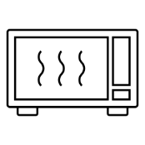
Home appliances
Bithermal dishwashers and washing machines save energy, money and time.
It is convenient to completely turn off televisions and equipment with information in digital windows (displays) when we do not use them.
Choose computers and printers with energy saving systems.
Microwaves and super-fast pressure cookers save energy.
In the points of light that are lit more than one hour a day install the energy saving lamps or fluorescent tubes.
Source: “Guía Práctica de la Energía. Consumo Eficiente y Responsable”. IDAE Instituto para la Diversificación y Ahorro de la Energía

Slide 15
Home appliances
Curiosities
1
There are thermo-efficient washing machines on the market, with two independent water intakes: one for cold water and one for hot water. In this way, the hot water is taken from the sanitary hot water circuit, from the solar energy accumulator, heater or from the gas or diesel boiler. Thanks to this, the washing time is reduced by 25% and energy is saved.
2
The luminous efficacy of a lamp is the amount of light emitted per unit of electrical power (W) consumed. It is measured in lumens per watt and allows to compare the efficiency of some light sources with respect to others. The luminous efficacy of incandescent bulbs is between 12 lm / W and 20 lm / W, while for fluorescent lamps it ranges from 40 lm / W to 100 lm / W.
3
Incandescent light bulbs only take advantage of 5% of the electricity
consumed in lighting, the remaining 95% is transformed into heat, without lighting.
4
Keep in mind that, for the same level of benefits, there are devices that consume up to 60% more electricity than others.
Source: “Guía Práctica de la Energía. Consumo Eficiente y Responsable”. IDAE Instituto para la Diversificación y Ahorro de la Energía

Slide 16
Home appliances
Curiosities
1
In the air conditioning can achieve energy savings of more than 30% installing awnings in the windows where the sun shines, avoiding the entry of hot air inside the house and properly insulating walls and ceilings.
2
The use of an electric razor can be less energy than a shaving type natural: everything depends on the time we keep the hot water tap open.
3
Office equipment labeled "Energy Star" has the ability to go to a resting state after a certain time in which the equipment has not been used. In this state (low energy mode) the energy consumption is a maximum of 15% of normal consumption.
4
In an electric plate, if we use an open pot with a poor heat diffuser bottom, keep 1.5 liters of water boiling, would require a power of 850 W, compared to 150 W that would be required with a pressure cooker with thick diffuser background.
Source: “Guía Práctica de la Energía. Consumo Eficiente y Responsable”. IDAE Instituto para la Diversificación y Ahorro de la Energía

Slide 17
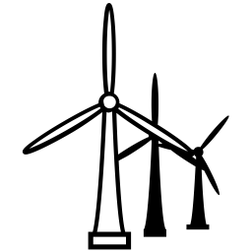
The new housing
The energy consumption of a house has a great impact on our quality of life and the family budget. Therefore, at the time of purchase it is very important to ask for information about the quality of the home, as well as its HVAC systems and hot water production, and to take into account the quality of the facilities in our purchase decision.
The equipment for thermal utilization of solar energy constitutes a reliable and profitable technological development for the production of sanitary hot water in the housing sector.
A good bioclimatic design can achieve savings of up to 70% for the air conditioning and lighting of your home.
Renewable energies can be used in the supply of energy to our homes by incorporating equipment that takes advantage of the energy coming from the sun, air, biomass and geothermal energy.
Source: “Guía Práctica de la Energía. Consumo Eficiente y Responsable”. IDAE Instituto para la Diversificación y Ahorro de la Energía

Slide 18
The new housing
Since 2007, the energy certification of buildings has been generalized throughout Europe, which provides information on the energy efficiency of our house, depending on the characteristics of the insulation, glazing, heating systems, hot water production and air conditioning
A
B
C
Likewise, biomass boilers are a very interesting and competitive option, especially for the replacement of coal boilers. They are also an option that should be considered in new homes.
By means of a suitable collection system and a geothermal heat pump, in winter the heat from the inside of the earth can be used for domestic heating and obtaining hot water. In summer, that heat is extracted by transferring it to the subsoil and cooling the building.
Source: “Guía Práctica de la Energía. Consumo Eficiente y Responsable”. IDAE Instituto para la Diversificación y Ahorro de la Energía

Slide 19
The new housing
Curiosities
1
We can avoid summer heat gains through evaporative and water spray systems, based on the fact that liquids need an input of energy to change state and evaporate. Thus, placing a curtain or sheet of water on a wall increases the feeling of comfort in summer, since the heat is absorbed by the water when evaporating and, in this way, the wall is kept at a lower temperature, with the consequent effect refrigerant inside the house.
2
Solar thermal energy is integrated into new buildings as an additional facility that can provide an important part of our needs for domestic hot water, heating and cooling.
3
The use of biomass in our heating systems supposes a neutral balance in the emission of CO2.
Biomass is an excellent option for its combination with solar thermal energy for production of hot water, heating and air conditioning.
4
It is a cheaper and more ecological fuel than the conventional ones that allows generating employment in rural areas, preventing fires and maintaining natural ecosystems
5
Investments in renewable energy to meet the energy needs of a home away from urban centers acquire a special attraction. Keep in mind that carrying a power line to an isolated point has a very important cost to the consumer.
Source: “Guía Práctica de la Energía. Consumo Eficiente y Responsable”. IDAE Instituto para la Diversificación y Ahorro de la Energía

Slide 20
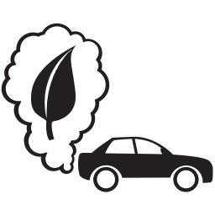
Car
The private car represents 15% of the total energy consumed.
In the city, 50% of trips by car is less than 3 km and 10% less than 500 m. Avoid traveling by car for short distances. Do it walking or cycling.
Efficient driving allows to achieve an average saving of fuel and CO2 emissions of 15%.
In most cases there are alternatives to using the car. Public transport is much more efficient than the tour vehicle.
Source: “Guía Práctica de la Energía. Consumo Eficiente y Responsable”. IDAE Instituto para la Diversificación y Ahorro de la Energía

Slide 21
Car
The car is the main source of pollution and noise in our cities, and one of the main sources of greenhouse gas emissions.
At the time of purchase, it is important to choose a car model adapted to our needs and look at the fuel consumption label, vehicle energy class and CO2 emissions.
The shared use of the tourism vehicle allows to improve its energy efficiency. The car sharing management systems ("car sharing") and the carpooling system favor, in this sense, the increase in the occupancy rate of the passenger car.
Source: “Guía Práctica de la Energía. Consumo Eficiente y Responsable”. IDAE Instituto para la Diversificación y Ahorro de la Energía

Slide 22
Car
Curiosities
1
In these short trips, the increase in consumption is 60%. When in most cases these trips could be perfectly done on foot or by bicycle!
2
20% of the EU population is exposed to noise levels above the threshold of 65 dBA.
3
Efficient driving allows to achieve an average saving of fuel and CO2 emissions of 15%.
Source: “Guía Práctica de la Energía. Consumo Eficiente y Responsable”. IDAE Instituto para la Diversificación y Ahorro de la Energía

Slide 23
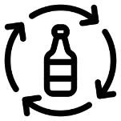
Trash and energy use
We could avoid the dumping of 90% of the waste generated by good waste management; a management that includes measures that promote reuse, recycling and energy recovery.
The recycling of materials can reach very high percentages. In general terms, the EU countries that recycle the most are also those that manage the most waste through energy recovery.
For every ton of glass that is recycled, 1,200 kg of raw materials and 130 kg of fuel are saved.
Source: “Guía Práctica de la Energía. Consumo Eficiente y Responsable”. IDAE Instituto para la Diversificación y Ahorro de la Energía

Slide 24
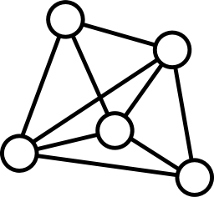
Trash and energy use
The progressive increase of paper recycling must be maintained with the collaboration of all: recycling avoids excessive uses of forest resources, water and fuel.
There are consolidated technologies that allow the energy recovery of waste with environmental guarantees and at the same time contribute to reduce the external energy dependence.
The clean points are facilities where certain domestic waste is received, previously selected, such as paper, furniture, household appliances, used oils, batteries, etc., so that they can be recycled and subsequently used.
Source: “Guía Práctica de la Energía. Consumo Eficiente y Responsable”. IDAE Instituto para la Diversificación y Ahorro de la Energía

Slide 25
Trash and energy use
Curiosities
1
Prevention, reuse, recycling, recovery and disposal: that is the right hierarchy to manage waste.
2
Paper recycling reduces water consumption by 86% and energy consumption by 65%. For each folio of normal size (DIN A4) that is recycled, the energy equivalent to the operation is saved, during one hour, of two 20 watt low energy bulbs, which give the same light as two 100 watt incandescent bulbs.
3
For each bottle that is recycled, it saves the energy needed to have a TV on for 3 hours or the energy needed by 5 low-power 20W lamps for 4 hours.
4
With the energy needed to make an aluminum soda can, you could have a TV working for two hours.
5
There are pilot plants that seek to obtain fuels for transport from urban solid waste.
Source: “Guía Práctica de la Energía. Consumo Eficiente y Responsable”. IDAE Instituto para la Diversificación y Ahorro de la Energía

Slide 26
As we have seen, energy is a scarce resource that we must respect and take care of among all. Its responsible use is fundamental for the sustainability and the future of our world.
Because never forget that EVERY SMALL GESTURE COUNTS
Source: “Guía Práctica de la Energía. Consumo Eficiente y Responsable”. IDAE Instituto para la Diversificación y Ahorro de la Energía

Slide 27
Thanks For Your Attention!
This project has received funding from the European Union’s H2020 Coordination Support Action under Grant Agreement No.785047.

Slide 28
Towards a sustainable agro-food industry. Capacity building programmes in energy efficiency.

