Slide 1
Workshop
Motivation of the Energy Management Team
Towards a Sustainable Agro-Food Industry. Capacity Building Programmes in Energy Efficiency.
This project has received funding from the European Union’s H2020 Coordination Support Action under Grant Agreement No.785047.

Slide 2
Motivation
Major theories of motivation:
Hierarchy of Needs theory
The Two-Factor theory
Expectancy theory
Equity theor

Slide 3
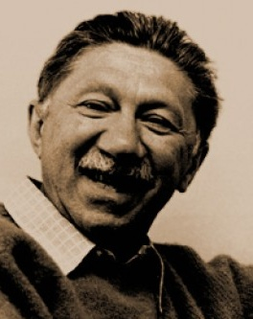
Hirarchy of Needs
Abraham Maslow: We are motivated by five initially unmet needs
Hierarchy of Needs | Professional fulfillment
Self-Actualization | Challenging work, leadership, professional achievement
Esteem | Authority, titles, recognition
Social | Team membership and social activities
Safety | Seniority/Job security
Physiological | Salary
*Lower stages need to be fulfillied to „activate“ higher stages

Slide 4
Two-Factor Theory
Motivation factors
Recognition
Achievement
Responsibility
Promotion opportunities
Opportunities for personal growth
Hygiene factors
Rewards
Job security
Policies of the company
(social) Relations with others
Quality of supervision
working conditions (physical)
Motivation factors:
Directly contribute to job satisfaction
Hygiene factors: rather than contributing directly to satisfaction they should be present to prevent dissatisfaction

Slide 5
Expectancy Theory
Effort
Reward
Performance
Employees believe that effort will produce positive effects.
Employees believe that positive Effects will lead to reward.
Employees consider the reward appropriate
Employee needs to:
- see a positive link between his/her effort and positive effects for the company.
- be confident that the positive effects would lead to a reward for the employee.
- consider the reward valuable for him/her

Slide 6
Equity Theory
Education
Amount of Hours worked
Work performance Experience (…)
Salary
Rewards
Recognition
Promotions (…)
Job Inputs
Job Outcomes
Perception of inequity leads to:
Less motivation in order to bring the ratio into balance
Demand of higher rewards
If perception of inquity remains, employee:
may complain, seek for another job, leave organization, or rationalize the situation
Or question his/her perception and rationalize that the situation is ok after all.

Slide 7
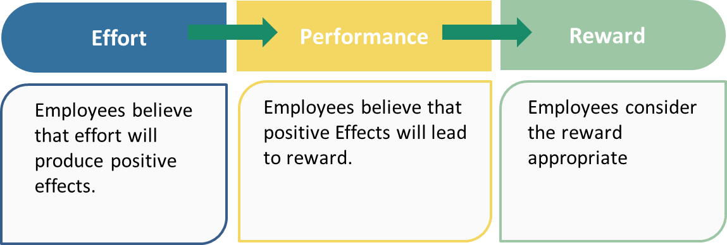
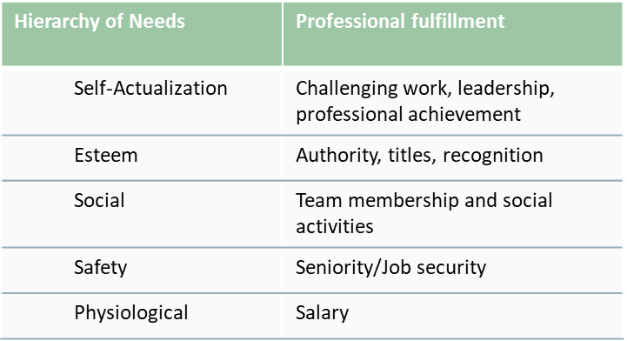
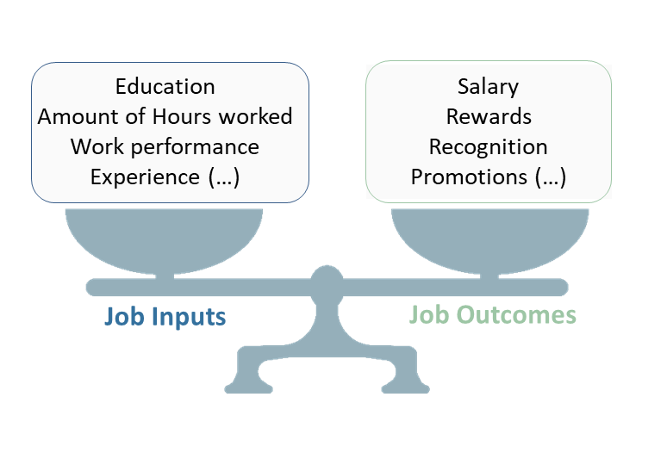
Equity Theory
Expectancy
Needs
What could be done – with regards to realistic possibilities in your company – to further improve motivation for Energy management?
Two-Factor
Equity
Motivation factors
Recognition
Achievement
Responsibility
Promotion opportunities
Opportunities for personal growth
Hygiene factors
Rewards
Job security
Policies of the company
(social) Relations with others
Quality of supervision
working conditions (physical)

Slide 8
Towards a sustainable agro-food industry. Capacity building programmes in energy efficiency.

