Slide 1
Best practices in environmental management
Towards a Sustainable Agro-Food Industry. Capacity Building Programmes in Energy Efficiency.
This project has received funding from the European Union’s H2020 Coordination Support Action under Grant Agreement No.785047.

Slide 2
Agenda
Performing an enviromental sustainability assessment of poducts and/or operations.
Sustainable supply chain management.
Impoving or selecting packagning to minimise enviromental impact.
Environmentally friendly cleaning operations.
Improving transport and distribution operations.
Improving freezing and refrigeration.
Deploying anergy management and improving energy efficiency thoughout all operations.
Integrating enewable energy in the manufacturing processes.
Avoiding food waste in manufacturing operations.
Source: Dri, M., Antonopoulos, J., Confra, P., & Gaudillat, P. (2015). Best Environmental Management Practice for the Food and Beverage Manufacturing Sector. JRC Scientific and Policy Reports.

Slide 3
Performing an enviromental sustainability assessment of poducts and/or operations.
Summary
BEMP is to assess the environmental impact of products and operations using life-cycle assessment (LCA) tools to identify priority areas for action, or ‘hotspots’, and define a strategy for reducing the environmental impacts
Applicability
When undertaking an environmental sustainability assessment, food and beverage manufacturers can face a number of challenges which include the complexity of the product and the accessibility of information; it can be expensive and time-consuming to undertake LCAs, and certain environmental impacts may also be beyond the control of the manufacturer and thus very difficult to act upon, even if they can be quantified.

Slide 4
Performing an enviromental sustainability assessment of poducts and/or operations.
Environmental performance indicators
Percentage of sites or products assessed using a recognised environmental sustainability assessment protocol (%). Number of sites or products assessed using a recognised environmental sustainability assessment protocol.
Benchmarks of excellence
A company-wide environmental sustainability assessment covering all operations is implemented. An environmental sustainability assessment for all new products under development is carried out.

Slide 5
Performing an enviromental sustainability assessment of poducts and/or operations.
Metodology: several guidelines have been established for the environmental sustainability assessment of specific product categories and organisations though various processes.
PEF / OEF (ENVIFOOD protocol) (According to 14040 y ISO 14044)
Environmental Product Declarations (According to ISO 14025, ISO 14020 y ISO 14021)
Global Reporting Initiative (According to Sustainable Reporting Framework)
Carbon Disclouse Project (CDP) Cool Farm Tool (CFT)
Sectoral initiatives
Business initiatives

Slide 6
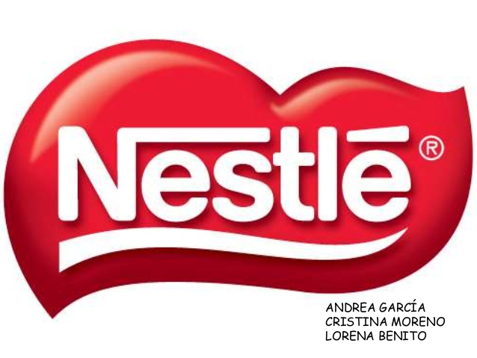
Performing an enviromental sustainability assessment of poducts and/or operations.
Success stories:
Nestle has reduced direct GHG emissions by 15.11% and direct emissions of GHG per ton by 46.11% over 10 years.
Nestle has recently developed 'EcodEX'.
Pepsico has undertaken ACV using the PAS 2050 methodology for his brand of Walkers chips in the United Kingdom.
The alcoholic beverage company had a disclosure rating of 98 and an "A" performance band rating.

Slide 7
Performing an enviromental sustainability assessment of poducts and/or operations
Environmental benefits
Economic benefits
The carrying out of an environmental sustainability assessment cannot itself lead directly to environmental benefits.
The exercise is a critical first step in a strategy to enhance the sustainability of products and operations.
The EC’s PEF costs EUR 50,000 per product.
FoodDrinkEurope (2013) reports that the development of the sectorial ENVIFOOD Protocol ‘has created more user-friendly and affordable tools for the assessment and voluntary communication of environmental impacts along the food chain’.

Slide 8
Performing an enviromental sustainability assessment of poducts and/or operations.
Driving force for implementation: WRAP (2013) suggests a number of reasons for food and drinks businesses undertake a sustainability assessment– as well as ways the results can be used.
A key factor in carrying out a sustainability assessment is to identify and reduce any unnecessary costs.
For larger organisations with a significant public profile, aspects such as ‘Brand improvement’, ‘Reputational Risk’ and CSR concerns will also be important.
Companies that can demonstrate that they take their environmental impacts seriously will maintain a positive image.
Regulation, actual or anticipated may be another factor, with laws requiring manufacturers to measure and report on the sustainability of their operations.
Example: Nestlé takes into account a "theoretical" inflated price of water when deciding an investment of a process to protect itself from a future shortage of supply.

Slide 9
Sustainable supply chain management.
Summary
BEMP must manage the supply chain, choosing one or more of the following three approaches: (1) selection of suppliers that meet the identified environmental performance criteria, (2) adaptation of recipes to eliminate unsustainable ingredients, (3) support for suppliers in the improvement of their environmental performance. Later, a sustainability program for water resources can be implemented.
Applicability
Sustainable supply chain management can have some limitations: (i) the green procurement approach assumes that ‘green’ choices are available; (ii) recipes can be adapted if unsustainable ingredients can be removed with equivalent, more sustainable alternatives; and (iii) it may not always be possible to influence the performance of existing suppliers, e.g. due to small volumes of products purchased by an SME. However, the three approaches presented are in most cases broadly applicable.

Slide 10
Sustainable supply chain management.
Environmental performance indicators
Percentage of ingredients or products that meet sustainability criteria or are obtained through green purchases. Percentage of suppliers participating in sustainability improvement programs or with established environmental management systems.
Benchmarks of excellence
N/A

Slide 11
Sustainable supply chain management.
This BEMP examines some ways that frontrunners manage their supply chain to be more sustainable.
1. Embalajes de papel y cartón 4. Energía de la madera
2. Aceite de palma 5. Caña de azúcar
3. Soja para alimentación animal 6. Materias primas de origen biológico para embalaje.
Green procurement: The manufacturer can change suppliers to reduce environmental impacts.
Six key commodities have been identified as priorities:
Adapting recipes to remove unsustainable ingredients:
an ingredient may be substituted with a similar one or removed altogether.
Improving the performance of existing suppliers.
Multi option approach.
Sustainable wáter sourching.
paper and cardboard packging
Wood energy
palm oil
sugar cane
soy for animal feed
bio-sourced raw materials for packaging.

Slide 12
Sustainable supply chain management.
Success stories:
Illy reports that manages the entire supply chain of coffee.
Illy is certified by an independent external body (DNV).
Raw material | % sustainably sourced by end 2013
Palm Oil | 100%
Paper/board | 62%
Soy | 12-25%
Tea | 53-83%
Fruit | 25%
Veg | 76%
Cocoa | 70%
Sugar | 49%
Sunflower Oil | 23%
Rapeseed Oil | 39%
Dairy | 31%
Unilever, achieves its stated target of ensuring that 100% of the agricultural raw materials it uses are 'sustainably sourced’.
Through the 'Knorr Sustainability Partnership Fund' which contributes funds towards complex sustainable agriculture projects.
Kellogg lauched its “Origins Farmer” programme supporting European farmers who grow grins for Kellogg, enabling Access to best practice.

Slide 13
Sustainable supply chain management.
Environmental benefits
Economic benefits
Decreasing water supply improves watershed levels and reduces water stress to natural environments.
McCain Foods McCain Foods recently developed a new potato variety which cut irrigation needs from ten times per season to eight.
Illy reports that the investment to monitor and provide the green coffee supply chain with the specific support activities cost EUR 3.2 million over the three years from 2011 to 2013.
McVitie's increases its cookie sales by 5%.

Slide 14
Sustainable supply chain management.
Driving force for implementation:
Consumer pressure is becoming a significant driver for sustainable procurement (Dutch consumers are becoming more environmentally conscious with sales of food produced in an environmentally friendly way rising by 10 % in 2013).
For larger companies, "future testing" is a particular concern.
Example: Nature, thanks to a targeted advertising campaign, "achieved 17% awareness amongst Danone consumers and boosted image perceptions of the brand by 20% amongst those who remembered the campaign”. “Went from negative year on year sales to double-digit growth following the campaign”.

Slide 15
Improving or selecting packing to minimise environmental impact.
Summary
BEMP is to minimise the environmental impact of packaging (i.e. primary, secondary and tertiary packaging), throughout the product life cycle. BEMP is for food and beverage manufacturers to help consumers reducing the food waste they generate.
Applicability
This BEMP is applicable to all food and beverage manufacturers.

Slide 16
Improving or selecting packing to minimise environmental impact.
Environmental performance indicators
Packaging-related CO2 emissions per weight/volume unit of product manufactured (packaging g CO2eq/g or ml of product). Weight of packaging per weight/volume unit of product manufactured (g of packaging/g or ml of product) - Percentage of packaging which is recyclable (%). Percentage of recycled material content in packaging (%). Average density of net product category per volume of packaged product (kg of product/l of packaged product)
Indicadores
Emisiones de CO₂ relacionadas con el embalaje por unidad de peso/volumen del producto fabricado (embalaje g CO₂eq / g o ml de producto) Peso del embalaje por unidad de peso / volumen del producto fabricado (g de embalaje / g o ml de producto). Porcentaje de embalaje que es reciclable (%) Porcentaje del contenido de material reciclado en el embalaje (%) Densidad media de la categoría de producto neto por volumen de producto envasado (kg de producto / l de producto envasado).
Puntos de referencia de excelencia
Se emplea una herramienta de diseño ecológico cuando se diseñan envases para identificar opciones con un bajo impacto ambiental.
Benchmarks of excellence
An eco-design tool is employed when designing packaging to identify options with a low environmental impact.

Slide 17
Improving or selecting packing to minimise environmental impact.
The environmental impact of the packaging can be minimized, through the use of measures such as:
Eco-design tools to simulate the environmental performance of the packaging during the design.
‘Lightweighting’ (i.e. packaging with reduced weight but the same protective performance)
Bulk packaging of ingredients delivered by suppliers to the company.
Refillable packaging to be returned to the food and beverage manufacturer.
Returnable secondary and tertiary packaging.
Packaging containing recycled material.
Packaging containing bio plastics provided.

Slide 18
Improving or selecting packing to minimise environmental impact.
Furthermore, BEMP is for food and beverage manufacturers to help consumers reducing the food waste they generate, by:
Identifying the optimum portion size of the packaging with a view to better cater for different lifestyles and households to reduce leftovers.
Including messages on packaging recommending optimised storage of the food product to avoid its spoilage.
Using modified atmosphere packaging to increase shelf-life of products.

Slide 19
Improving or selecting packing to minimise environmental impact.
Success stories:
Barilla introduced its ‘LCA Packaging Designer’, a computer-based tool allowing the comparison of different packaging solutions to select those with the least environmental impact whilst preserving product quality.
Barilla reached the point where 98% of its packaging was technically recyclable.
Mondelēz International has also employed an eco-design tool for optimising the packaging it uses' by taking into account:
the percentage of post-consumer recycled materials in a pack.
the amount of energy and greenhouse gas emissions associated with creating and disposing of a pack.
Novelis has developed aluminium sheet with 90 % recycled content enabling beverage can manufacturers to have a product made of 70% recycled material.

Slide 20
Improving or selecting packing to minimise environmental impact
Environmental benefits
Economic benefits
The conversion of Cadbury Dairy Milk bars in Australia from traditional foil and cardboard packaging to a new, single-layer flow wrap which saved 1,270 tonnes of packaging.
A G Barr cut the carbon impact of its 2l, 500ml and 250ml bottles by 1,869 tCO2eq in 2010, saving 505 tonnes of plastic.
EUROPEN estimates that food and drink producers pay estimated annual fees of up to EUR 3.1 billion to Extended Producer Responsibility (EPR) schemes in Europe and this is reflected in an overall recovery rate of 76% and recycling rate of 63%.
Corus to reduce the thickness of ‘Easy Open’ can ends by 10% to 0.18mm thick, where the savings come from.

Slide 21
Improving or selecting packing to minimise environmental impact.
Driving force implementation:
Packaging Europe states that regulatory issuis are still significant drivers but now with greater pressure from both consumers and regularors.
EUROPEN stresses that the key driver is cost and states: " Whatever we do in terms of prevention, in reducing packaging through the whole value chain, is reducing, on the one hand, the cost factor; and on the other hand, the CO2 footprint which is indirectly a cost factor".
The main drivers are the rising cost of raw materials and concerns about security of supply.
Example: the US confectionery manufacturer Mars stated an ambition to increase the recycled content in its packaging by 10% by 2015.

Slide 22
Environmentally friendly cleaning operations.
Summary
BEMP is to reduce the amount of water, energy and chemicals used during cleaning operations.
Applicability
This BEMP is applicable to all food and beverage manufacturers. However, some limitations may arise when substantial economic investment is needed in order to adopt more sophisticated cleaning systems.

Slide 23
Environmentally friendly cleaning operations.
Environmental performance indicators
Cleaning-related energy use per unit of production (kWh/weight, volume or number of products). Cleaning-related water use per unit of production (m3/weight, volume or number of products). Cleaning-related water use (m3) per day. Cleaning-related waste water generation per unit of production (m3/weight, volume or number of products). Cleaning-related waste water generation (m3) per clean. Mass (kg) or volume (m3) of cleaning product used per unit of production (weight, volume or number of products). Share of cleaning agents (%) with an ISO Type I ecolabel25 (e.g. EU Ecolabel).
Benchmarks of excellence
N/A

Slide 24
Environmentally friendly cleaning operations.
Operations:
Implementing and optimising ‘Cleaning In Place’ (CIP) systems by optimal cleaning preparation (e.g. ice pigging), accurate design and configuration, measuring and controlling detergent temperature and concentration, using mechanical action appropriately, reusing final rinse water for the pre-rinse, recycling detergents, and by using real-time cleaning verification.
Optimising manual cleaning operations by raising awareness, monitoring the energy, water and chemicals used, dry clean-up and cleaning of equipment as soon as possible after use.
Minimising or avoiding the use of harmful chemicals by capturing and reusing cleaning agents and using less harmful and biological chemicals.
Better production planning in order to avoid changes in the production process that require the equipment to be cleaned
Better plant design by improving the design of vessels, pipework, etc. so as to eliminate areas that detergent cannot reach or where fluid accumulates.

Slide 25
Environmentally friendly cleaning operations.
Success stories:
The South African brewing company SABMiller trialled a new CIP system which uses ECA instead of detergent and disinfectants at its ‘Chamdor’ brewery. The result was an 83% reduction in water use.
EThe ‘Green CIP’ method results in a reduction on energy consumption by up to 50% because:
Waste water treatment is no longer required.
The pipes are no longer cooled down with the initial cold water flush and thus no longer need heating up again when production resumes after cleaning (this also saves time which is critical from a financial perspective.
Coca-Cola realised similarly substantial chemicals savings after introducing ECA to the CIP system at its Atlanta Beverage Base Plant (ABBP) in the USA, reducing chemicals usage by 84%.
*ECA Activación electroquímica

Slide 26
Environmentally friendly cleaning operations.
Environmental benefits
Economic benefits
Three main benefits derived from the use of environmentally friendly cleaning operations have been identified:
Saving water.
Energy saving.
Savings of chemical products.
Advanced cleaning techniques, especially CIP, offer manufacturers several economic benefits including:
cutting the considerable costs of downtime
cutting the cost of energy, water, chemicals and effluent treatment
cutting the cost of food waste which might otherwise have arisen during production interruptions
reduction of labour requirements.

Slide 27
Environmentally friendly cleaning operations.
Driving force for implementation:
The opportunity to reduce costs, especially those associated with energy, cleaning chemicals, water and, above all, downtime.
With water, a double financial savings benefit can be gained in that manufacturers can not only cut the costs of water consumption but also those of treating waste water effluent prior to discharge to municipal sewage systems.
Regulatory compliance is also likely to play a role as manufacturers are legally required to ‘clean up’ effluent prior to discharge.
Voluntary agreements and initiatives have also been demonstrated to motivate the implementation of sustainable cleaning operations in the sector.
Example: Tulip adheres to the Commitment of the Chamber of the Federation of Food and Beverages (FHC) and voluntarily acquires the responsibility of implementing respectful cleaning operations. It used 7.1% less water in 2011 than in 2010.

Slide 28
Improving transport and distribution operations
Summary
BEMP is to improve the environmental impact of the transport and logistics operations, from a more strategic/general level down to operational considerations, by: green procurement and environmental requirements for transport providers, efficiency monitoring and reporting for all transport and logistic operations, integration of transport efficiency into sourcing decisions and packaging design, shift towards more efficient transport modes (e.g. rail, maritime), optimisation of warehousing (i.e. thermal insulation, location, management), route optimisation (for road transport): optimisation of route network, route planning, use of telematics and driver training, minimisation of the environmental impact of road vehicles through purchasing decisions and retrofit modifications (e.g. purchase of electric vehicles for local deliveries or conversion of engines to natural gas and biogas in larger trucks).
Applicability
This BEMP is applicable to all food and beverage manufacturers. However, some of the specific measures listed above may not be relevant if the company does not manage or have any influence on the related specific activities in the field of transport and logistics.

Slide 29
Improving transport and distribution operations
Environmental performance indicators
Specific transport GHG emissions per product quantity. kg CO2eq emitted during transport per: tonne, m3, pallet, or case (according to relevance) or kg CO2eq per net amount (tonne, m3) of product delivered. Specific transport GHG emissions per product quantity and distance. CO2eq emitted during transport per tonne of product and kilometre transported (kg CO2eq/tonne/km). Vehicle fuel consumption for road transport (l/100 km). Total energy use of warehouses (kWh/m2) over a specific timespan (e.g. annual) normalised by relevant unit of throughput (e.g. kg net product). Percentage of transport by different modes (%). Load factor for freight transport (e.g. truck load factor) (% weight or volume capacity). Percentage of empty runs for road vehicles (%). Percentage of deliveries carried out via back- hauling (%).
Benchmarks of excellence
For 100 % of transport and logistics operations (including third-party providers), the following indicators are reported: % of transport by different modes; kg CO2eq per m3/pallet etc. delivered. For in-house transport and logistics operations, the following indicators are reported: load factor for freight transport (% weight or volume capacity); kg CO2eq per t·km. Insulation of temperature-controlled warehouses is optimised. Heavy goods vehicles' average fuel consumption is less than or equal to 30 l/100 km.

Slide 30
Improving transport and distribution operations
Aside from GHG emissions and the associated climate change, the major sustainability pressures associated with goods transport are:
Air pollution | Acidificacition, ozone formation, and other human health effects
Resource depletion | Predominantly oil
Water pollution | e.g. heavy metals and PAH runoff from roads, chemical spillages
Ozone depletion | From leakage of refrigerants used for transportation
Road accidents
Congestion of Passenger transport corridors
Noise

Slide 31
Improving transport and distribution operations
Techniques overview: The seven techniques outlined in this BEMP aim to improve the environmental impact of the T&L function, from a more strategic/general level down to operational considerations.
T1 | Green procurement and environmental requirements for transport providers.
T2 | Efficiency monitoring and reporting for all transport and logistic operations.
T3 | Integrating of transport efficiency into sourcing decisions and packaging design.
T4 | Shift towards more efficient transport modes.
T5 | Optimisation of warehousing.
T6 | Route optimisation: optimisation of route network, route planning, use of telematics and driver training.
T7 | Minimisation of the environmental impact of road vehicles through purchasing decisions and retrofit modifications.

Slide 32
Improving transport and distribution operations
BENEFICIOS MEDIOAMBIENTALES
T1 | Encourages external suppliers of T&L to implement the improvement options and obtain the associated environmental benefits. Use cleaner (lower-sulphur content) shipping fuels Use more efficient and cleaner (e.g. EURO V) trucks Use alternatively powered (biogas or hybrid) trucks Shift towards more efficient transport modes.
T2 | Detailed monitoring of truck loading efficiency at different stages of transport can inform the optimisation of packaging and of the distribution network according to the supplier cluster concept.
T3 | Avoiding airfreight and reducing transport distances can considerably reduce the environmental impact of T&L activities. (The specific impact of global warming on air transport is 60 times greater than that of maritime transport).
T4 | Shifting towards more efficient modes can result in a range of environmental benefits, mostly in terms of energy/CO₂, air pollution and noise.
T5 | Optimised warehousing yields numerous benefits related mostly to: The lower energy use and greenhouse gas emissions linked to building operation. Shorter distance travelled through better payload management.
T6 | More efficient driving techniques can reduce fuel consumption by up to 10 %, (though real-life experience may yield slightly lower results).
T7 | Fuel and CO₂ reductions attributable to various improvement measures. The use of natural gas and biogas could generate CO₂ savings of 10-15% and more than 60%, respectively.

Slide 33
Improving transport and distribution operations
Economic benefits
T1 | Third-party T & L providers that are more respectful of the environment, and those that meet specific environmental requirements, do not necessarily provide a more expensive service.
T2 | The exact costs of implementing a monitoring and reporting system for T&L operations are not known but are expected to be small compared with the potential economic benefits of more efficient T&L operations.
T3 | Life cycle costing should be applied to determine net costs. (Possible increases in sourcing and packaging costs may be offset by possible reductions in T&L, storage and in-store display and handling costs).
T4 | The investment in the distribution network necessary to achieve intermodal changes can be recovered by savings in transport costs. (Rail is more likely to offer cost savings compared to road transport for longer distances).
T6 | Driver training costs between 170 and 340 euros per driver. A fuel saving of 5% would translate into 2,500 euros saved only in the first year.
T7 | Vehicle modifications can result in substantial fuel and cost savings.

Slide 34
Improving transport and distribution operations
Driving force for implementation:
fulfilling corporate social responsibility duties including reporting (e.g. operation carbon footprint);
realizing cost-saving opportunities associated with efficient T&L operations;
reducing exposure to energy price volatility (risk management);
realizing cost-effective carbon footprint reductions;
reducing potential future liabilities associated with carbon pricing;
improving their marketing positioning and public image;
reducing their overall (reported) environmental burden, or that of particular product groups;
calculating products' environmental footprints.

Slide 35
Improving freezing and refrigeration.
Summary
BEMP is to improve the existing refrigeration and freezing equipment and procedures.
Applicability
This BEMP is applicable to all food and beverage manufacturers. Some limitations to the implementation of each of the measures listed above may arise from specific process or product requirements.

Slide 36
Improving freezing and refrigeration.
Environmental performance indicators
Percentage use of refrigeration systems running on natural refrigerants compared to the total number of refrigeration systems (%). Coefficient of performance (COP) per single refrigeration system or for the entire facility. Coefficient of system performance (COSP) per single refrigeration system or for the entire facility. Energy efficiency ratio (EER) per single refrigeration system or for the entire facility. Energy used for refrigeration per product unit per cooled area (kWh/m2/weight, volume or number of products)
Benchmarks of excellence
Use 100 % refrigeration systems running on natural refrigerants in all sites.

Slide 37
Improving freezing and refrigeration.
BEMP is to improve the existing refrigeration and freezing equipment and procedures by:
Appropriate temperature selection based on the needs of the products that are refrigerated or frozen.
Precooling of hot/warm products before placing them into the cooling equipment.
Minimising the volume of products or ingredients kept in cold storage.
Avoiding temperature leakage e.g. via door seals, thanks to the use of high-speed doors and of air curtains, and to information and training of the staff.
Systematically collect data on cooling loads, energy use and leakage rates and have in place a regular inspection and maintenance plan for the cooling equipment.

Slide 38
Improving freezing and refrigeration.
When freezing and refrigeration equipment is upgraded or new facilities are designed and built, it is BEMP to:
Switch from hydrofluorocarbons (HFCs) to refrigerants with lower global warming potential (e.g. natural refrigerants).
Agree a multi-year ‘leak-free warranty’ with the equipment supplier.
Recover and reuse waste heat generated from the refrigeration unit or from other processes generating waste heat (e.g. production processes).
Choose equipment, control systems and a plant layout that allow minimum energy consumption and avoid temperature losses and refrigerant leaks.

Slide 39
Improving freezing and refrigeration.
Success stories:
The new Arla dairy production facility in the UK includes an ammonia refrigeration system, with a cooling capacity of more than 7.5MW.
Mlekpol, the largest dairy producer in Poland reported 25% energy savings compared to previous solutions at two of its plants.
The Salcheto winery, based in Tuscany, invested in a geothermal cooling system for chilling its wine cellar.
The energy demand for running the geothermal cooling system is 10% lower than that previously in use

Slide 40
Improving freezing and refrigeration.
Environmental benefits
 | Refrigerant GHG emissions | Energy
Existing systems | 50% | 25%
New systems | > 90% | 40%
Environmental savings potential from optimising refrigeration in the grocery supply chain. Source: Product Sustainability Forum (2013)
Economic benefits
The Daniel Thwaites brewery in the UK installed a reciprocating compressor using ammonia and as a result increased output from 310 kW to 400 kW with improved energy efficiency and saving around EUR 2,500 per week in electricity costs. The investment paid back in less than 18 months.

Slide 41
Improving freezing and refrigeration.
Driving force for implementation:
Perhaps the greatest driver of change in the sector has been the much anticipated, and recently confirmed, EU rules for a ‘fast phase-down’ of HFCs (also known as ‘Fgases’).
Corporate responsibility may also be a factor.
The use of more efficient cooling equipment is also driven by the need to cut costs.
Due to the high capital cost of new refrigeration plants, it is unlikely that manufacturers will replace recently installed machinery.
Ejemplo: The initiative promotes a change to alternative solutions without HFC for cooling technology that protects both the climate and the ozone layer.

Slide 42
Deploying energy management and improving energy efficiency throughout all operations.
Summary
BEMP is to manage energy use throughout all operations of the company.
Applicability
This BEMP is applicable to all food and beverage manufacturers.

Slide 43
Deploying energy management and improving energy efficiency throughout all operations.
Environmental performance indicators
Overall energy use per product unit (kWh/weight, volume, value or number of products). Overall energy use per facility surface area (kWh/m2). Overall energy use (kWh) for specific processes. Net energy use (i.e. overall energy use minus recovered and renewable energy) per product unit (kWh/weight, volume, value or number of products). Deployment of heat exchangers to recover hot/cold streams (y/n) - Insulation of all steam pipes (y/n)
Benchmarks of excellence
A comprehensive energy management system (EnMS) is in place (e.g. ISO 50001). Regular energy auditing and monitoring are deployed to identify the main drivers of energy use. Appropriate energy efficiency solutions are implemented for all processes in a facility. Synergies in heat/cold/steam demand are exploited across processes, within the facility and neighbouring ones.

Slide 44
Deploying energy management and improving energy efficiency throughout all operations.
Best practices in the area of energy management and efficiency can therefore centre on:
Putting in place a comprehensive energy management (ENMs), such as ISO 50001, as part of an environmental management system such as EMAS.
Installing meters (or smart meters) at the individual process level, ensuring accurate energy monitoring.
Carrying out regular energy auditing and monitoring to identify the main drivers of energy use.
Implementing appropriate energy efficiency solutions for all processes in a facility, in particular taking into account potential synergies in heat, cold and steam demand.
Investigating and, if possible, exploiting synergies for the production and use of electricity, heat, cold and steam with neighbouring facilities.

Slide 45
Deploying energy management and improving energy efficiency throughout all operations.
Environmental benefits
Economic benefits
Reducing energy consumption has a number of beneficial environmental impacts, especially in the most common case where energy demand is met with fossil sources.
It helps reduce the upstream emissions of greenhouse gases and air pollutants associated with fossil energy extraction and transport, but also reduces direct emissions on the premises, potentially improving local environmental and working conditions.
Energy efficiency in all sectors is the area for environmental improvement with the most attractive business case, as energy savings result directly in lower energy bills as well as a hedge against future energy price increases.

Slide 46
Deploying energy management and improving energy efficiency throughout all operations.
Driving force for implementation:
Cutting energy costs.
Cutting greenhouse gas emissions (which may also be associated with specific taxes/levies/permits).
Cutting pollutant emissions.
Improving process efficiency.
Improving working conditions and staff engagement.
Improving public image.

Slide 47
Integrating renewable energy in the manufacturing processes.
Summary
BEMP is to integrate the use of renewable energy into the production of food and beverages. BEMP is to go beyond the use of renewable electricity and to meet the heat demand of production processes.
Applicability
The principle of this BEMP is applicable to all food and beverage manufacturers. However, renewable heat systems rely on the availability of a suitable local renewable energy source and the heat and temperature requirements of the production processes. Additionally, retrofitting an already existing production facility with renewable heat requires a detailed technical feasibility analysis taking into account the current layout and the constraints of the current production processes.

Slide 48
Integrating renewable energy in the manufacturing processes.
Environmental performance indicators
Percentage of the energy use of production facilities (heat and electricity separately) met by renewable energy sources (%). Percentage of the energy use of production facilities (heat and electricity separately) met by on-site or nearby renewable energy sources (%)
Benchmarks of excellence
On-site or nearby renewable heat energy generation for suitable manufacturing processes is implemented. Process technologies are adapted to better match the supply of heat from renewables.

Slide 49
Integrating renewable energy in the manufacturing processes.
The main renewable sources of energy can be divided into:
Biomass: it can be used for the production of heat or in the combined production of heat and power.
Biogas generated from suitable organic material: it can be employed for generating heat and power.
Solar thermal systems: they directly generate heat.
On-site and nearby photovoltaic (PV): small scale wind turbines and other available renewable sources of energy: they can generate on-site electricity.

Slide 50
Integrating renewable energy in the manufacturing processes.
Casos de exito:
Reference organisations:
Has integrated a solar heat system for the brewing process which began operation in May 2010.
During production free periods, the drawdown tank is completely filled with solar heated brewing water.
The conventional heat source is a steam boiler.
Miguel Torres S.A: Winery which uses biomass for renewable heat and cold production.
Lesa Dairy (Switzerland): Implemented solar heating system in their production process.
Göss Brewery (Austria): First solar brew relying only on renewable heat for mashing.
Cervecería Hofmühl (Germany): Supplies hot water to various process stages thanks to a solar heating system.
Neumarkter Lammsbräu (Germany): Solar energy is used to preheat ambient air for the drying process in the malt house.

Slide 51
Integrating renewable energy in the manufacturing processes.
Environmental benefits
Economic benefits
The use of renewable energies for production processes mainly replaces fossil fuels (for example, natural gas or coal), which reduces the air emissions generated during combustion.
Solar radiation on the earth's surface has seasonal variations, which can be 1:2 in the tropics and up to 1:10 in higher latitudes.
The economy of the renewable energy system is based on the analysis of the installation costs and the energy generated. Therefore, they depend on local conditions and the type of renewable energy source.

Slide 52
Integrating renewable energy in the manufacturing processes.
Driving force for implementation:
The reduction in cost related with energy use in a scenario of continuous fuel price increases.
The reduction in CO2 emissions, which allows the carbon footprint at corporate and product level to be reduced.
Investments in solar energy improve the company's market image and can add value to certain special “green” products.
The increased security in energy supply achieved thanks to the use of renewable energies on site and nearby.

Slide 53
Avoiding food waste in manufacturing operations
Summary
BEMP is to reduce food waste generation at the production facility by identifying all avoidable waste Moreover, it is BEMP to publicly report on food waste generation and the waste prevention activities in place and planned for the future, as well as to identify targets in this field and plan appropriate activities to achieve them.
Applicability
This BEMP is applicable to all food and beverage manufacturers.

Slide 54
Evitar el desperdicio de alimentos en las operaciones de fabricación
Indicadores
Efectividad general del equipo (OEE) (%). Relación entre la cantidad de residuos de alimentos generados (enviados para reciclaje, recuperación y eliminación, incluidos los residuos de alimentos utilizados como fuente de energía o fertilizantes) y la cantidad de productos terminados (toneladas de residuos de alimentos / tonelada de productos terminados).
Puntos de referencia de excelencia
N/A

Slide 55
Avoiding food waste in manufacturing operations
BEMP is to reduce food waste generation at the production facility by identifying all avoidable waste with approaches such as:
Total productive maintenance (engaging staff at all levels and functions to maximise the overall effectiveness of production equipment).
Kaizen: (focusing on continuous improvement in reducing food waste identifying and realising the savings that are easy to achieve (i.e. easy wins, ‘low-hanging fruit’)).
Value stream mapping: (improving visibility of value-adding and non-value-adding processes in order to highlight sources of waste).

Slide 56
Avoiding food waste in manufacturing operations
Using these approaches, food waste can be reduced by implementing the following:
Awareness-raising/staff engagement campaigns.
Review of product ranges and consequently reduction of inventory losses.
Production-ready packaging in order to reduce raw ingredient losses
Just-in-time procurement and delivery of raw material
Increased visibility of wastage quantities generated through waste audits
Optimise production yields.
Move from the traditional supplier ‘push’ approach to a customer ‘pull’ system to ensure that production reflects the demand.
Encourage tidier housekeeping and standards of cleanliness.

Slide 57
Avoiding food waste in manufacturing operations
Success stories:
United Biscuits developed a program of employee participation in waste reduction at all its manufacturing sites, which resulted in an 18% reduction in food waste in the first eight months of 2008.
Greencore worked in partnership with WRAP on one of its manufacturing sites in the United Kingdom and, through an employee hiring program, achieved a reduction in annual food waste of 950 tonnes or 12.6%.
Operations consultancy Suiko carried out an approach similar to that of Kaizen in Fox's Biscuits, where, through the training of employees, an increase of 74% to 85% in the effectiveness of operating equipment (OEE) was achieved. and factory waste was reduced by 26%.

Slide 58
Avoiding food waste in manufacturing operations
Environmental benefits
Economic benefits
From a raw material perspective, less energy, water, etc. is required to produce products that are destined to become waste at the point of manufacture.
Transportation efficiencies can be improved by reducing the quantity of raw materials being transported that are destined to become waste.
The processing plant efficiencies will increase and there will be reductions in the quantity of waste that requires managing.
The costs should include the resources (labour costs) for delivering the work and the hidden benefits should include the labour cost for producing the product to the point of rejection and handling of the waste, the embedded energy and water costs, etc.

Slide 59
Avoiding food waste in manufacturing operations
Driving force for implementation
Cost savings.
Supply chain pressure especially from consumers and retailers.
Voluntary agreements – e.g. the Courtauld Commitment in the UK. (This is a means of putting peer pressure on companies to commit to waste prevention).
Anticipation of stricter waste legislation.
Ejemplo: Barilla (2012) reports that the main causes of production waste are technical failures and inefficiencies in production processes and cites the estimated value of the impact that this has in Italy at 1,178 million euros per year.

Slide 60
Specific sectors
1 | Processing of coffee.
2 | Manufacture of olive oil.
3 | Manufacture of soft drinks.
4 | Manufacture of beer.
5 | Production of meat and poultry meat products.
6 | Manufacture of fruit juice.
7 | Cheese making operations.
8 | Manufacture of bread biscuits and cakes.
9 | Manufacture of wine.

Slide 61
Processing of coffee.
Overall the most relevant areas are:
Energy: Energy is consumed mainly in the roasting and the exhaust air treatment systems.
Air emissions: VOCs (volatile organic compounds), CO, particulate matter, smoke, odour and NOx are produced during the roasting process. VOC’s are also produced when using solvents in the decaffeination stage.
Organic waste: Coffee chaff is produced in the coffee roasting process and can be used as CO2-neutral fuel replacing fossil fuels. Spent coffee grounds in the production of soluble coffee products and coffee chaff can be used as co-substrate for improving the quality of bio-based fertilizer (composting).
El consumo de agua y la generación de aguas residuales.
Indirect aspects: Generation of waste from packaging and energy consumption in transport and use phase.

Slide 62
Processing of coffee.
Summary
BEMP is to preheat the coffee beans immediately before the roasting operation by means of recirculating the exhaust gases from the roasting of the previous batch. This energy-saving technique can be combined with other energy-saving techniques, such as the partial reuse of the roasting gases in the same roasting system either directly (roasters with recirculation) or by means of a heat exchanger, or to use the roasting gases to produce warm water or for space heating.
Applicability
This BEMP is applicable when planning the installation of any new batch coffee roaster but may require considerable space and/or reinforcement of the building structure. It is also possible to retrofit an existing roaster with a preheater; however, it is more complex than the installation of a coffee preheater in a new coffee roaster because of costs, space requirements, building works, etc.

Slide 63
Processing of coffee.
Environmental performance indicators
Reduction of heat energy use in coffee roasting due to the introduction of green coffee preheating (%). Heat energy use in roasting operations (kWh/tonne of green coffee). Specific CO2 emission (kg CO2eq/tonne roasted coffee) calculated taking into account electricity and fuel consumption (e.g. propane, methane) in roasting operations.
Benchmarks of excellence
A green coffee preheating system is in place.

Slide 64
Processing of coffee.
Environmental benefits
Reduction of energy consumption.
Reduction of CO2 emissions and carbon footprint.
Economic benefits
With the savings in energy costs alone, there will be a yearly payback of the investment in the range of 10 - 15%.
A new coffee roaster equipped with pre-heating recirculating waste gases with a capacity of 3500 tones/year could cost about EUR 800 000 and have a payback period in the range of eight or nine years.
Driving force for implementation:
The main driving force to install a preheating system before roasting is economics.
This system can reduce energy costs by up to 25%.

Slide 65
Manufacture of olive oil.
Overall, the most relevant environmental aspects are:
Water consumption and wastewater generation in the fruit washing stage.
Water consumption and wastewater generation in the olive oil cleaning stage (separation).
Water consumption and wastewater generation in the extraction stage when a three-phase extraction system is used.
By-products; spent olives and moist spent olives.
Energy consumption.
Indirect aspects: Agriculture and production of packaging are the most relevant in the supply chain. In addition transport and logistics (both upstream and downstream), retail and food preparation by consumers are the other indirect environmental aspects.

Slide 66
Manufacture of olive oil.
 | Valors
Solids (%) | 0,50 – 0,67
Oil content / wet matter(%) | 0,10 – 0,16
COD (g/kg) | 7,87 – 10,35
Composition of washing water of the olive (Regional Activity Centre for Cleaner Production (RAC/CP, 2000)
 | Traditional system | 3-phase system | 2-phase system
Energy consumption (kWh/ toneladas de aceituna procesada) | 40 - 60 | 90 – 117 | < 90 – 117
Energy consumption in oil mills. (Regional Activity Centre for Cleaner Production (RAC/CP, 2000)

Slide 67
Manufacture of olive oil.
Minimising wáter consumption in olive oil separation:
Summary
During the separation (also known as clarification or polishing) of the olive oil from the remaining fine particles and water, BEMP is to use a vertical centrifuge that minimises the use of water. The quantity of water used should be kept to the minimum amount required to achieve the desired final olive oil composition.
Applicability
This BEMP is applicable to all olive oil manufacturers. The amount of water needed in the separation phase is highly dependent on the quality of the oil coming from the decanter.

Slide 68
Manufacture of olive oil.
Minimising wáter consumption in olive oil separation:
Environmental performance indicators
Water use in olive oil separation (l) per weight (tonnes) of olives processed or per unit volume (l) of olive oil manufactured.
Benchmarks of excellence
Water used in olive oil separation is less than 50 l (5 %) per 1,000 l of olive oil manufactured.

Slide 69
Manufacture of olive oil.
Environmental benefits
Economic benefits
The obvious environmental benefit is that of reduced water consumption.
A clear economic saving is that of water costs. In terms of machinery, no costs will be incurred as different technologies are not required.
Reducing water inputs also results in reduced wastewater outputs.
Driving force for implementation:
Reducing stress on water resources.
A reduction in the generation of waste and its environmental impacts should be considered an important factor to minimize the use of water during the separation of olive oil.

Slide 70
Manufacture of olive oil.
Reduced washing of olives upon reception:
Summary
BEMP is to reduce the need for olives to be washed before being processed into olive oil. For instance, this can be achieved by harvesting the olives from the trees. To this aim, olive oil manufacturers can establish an appropriate cooperation with the farmers providing the olives. The adoption of appropriate measures to recycle the water still needed to wash olives can deliver further water savings.
Applicability
This BEMP is aplicable to a bras rango of olive oil.

Slide 71
Manufacture of olive oil.
Reduced washing of olives upon reception:
Environmental performance indicators
Ratio between the quantity of water used to wash the olives upon reception and the quantity of olives processed (l of water per tonne of olives).
Benchmarks of excellence
For olives delivered clean, no water (0 l) is used to wash the olives upon reception.

Slide 72
Manufacture of olive oil.
Economic benefits
Taking into account that the dirty and clean olives must not be mixed, it is necessary to set up two different olives reception facilities.
Therefore the implementation costs are related only to this.
Environmental benefits
When the olives are clean, the water savings achieved thanks to reduced washing range from 15 % to 34% of the total water consumption in the oil mills.
The waste water generated in the washing stage is directly related to water used. However, there are slight differences between the volume of water consumption and waste water generated.
Driving force for implementation:
Reduction of water consumption and wastewater generation is the main driving force.

Slide 73
Manufacture of soft drinks.
Overall, the most relevant environmental aspects are:
Pasteurisation and sterilisation of drinks are steps involving high water and energy consumption. Another relevant factor affecting environmental impacts is related with the types of packages used, including returnable glass bottles and single-use packages (glass, plastic, cans, cartons).
The most relevant indirect environmental aspects are:
production and end use of packaging;
transport and logistics operations of ingredients and final products;
retail of the final products;
use by consumers.

Slide 74
Manufacture of soft drinks.
Summary
BEMP is to install well-designed high-velocity small blowers at the point of use (in can/bottle-drying stages and in air-ionising rinsing systems) which can replace compressed air-based dryers.
Applicability
This BEMP is applicable to manufacturers of soft drinks that air rinse or dry cans or bottles before filling them.

Slide 75
Manufacture of soft drinks.
Environmental performance indicator
Energy use for blowing/drying per litre of product (kWh/l).
Benchmarks of excellence
N/A

Slide 76
Manufacture of soft drinks.
Environmental benefits
Economic benefits
Reduction of electricity consumption is the main environmental benefit associated with the use of high-speed air blowers instead of air compressors in the drying stage.
Energy savings of up to 87% have been reported in the case of soft drink companies which replaced compressor systems with high-speed centrifugal blower systems.
The investment in blowers for drying or ionised air applications is higher than for compressed air systems but it often has a quick return of investment due to the significant energy savings.
Driving force for implementation
:
Blowers require very little maintenance work.
Blowers allows the packaging line to be fully automated, so that when the production line stops the blowers do too.
Individual blowers also fit better with the air stream requirements at the point of use than compressed air system do.

Slide 77
Manufacture of beer
Overall, the most relevant environmental aspects are:
Breweries are highly dependent on the quality of the required raw materials (natural resources). Overall, the main environmental pressures of the industry are: water and energy consumption, by-products, waste and waste water management, and packaging.
The most relevant indirect environmental aspects are classified into upstream and downstream activities:
Upstream activities:
Primary production of barley and its transport: Agriculture and transport activities.
Usage of packaging materials: production of packaging.
Downstream activities:
Packaging waste
Transportation of packaged beer and retail.

Slide 78
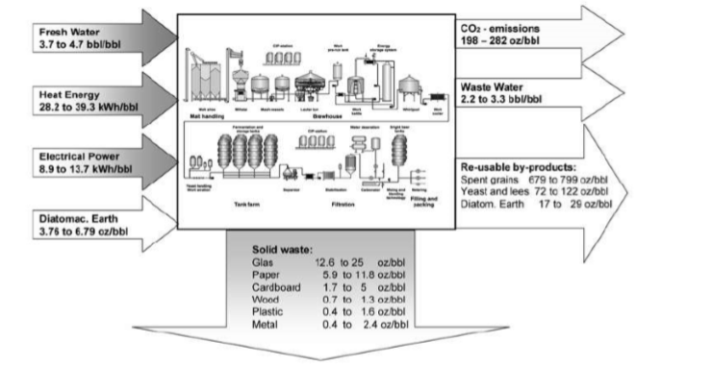
Manufacture of beer
Análisis de entrada-salida para la etapa de elaboración de cerveza con una producción> 1 millón de hl / año de datos de las cervecerías alemanas (Scheller et al., 2008)

Slide 79
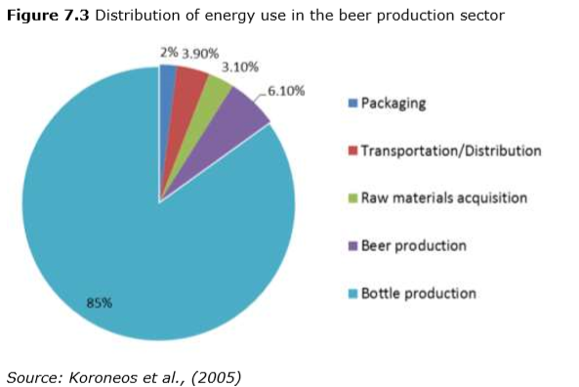
Manufacture of beer
 | Units | 2009 | 2010
Total production in EU-27 + 3 | Millones hl | 401 | 399
Production represented (including other beverages) | % | 64,8 | 64,8
Production represented which is not beer *** | % | 2,8 | 2,6
Specific water consumption | hl/hl** | 4,4 | 4,2
Waste water production | hl/hl** | 2,8 | 2,7
Total direct energy | MJ/hl** | 119,5 | 116,8
Renewable energy | % | 4,8 | 5,3
Carbon emissions from brewery (Scope One) | Kg/hl** | 4,7 | 4,6
Carbon emissions electricity usage (Scope Two) | Kg/hl** | 3,3 | 3,2
Total carbon emissions (Scopes One and Two) | Kg/hl** | 8,0 | 7,8
Secondary products: Animal feed | Kg/hl** | 15,2 | 15,5
Secondary products: Biogas production | M3/1,000 hl** | 83 | 92
* Based on 2010 data when compared to 2008. ** Per hectolitre of beer produced. *** In some production facilities beer is not the only beverage that is being produced. Data which were gathered represented production of all beverages. Key environmental performance indicators of the European brewing sector. Souerce: KWA and Campden BRI, 2012.
 | Energy use (kWh/hl) | Energy use in brewhouse (%)
Mashing 52/78ºC | 2,21 | 19,8
Heating 78/99ºC | 3,38 | 30,2
Boiling | 5,03 | 45
CIP | 0,28 | 2,5
Hot service water | 2,28 | 2,5
Energy demand in brewhouse at 7.5% of total evaporation (Scheller et al.,2008)

Slide 80
Manufacture of beer
Parámetros | Cervecería continua
Capacity | 200 hl/h of cold wort at 20ºP
Pumps | Mash: 180 hl/h – 5.5 kW Wort: 225 hl/h – 4 kW
Utilities | Steam peak flow: 3 t/h Water peak flow: 220 hl/h Electricity installed: 250 kW Electricity peak: 200 kW Peak cooling power: 2,200 kW
Brewhouse with continuous wort boiling and a capacity of 3 million hL at 12 brews/day (Larry Nelson, 2009)

Slide 81
Manufacture of beer
Historical data for a 10% Boil without Energy Recovery.
Same Data with 4% Boil with Wort Preheating using Energy Recovery
Wort boiling without energy recovery and with wort pre-heating using energy recover (Hancock, 2014).

Slide 82
Manufacture of beer
Company | Country | Technique
Heineken Madrid plant | Spain | Wort vapour recovery system
Heineken Sevilla plant | Spain | Reduction of the rate of evaporation with wort of two phases that boils from 6.2% to 4.5%. This technique has reduced the thermal energy rate to 1.5 MJ / hl beer.
Heineken Violonga plant | Portugal | Wort vapour recovery system. Boil the wort in two phases. Low pressure dynamic boiling (test)
Heineken The Wijlre plant | The Netherlands | Evaporation rate reduction of 2.5%, compared to 4.5%.
Mahou-San Miguel Alovera plant | Spain | Wort vapour recovery system. Total thermal energy consumption was reduced by 25%.
Reference organisations for the implementation of wort pre-heating and reduction of evaporation.

Slide 83
Manufacture of beer
Reducing energy use in wort boiling:
Summary
BEMP is to reduce the energy use during wort boiling by: implementing wort preheating with heat recovered from the wort vapour condensing thanks to the use of an energy storage system, reducing evaporation rates during boiling (e.g. by two-phase boiling systems, dynamic lowpressure boiling) provided that the beer taste allows adopting this solution.
Applicability
This BEMP is broadly applicable to all manufacturers of beer. The adoption of wort preheating is applicable to new breweries, provided that there are no space restrictions for installing the equipment needed. In the case of existing plants an economic study should be carried out in order to assess the opportunity to change the wort boiling installation. The reduction of evaporation rates is not suitable for all types of beer since it influences the beer's organoleptic characteristics. When implemented, it needs to be considered within the overall brewing process and applied to the extent that is suitable to the specific product.

Slide 84
Elaboración de cerveza
Reducing energy use in wort boiling:
Environmental performance indicators
Evaporation rate (%) during wort boiling. Overall energy use in the production process per hectolitre of beer produced (MJ/hl). Energy use in wort preheating per hectolitre of beer produced (MJ/hl). Number of brews between two cleans of the kettle
Benchmarks of excellence
A wort preheating system with recovered heat from wort vapour condensing is installed. Evaporation rate during wort boiling is less than 4%

Slide 85
Manufacture of beer
Economic benefits
Possible large energy savings, especially if the energy recovered from the steam condenser is used to preheat the wort.
The data of Mahou-San Miguel in Alovera show an investment of around 1,800,000 euros with an annual energy savings of 825,000 euros.
Environmental benefits
The installation of a vapour condenser and plate heat exchanger to recover heat from the wort vapour can reduce by 70% the energy needed to preheat the wort.
A reduction in the use of fossil fuels and CO2 emissions is achieved.
The reduction in the evaporation rate reduces the formation of scale, so less water, energy and cleaning products are required for cleaning.
Driving force for implementation:
The economic savings are the main driving force to install the proposed systems.
The reduction of direct CO2 emissions (combustion of fuel for thermal energy) and the reduction of the carbon footprint linked to beer produced.

Slide 86
Manufacture of beer
Moving from batch to continuous fermentation systems:
Summary
BEMP is to move from batch to continuous fermentation systems to save energy and water. One option is the use of a four-tank continuous system consisting of three stirred tanks and a fourth unstirred one, where the beer is separated from the yeast. From the last tank, the clarified beer flows to a warm maturation tank where the flavour is refined by yeast action.
Applicability
There are some limitations to the applicability of this BEMP. The technique is mostly feasible for large-scale brewing operations. Moreover, switching to continuous brewing can have effects on the organoleptic characteristics of the final product and may not be suitable for all beer types.

Slide 87
Manufacture of beer
Moving from batch to continuous fermentation systems:
Environmental performance indicators
Overall energy use in the production process per hectolitre of beer produced (MJ/hl). Water consumption in the production process per hectolitre of beer produced (hl of water/hl of beer)
Benchmarks of excellence
N/A

Slide 88
Manufacture of beer
Environmental benefits
Economic benefits
It saves approximately 30-35% of energy.
CO2 is not released systematically into the atmosphere. CO2 recovery is possible
The labor and capital costs are reduced because all the steps for the fermentation process are simplified.
Driving force for implementation
:
Reduction of the maximum consumption of public services.
Reduction of energy losses and extraction.
Reduction of waste disposal.
Limited space requirements.
Easy control of the process.

Slide 89
Manufacture of beer
CO2 recovery in beer production:
Summary
BEMP is to recover the CO2 generated during beer production from the tops of the fermentation tanks/vessels, the maturation vessels and the bright beer tanks. CO2 can then be scrubbed, purified and compressed for storage. It can later be used in-house in a number of brewery operations, e.g. carbonation and bottling, as well as sold or provided for other applications, in the framework of industrial symbiosis.
Applicability
This BEMP can be adapted to all scales of beer production. However, microbreweries and small breweries might find it unattractive because of investments costs and the complexity of the system to recover the CO2 generated.

Slide 90
Manufacture of beer
CO2 recovery in beer production:
Environmental performance indicator
Percentage of CO2 recovered from fermentation (%). Amount of CO2 recovered per hectolitre of beer produced (g CO2/hl). Hourly capacity of the brewery's CO2 recovery system (g CO2/h).
Benchmarks of excellence
A system recovering at least 50 % of the CO2 generated during fermentation is implemented.

Slide 91
Manufacture of beer
Environmental benefits
Economic benefits
CO2 is required at the end of the manufacturing process to achieve the effervescent effect in the final product.
Therefore, on-site generation, upon recovery, reduces operating costs of breweries.
The implementation of this technique reduces the amount of CO2 purchased, which reduces the environmental footprint of the final product.
Driving force for implementation:
The reduction of operating costs (reduction of purchased CO2).
Better visibility of the market thanks to the promotion of an innovative product.

Slide 92
Production of meat and poultry meat products
Overall, the most relevant impacts are:
Energy consumption, both in terms of thermal energy and electricity.
Water consumption, used as an ingredient, for cleaning, for unfreezing of raw materials and for cooling cooked products.
Wastewater, which contains a significant organic load, characterized by a high salt content and organic constituents including mainly blood, fat, protein, sugars, spices, additives, detergents and disinfectants.
Solid waste consists mainly of by-products generated during the meat and poultry meat processing. These wastes include non-conforming products and meat scraps remaining on the processing equipment (e.g. bone, fat, leftover choppings). Other solid wastes such as packaging wastes (e.g. glass, cardboard, plastics, metal) can also be found.

Slide 93
Production of meat and poultry meat products
Summary
BEMP is to use high-pressure processing for pasteurization and cooking processes in the production of meat and poultry meat products, in order to reduce energy use. High pressures can be used in different ways for: replacing thermal pasteurization, reducing the cooking stage: by using high pressures, the cooking stage can be reduced as the complete pasteurization is carried out during the high-pressure processing pasteurization stage.
Applicability
This BEMP is applicable to all producers of meat and poultry meat products. However, investment costs for purchasing the equipment are high and could discourage SMEs. When this is the case, SMEs can use a rental service for high-pressure processing, if available. Environmental performance indicate.

Slide 94
Production of meat and poultry meat products
Environmental performance indicators
Total energy use per amount of meat and poultry meat processed (kWh/kg of product). Energy use in high-pressure processing (kWh/cycle of processed product or kWh/kg of product)
Benchmarks of excellence
High-pressure processing (owned or outsourced) is used to treat suitable meat products (e.g. cooked products, cured and cooked products, raw-cured).

Slide 95
Production of meat and poultry meat products
Economic benefits
Environmental benefits
The investment needed for a HPP machine is in the range of EUR 500 000-2 000 000 depending on the volume of the vessel.
Although the initial investment is high, the processing cost has been estimated at EUR 0.14/kg of product treated at 600 MPa, including investment and operation costs.
HPP equipment is very efficient systems, with low power consumption.
The level of pressure required is generally generated with the use of intensifiers that use electricity.
Pressure processing uses cold water (or room temperature) as the transmission fluid, so no additional energy is needed to generate steam or hot water, and the water used can be recycled.
Driving force for implementation
:
Companies implementing HPP can improve its image thanks to a higher product quality and the achievable microbial risk reduction potential.
Companies can reduce energy and reduce the process time in some meat and poultry meat products.
High Pressure Processing allows icompanies’ to increase their turnover in two ways.

Slide 96
Manufacture of fruit juice
Overall, the most relevant environmental aspects are:
Water consumption and wastewater generation.
Energy consumption.
Organic derived products / waste.
Emissions to the air.
Indirect aspects: Primary production of fruit and its transport (agricultural and transport activities), the generation of waste (packaging and food) and the transportation of packaged fruit juice and retail

Slide 97
Manufacture of fruit juice
Summary
It is BEMP to dispose of the fruit residues of the production process by following the priority cascade: recovery of valuable products, whenever feasible: e.g. pectin (from citrus and peach residues), fine chemicals (beta-carotenoids from carrot residues) and multifunctional food ingredients (from carrot, orange and apple residues) that can be used in bakery products, use of the fruit residues as animal feed, if there are any local livestock or animal feed producers interested in this by-product, use of the fruit residues as anaerobic digestion co-substrate in an already existing anaerobic digestion plant nearby or plan the construction of a new anaerobic digestion system together with other nearby organizations producing organic waste that could be processed in an anaerobic digestion plant (e.g. livestock farmers).
Applicability
This BEMP is applicable to all manufacturers of fruit juice, providing that local conditions (e.g. availability of local livestock to feed, presence of anaerobic digestion plants) allow the implementation of the options listed above.

Slide 98
Manufacture of fruit juice
Environmental performance indicators
Fruit residue exploitation rate (%): total amount of fruit residues used for recovery of valuable products (e.g. pectin, essential oils), as animal feed or as co-substrate in an anaerobic digestion plant.
Benchmarks of excellence
100 % of the fruit residues are used for the recovery of valuable products (e.g. pectin, essential oils), as animal feed or as co-substrate for anaerobic digestion.

Slide 99
Manufacture of fruit juice
Economic benefits
Environmental benefits
The main costs are related to the transport of waste and the market price assigned to fruit waste.
The benefits of biogas plants that use fruit waste are related to the increase in biogas production.
Extracted components can be used to substitute ‘virgin’ components which otherwise.
The use of fruit residues as co-substrate for biogas production contributes to the reduction of the environmental impacts caused by inappropriate management.
The anaerobic digestion process generates biogas which can then be employed for the generation of renewable electricity and heat.
Driving force for implementation:
The environmental benefits and potential economic benefits that can be achieved thanks to the potential market value of the useful products that can be extracted and the waste of fruit used as food or co-substrate.

Slide 100
Cheese making operations
En general, los impactos ambientales más relevantes son:
By-products generation, mainly whey from coagulation, curd treatment and drainage, as well as pressing processes.
Waste water generation, mainly whey from coagulation, curd treatment, drainage and pressing, and brines from the salting stage. In addition, it is important in cleaning and disinfection operations.
Energy consumption, both in terms of thermal energy (pasteurization as well as cleaning and disinfection operations) and electricity (refrigeration).
Water consumption, mainly used in cleaning and disinfection operations.
Indirect aspects: The most relevant indirect aspects of cheese production is the production of milk (agricultural phase). In addition, other indirect environmental aspects are the transport and distribution of milk and finished products, the choice of packaging and the retail of the finished products.

Slide 101
Cheese making operations
Environmental aspects |  | Amount
Energy | Thermal | 0.15-4.6 MJ/l processed milk
 | Electricity | 0.08-2.9 MJ/l processed milk
Waste water generation |  | 2-4 l/l processed milk
Water consumption |  | 1-60 l/l processed milk
Main consumptions and wastewater generation in cheese production. Source: European Commission (RAC/PL, 2000)

Slide 102
Cheese making operations
Summary
BEMP is to recover all the whey from the production of cheese and to use it in new applications, according to the following priority list: concentrate, filter and/or evaporate the whey to produce whey powder, whey protein concentrate (WPC), lactose and other by-products, manufacture whey products intended for human consumption such as whey cheeses or whey drinks, feed the whey to animals, use it as a fertiliser or process it in an anaerobic digestion plant
Applicability
This BEMP is applicable to all cheese producers, provided that local conditions (e.g. sufficient generation of whey for the implementation of a whey concentration system, market demand for whey-based products, availability of local livestock to feed) allow the implementation of the options listed above.

Slide 103
Cheese making operations
Environmental performance indicators
Percentage (% weight) of the total dry matter weight of generated whey recovered for use in products intended for human consumption, in animal feed and as feed for anaerobic digestion. Percentage (% weight) of the total dry matter weight of generated whey recovered for use in products intended for human consumption
Benchmarks of excellence
Whey is recovered and further treated in order to obtain other products for human consumption based on market demand. Excess whey is employed instead for animal feed or for anaerobic digestion.

Slide 104
Cheese making operations
Economic benefits
Cost savings because the disposal of drains can be expensive.
Commercial prices of whey powder have increased markedly in the last 10 years.
Environmental benefits
The production of whey powder offers the greatest environmental benefit of all the options for recovering whey in that large quantities of polluting effluent are.
Nutrients can be used to replace "virgin" ingredients in a wide variety of food products.
The use of whey as a raw material in the production of biogas offers the advantage of generating renewable energy.
Driving force for implementation:
Avoid the high costs associated with the elimination of serum from drains.
Maximize the value of serum by producing highly marketable products, such as whey powder.

Slide 105
Manufacture of bread, biscuits and cakes
Overall, the most relevant impacts are:
Energy consumption: thermal energy is used for baking and steam production. In addition, electricity is used during several production stages.
Water consumption, it is used both as an ingredient and also for others purposes (e.g. cleaning operations).
Waste water, generated during cleaning/disinfection of the facilities.
Air emissions, mainly produced during fermentation (CO2, VOCs produced by yeast metabolism). In addition, air emissions are also produced during baking due to the combustion of fossil fuels.
Solid waste, due to inorganic (linked to packaging stage) and organic waste (wasted dough).
Indirect aspects: Primary production of ingredients, mainly from agriculture, transportation and distribution of ingredients and finished products, packaging production, retail sale of finished products and waste generated at the consumer or retail level (bread without selling).

Slide 106
Manufacture of bread, biscuits and cakes
Unsold bread waste reduction schemes:
Summary
BEMP is to establish appropriate bread ‘take-back’ schemes where the unsold bread from the points of sale is taken back to the bakery where it was produced. The collected bread is stored in the bakery and can be processed into bread-crumbs and dumplings or can be collected by licensed companies (e.g. charities or social organisations if bread is still suitable for human consumption as it is) or can be used for other purposes (e.g. animal feed). The collection of bread by licensed companies can also take place directly at the points of sale.
Applicability
This BEMP is applicable to all manufacturers of bread. Bakeries not delivering bread to distant points of sale can directly implement the measures listed above, without the need to set up a bread take-back scheme. Depending on the use that it is planned for the returned bread, appropriate handling, transport and storage must be ensured to meet hygiene requirements.

Slide 107
Manufacture of bread, biscuits and cakes
Unsold bread waste reduction schemes:
Environmental performance indicators
Return rate (%) of unsold bread from points of sale participating in the ‘take-back’ scheme. Participation (%) of points of sale in existing returning schemes for a given area. Percentage of unsold bread converted to other uses to avoid food waste generation (%)
Benchmarks of excellence
For bakeries: 100 % of the points of sale selling the produced bread participate in an appropriate take-back scheme for the unsold bread.

Slide 108
Manufacture of bread, biscuits and cakes
Unsold bread waste reduction schemes:
Economic benefits
Supermarkets send unsold bread to the bakery; a significant economic loss is perceived in its value for the bakery.
Example: An Austrian industry saved more than 4000,000 euros in 2008 when applying its measures.
Environmental benefits
Social benefits when feeding large number of population with the amount of food wasted.
The waste can be converted into animal feed and support the agricultural industries.
Driving force for implementation:
The minimization of the generation of waste from bakery products.
The optimization of the subsequent treatment of the residues of bakery products.

Slide 109
Manufacture of bread, biscuits and cakes
Minimising anergy consumption for baking:
Summary
BEMP is to minimize the energy consumption for baking by either operating existing ovens in the most energy- efficient way or by selecting the most efficient oven to cater for the specific baking needs based on production requirements, energy sources, space constraints, temperature requirements, operation mode and heat transfer mode.
Aplicabilidad
This BEMP is applicable to all manufacturers of bread, biscuits and cakes.

Slide 110
Elaboración de pan, galletas y pasteles
Minimising anergy consumption for baking:
Environmental performance indicators
Energy use in the baking process, i.e. kWh per: t of baked product, or t of input flour used, or m2 of baking area (oven surface)
Benchmarks of excellence
N/A

Slide 111
Manufacture of bread, biscuits and cakes
Minimising anergy consumption for baking:
Turn off the oven and the time between consecutive batches is long.
Reduce operations between consecutive batches.
Regular cleaning of ovens.
Optimization of the use of the oven.
Increase inspections and preventive maintenance of furnaces.
Burner maintenance.
Improved furnace insulation.
Heat recovery of the kiln outlet products.
Repair of air leaks.
Use of renewable energies.

Slide 112
Manufacture of bread, biscuits and cakes
Minimising anergy consumption for baking:
Economic benefits
Implementation costs may vary according to the nature and number of measures implemented.
Furnace replacement is generally more expensive than measures to improve energy efficiency.
Environmental benefits
A reduction in energy consumption and reduction related to CO2 and other emissions to the air (for example, particles).
Energy savings may vary depending on the type and number of measures implemented.
Driving force for implementation:
Improved energy efficiency leads to cost reductions, increased company competitiveness and improved market image.

Slide 113
Manufacture of wine
Overall, the most relevant impacts are:
Water use, not only for cleaning and sanitation, but also for other purposes e.g. cooling.
Wastewater generation, mainly due to the large amount of wastewater with high organic matter content generated in a short period of time.
Solid waste:
Solid organic waste, mainly due to the large amount produced during a short period of the year.
Other solid waste, namely the inorganic waste produced during bottling/packaging.
Energy use, both in terms of thermal energy and electricity, mainly for the refrigeration process.
Indirect aspects: production of packaging (mainly glass bottles), transport and logistics operations of final products, retail of the final products, use by consumers (including storage and refrigeration by consumers and generation of packaging waste by consumers).

Slide 114
Manufacture of wine
Summary
BEMP is: Reduce the consumption of water in the warehouse by improving cleaning operations and installing highly efficient equipment in the use of water. Implement a strategic resource efficiency approach for organic waste generated in the winery. It reduces energy consumption.
Applicability
This BEMP is applicable to all manufacturers of wine. However, there are some limitations to a number of the measures described above for existing wineries, where the applicability depends on the specific production processes already in place.

Slide 115
Manufacture of wine
Environmental performance indicators
Total water used in the winery (l) per litre of wine produced. Water used can also be measured at the process level. Organic waste generation in the winery (kg) per litre of wine produced per month/year. Thermal energy use (kWh/l of wine produced): can be calculated annually or during the harvesting season. Electricity use (kWh/l of wine produced): can be calculated annually or during the harvesting season.
Benchmarks of excellence
N/A

Slide 116
Manufacture of wine
Water use:
Installation and monitoring of water meters at various sections of the winery.
Use of brushes and squeegees (dry sweeping of floors before washing).
Stopping water flow during breaks, e.g. installing nozzles on water pipes.
Use of low-volume/high-pressure washers or use of equipment for mixing a water jet and a compressed air stream, which reduces water consumption by 50-75% compared to a low-pressure system. The use of low-volume/highpressure washers may have several disadvantages regarding the maintenance of the tanks and of the equipment used (FAO, 1985; WINEC, 2012).
Ozone tank cleaning of barrels (see Section 3.5).
Organising water awareness training for the staff working in the winery.

Slide 117
Manufacture of wine
Organic waste:
Distillation for alcohol production (e.g. Italian grappa), for the grape pomace.
As fuel in CHCP plants (especially ligno-cellulosic biomass).
As substrate for composting (displacing synthetic fertilisers or as soil mulch under the vines).

Slide 118
Manufacture of wine
Energy use:
Selection of a suitable orientation to avoid high sun exposure (avoid SE orientation).
Locate the aging room, the cellar and the bottling room in the basement of the winery in order to reduce sun exposure.
Selection and use of proper construction materials like cement blocks or other suitable materials with low U-value (thermal transmittance).
Use of green roofs or reflective paint/materials on the roof of the winery.

Slide 119
Manufacture of wine
Economic benefits
Savings in energy and water bills and waste management costs differ significantly from case to case.
Improving the environmental reputation of a company can benefit sales thanks to a greater number of customers.
Environmental benefits
They allow reducing the use of energy and water in the warehouse (consequently, saving natural resources and reducing GHG emissions).
The sustainable management of organic waste leads to a reduction in GHG emissions, thanks to the production of renewable energy or the displacement of fertilizer production.
Driving force for implementation:
The contribution to the reduction of production costs and the improvement of the quality of the final product (bottled wine).

Slide 120
Circular Economy

Slide 121
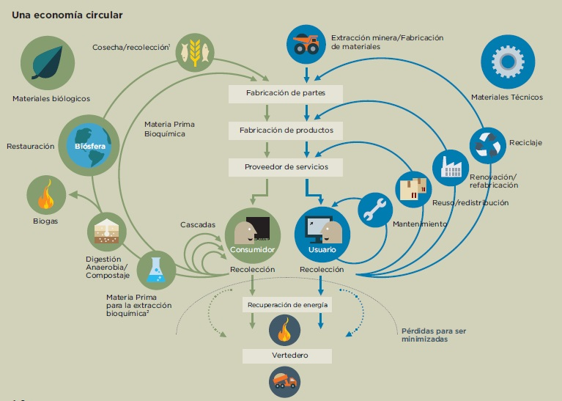
Circular Economy
This is the last and worst of strategies. 1st act on smaller circles and on the design of products/services
Fuente: EMF (Fundación Ellen MacArthur, 2015. “Hacia una economía circular”.

Slide 122
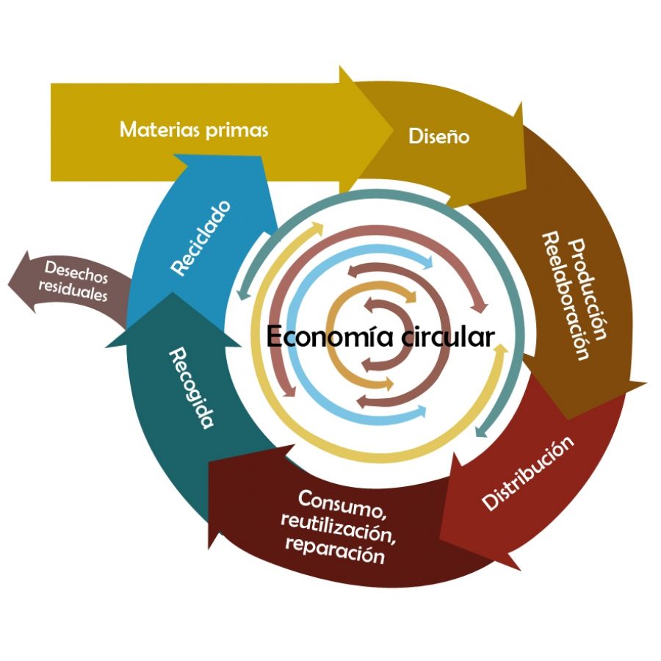
Circular Economy
Fuente: Adaptado de: http://www.ppa.pt/wp-content/uploads/2015/03/2-10_20H_WATER_CircularEconomy_PBLisbon.pdf.

Slide 123
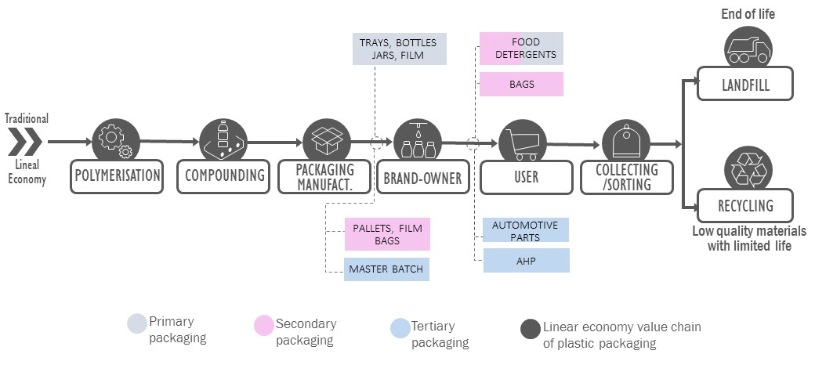
Value chain analysis under the Focus of the Circular Economy

Slide 124
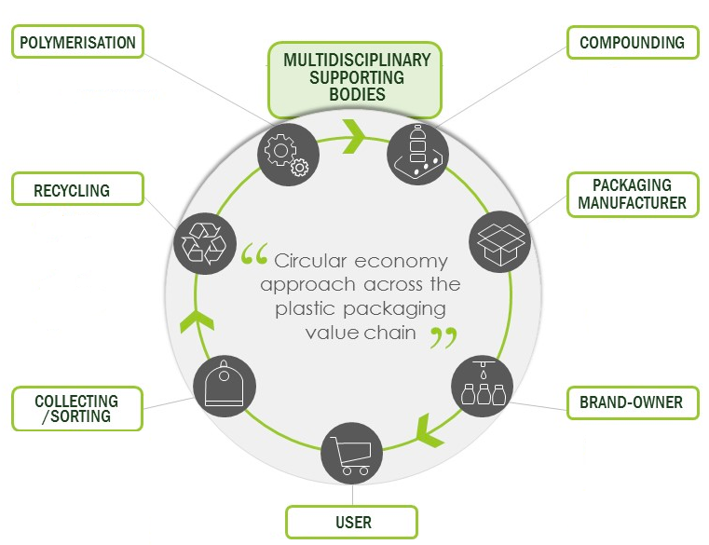
Value chain analysis under the Focus of the Circular Economy

Slide 125
Circular economy indicators
‘
‘
YOU CAN'T CONTROL WHAT CAN'T BE MEASURED
A set of macro-level monitoring indicators, from a life-cycle perspective, on resources, products and waste to power a circular economy indicator system (CEIS), used to quantify and monitor real progress towards a more circular value chain.

Slide 126
Thank you for your attention!
Inmaculada Fraj
Gema Millán
ifraj@fcirce.es
gmillan@fcirce.es
This project has received funding from the European Union’s H2020 Coordination Support Action under Grant Agreement No.785047.

Slide 127
Towards a sustainable agro-food industry. Capacity building programmes in energy efficiency.

