Slide 1












Workshop
Energy Management (Targets and Goals)
Towards a Sustainable Agro-Food Industry.
Capacity Building Programmes in Energy Efficiency.
This project has received funding from the European Union’s H2020 Coordination Support Action under Grant Agreement No.785047.

Slide 2
2.4.EN.2_Energy Managers - Energy Management Targets and Goals
Version of: 2.4.EN_Energy Managers - Energy Management Targets and Goals.
Description of the changes: A slide with the analysis of the indicator is included in the end of the presentation.
List of resources used: 2.4.c.EN_EnPI tool

Slide 3



ISO 50001:2018 is commented by ISO 50006:
Collection of Relevant Information on Energy-Related Performance
Define System Limits
Defining and quantifying energy flows
Defining and quantifying the relevant variables and static factors
Collecting data
Identification of Energy Performance Indicators (EnPI)
Identify users of indicators
Select suitable method
Continuous Improvement Process
Formation of the energy baseline EnB
Determine appropriate baseline period
Determination and testing of the energy baseline
Application of EnPI and EnB
Determine when normalization is required
Calculation of the energy efficiency change
Communicating the changes in energy efficiency
Maintenance and Adjustment of the EnPI and the EnB
Reference: ISO 50006:2014 (E) 4.1.4

Slide 4


Key Words
  Identification of relevant energy consumers
  "Defining and quantifying the relevant variables and static factors.“
  Relevant variables: quantifiable factor affecting energy-related performance and routinely changing
    Static factors: identified factor that affects energy-related performance and does not routinely change
  Determination of relevant variables and their influence
  Measurement: Ensuring data quality
  Identification of outliers

Slide 5
ISO 50001:2018 is commented by ISO 50006:
Collection of Relevant Information on Energy-Related Performance
Define System Limits
Defining and quantifying energy flows
Defining and quantifying the relevant variables and static factors
Collecting data
Identification of Energy Performance Indicators (EnPI)
Identify users of indicators
Select suitable method
Continuous Improvement Process
Formation of the energy baseline EnB
Determine appropriate baseline period
Determination and testing of the energy baseline
Application of EnPI and EnB
Determine when normalization is required
Calculation of the energy efficiency change
Communicating the changes in energy efficiency
Maintenance and Adjustment of the EnPI and the EnB
Reference: ISO 50006:2014 (E) 4.1.4

Slide 6
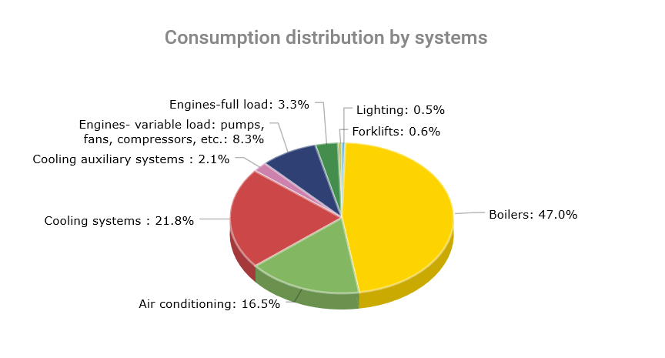
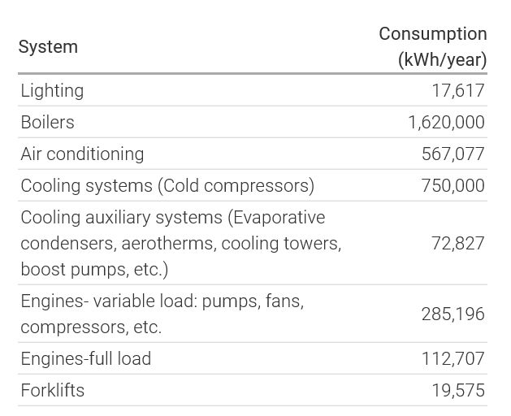

Análisis, ¿qué son los USEs?
Criteria on which to decide if an Energy Application is a „Significant Energy User“, is set by the company itself!
Only to those SEUs the detailed M&V approach needs to be applied!
Notes:
Wesentliche Verbraucher: Produktion & Druckluft
Produktion: Verbrauch verschiedenen Anlagen zusammengefasst
DL: zentrale Anlage – einfach zum steuern und Messdaten vorhanden

Slide 7
ISO 50001:2018 is commented by ISO 50006:
Collection of Relevant Information on Energy-Related Performance
Define System Limits
Defining and quantifying energy flows
Defining and quantifying the relevant variables and static factors
Collecting data
Identification of Energy Performance Indicators (EnPI)
Identify users of indicators
Select suitable method
Continuous Improvement Process
Formation of the energy baseline EnB
Determine appropriate baseline period
Determination and testing of the energy baseline
Application of EnPI and EnB
Determine when normalization is required
Calculation of the energy efficiency change
Communicating the changes in energy efficiency
Maintenance and Adjustment of the EnPI and the EnB
Reference: ISO 50006:2014 (E) 4.1.4

Slide 8
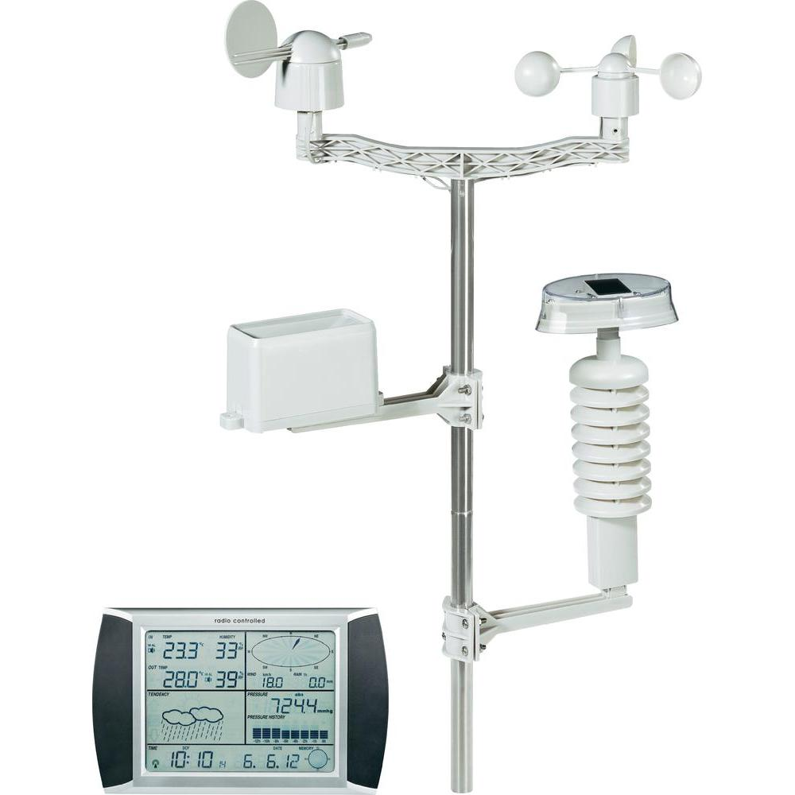


What are Relevant Variables?
All relevant variables must be measurable so that they can be taken into account.
Examples of relevant variables
Benefits
required production quantity
Environmental and Production Influences
Weather, Pressure, Humidity, Wind,
Sunshine Duration, Production Methods
Raw Material Characteristics
Type, purity, state of aggregation
Source: Conrad Weather Station
Source: urbanmining.at

Slide 9
ISO 50001:2018 is commented by ISO 50006:
Collection of Relevant Information on Energy-Related Performance
Define System Limits
Defining and quantifying energy flows
Defining and quantifying the relevant variables and static factors
Collecting data
Identification of Energy Performance Indicators (EnPI)
Identify users of indicators
Select suitable method
Continuous Improvement Process
Formation of the energy baseline EnB
Determine appropriate baseline period
Determination and testing of the energy baseline
Application of EnPI and EnB
Determine when normalization is required
Calculation of the energy efficiency change
Communicating the changes in energy efficiency
Maintenance and Adjustment of the EnPI and the EnB
Reference: ISO 50006:2014 (E) 4.1.4

Slide 10


Identify Users of the Indicators
Choice of indicators according to user and application
"Can the user do anything with the key figure?“
Company, System and Plant Level
Top Management / GL
EMB / Energy Manager
Plant Managers
Maintenance and Service
Process Manager / Production Manager
Plant Operators
Referencia: ISO 50006:2014 (E) 4.3.2

Slide 11
ISO 50001:2018 is commented by ISO 50006:
Collection of Relevant Information on Energy-Related Performance
Define System Limits
Defining and quantifying energy flows
Defining and quantifying the relevant variables and static factors
Collecting data
Identification of Energy Performance Indicators (EnPI)
Identify users of indicators
Select suitable method
Continuous Improvement Process
Formation of the energy baseline EnB
Determine appropriate baseline period
Determination and testing of the energy baseline
Theory: Regression
Basics
First Application
Model Validation
Optimization
Application of EnPI and EnB
Determine when normalization is required
Calculation of the energy efficiency change
Communicating the changes in energy efficiency
Maintenance and Adjustment of the EnPI and the EnB
Reference: ISO 50006:2014 (E) 4.1.4

Slide 12
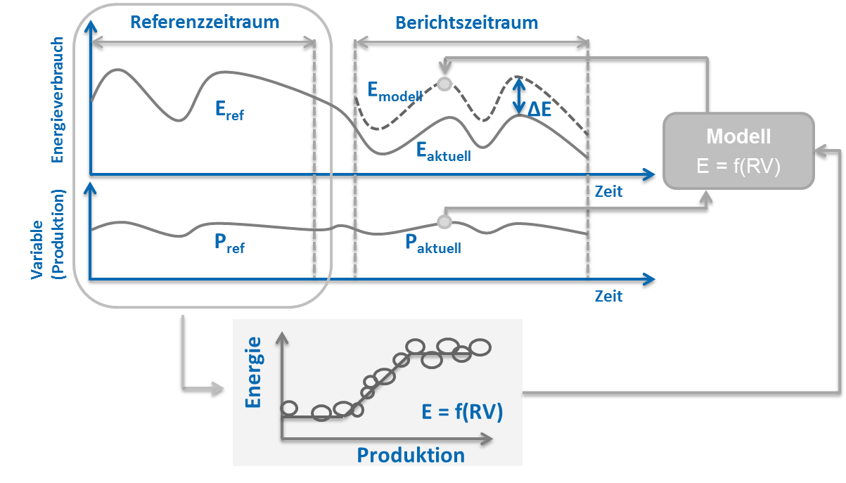

Step 5: Monitoring
Basic approach
Reference period:
Statistical determination of a baseline function that explains energy consumption (effort) on the basis of relevant variables (Benefits and external influencing factors).
Reporting period:
Application of the baseline to actual relevant variables
Comparison of the model with the actual current measurement to evaluate savings
Effort
Relevant Variables
Time
Illustration based on ISO 50006
Notes:
Abbildung in Anlehnung an ISO 50006

Slide 13

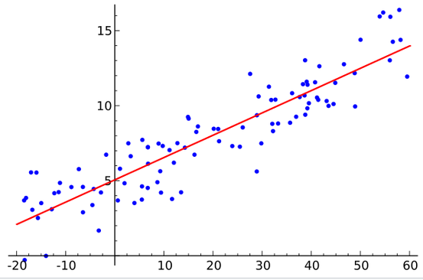
Methods: Lets begin with linear Regression
Is a statistical method that attempts to explain a dependent variable by one or more relevant variables (here: linear dependency).
Dependent (to be explained) variable
Relevant ( Explanatory ) Variable
Source: https://de.wikipedia.org/wiki/Lineare_Regression

Slide 14
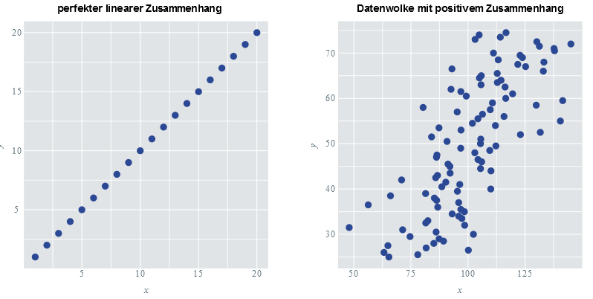

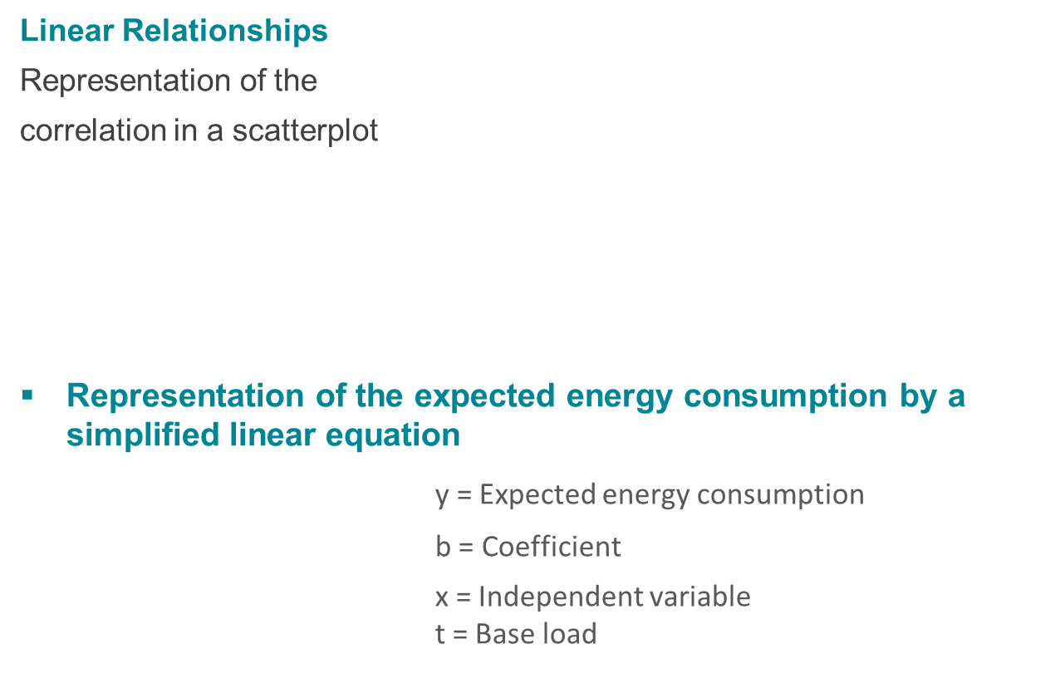
Basic Structure of Linear Regression Functions
Linear Relationships
Representation of the
correlation in a scatterplot
Representation of the expected energy consumption by a simplified linear equation
y = Expected energy consumption
$y = b∗x + t$ b = Coefficient
x = Independent variable t = Base load
Source: https://www.inwt-statistics.del

Slide 15
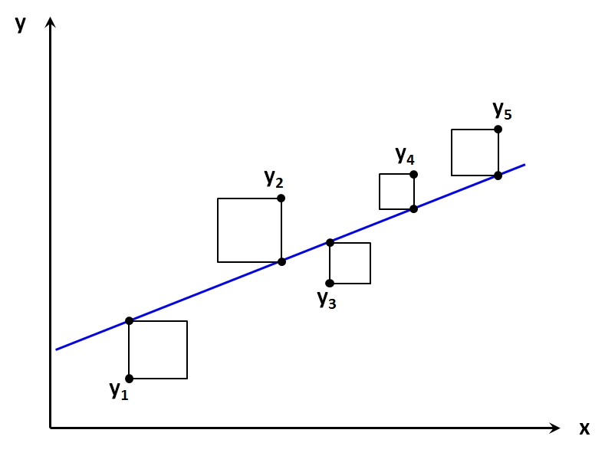
Computational solution: Method of least squares
Search for the most suitable straight line
Method for the mathematical determination of the most suitable straight line.
Source: www.methodenberatung.uzh.ch
x = Independent variable (e.g. benefit)
y = Power Consumption

Slide 16
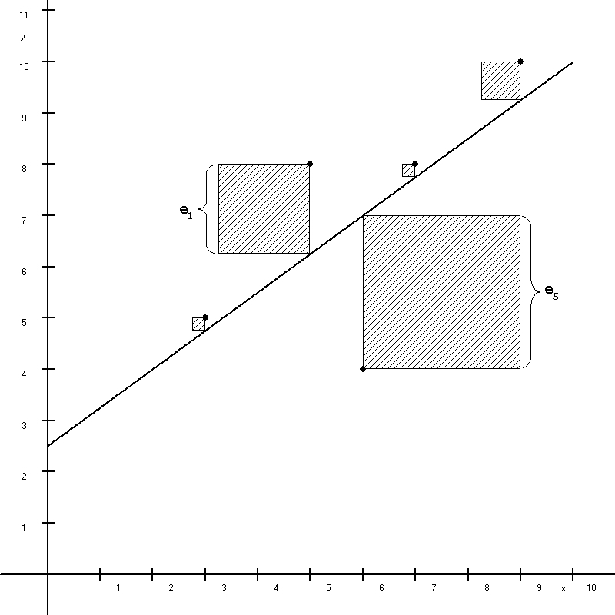
Computational solution: Method of least squares
Objective: To determine the degrees at which the square sums between the degrees and the measured values for power consumption are minimal.
Squaring, with it:
positive and negative distances between data points do not cancel each other out.
arger distances with a higher weight are included in the calculation.
Distance between data points and straight line is also called Residue (e_{x}) or "error”
Calculation e.g. with the Excel “Solver”
Source: www.wiwiweb.de

Slide 17
ISO 50001:2018 is commented by ISO 50006:
Collection of Relevant Information on Energy-Related Performance
Define System Limits
Defining and quantifying energy flows
Defining and quantifying the relevant variables and static factors
Collecting data
Identification of Energy Performance Indicators (EnPI)
Identify users of indicators
Select suitable method
Continuous Improvement Process
Formation of the energy baseline EnB
Determine appropriate baseline period
Determination and testing of the energy baseline
Theory: Regression
Basics
First Application
Model Validation
Optimization
Application of EnPI and EnB
Determine when normalization is required
Calculation of the energy efficiency change
Communicating the changes in energy efficiency
Maintenance and Adjustment of the EnPI and the EnB
Reference: ISO 50006:2014 (E) 4.1.4

Slide 18
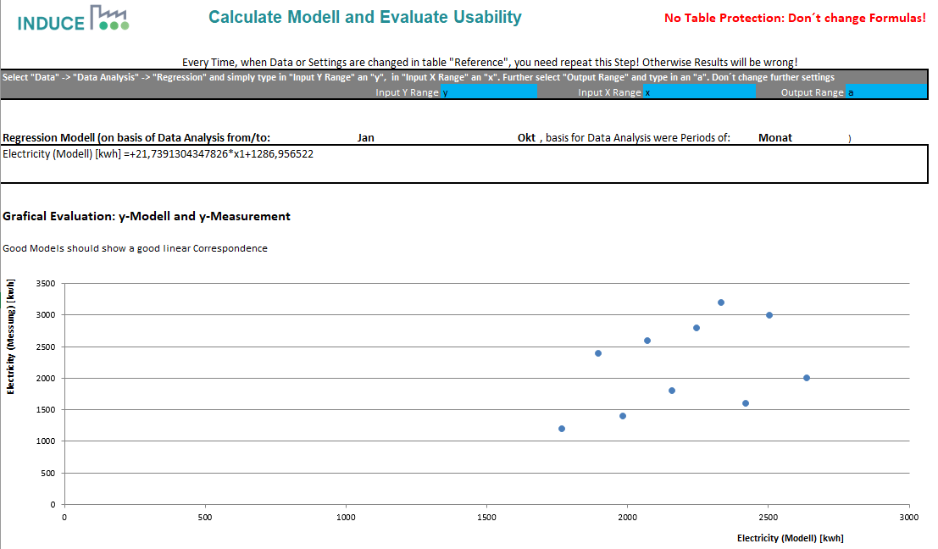

Exercise 1 with INDUCE Toolkit for Monitoring

Slide 19

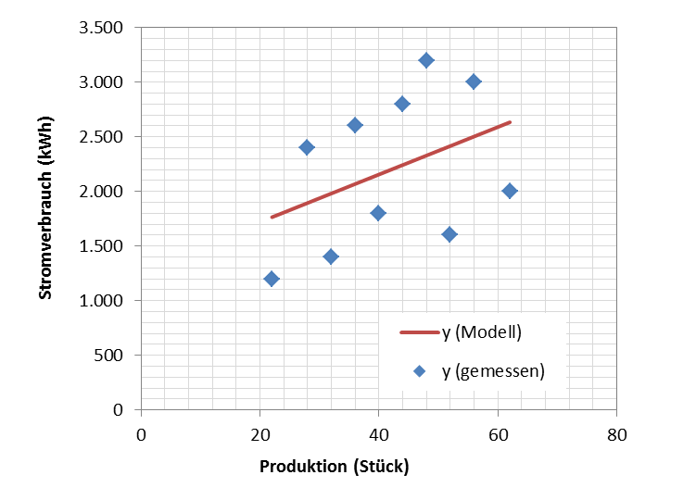
Null hypothesis
You really want to use that as a model?

Slide 20
Test quantities
You really want to use that as a model?
Too small
Too big
Great distance
Too Large

Slide 21


ISO 50006: Which test values should be used?
ISO 50006 Annex D.2 lists the following test quantities as test quantities, e.g.:
(Adjusted) Coefficient of Determination (R²)
Significance (P-value))
Recommendation (not specified in standardization!):
For the Entire Model:
Significance (P-value) should be less than 0.05 (frequent reference to literature)
(Adjusted) R²: as close as possible >0.9
For the individual independent variables and the intersection point:
P value: less than 0.05
Small distance upper/lower limits in 95% confidence interval

Slide 22


Discussion: Possibilities to improve the model
What could we do to improve the quality of our model?

Slide 23
ISO 50001:2018 is commented by ISO 50006:
Collection of Relevant Information on Energy-Related Performance
Define System Limits
Defining and quantifying energy flows
Defining and quantifying the relevant variables and static factors
Collecting data
Identification of Energy Performance Indicators (EnPI)
Identify users of indicators
Select suitable method
Continuous Improvement Process
Formation of the energy baseline EnB
Determine appropriate baseline period
Determination and testing of the energy baseline
Theory: Regression
Basics
First Application
Model Validation
Optimization
Application of EnPI and EnB
Determine when normalization is required
Calculation of the energy efficiency change
Communicating the changes in energy efficiency
Maintenance and Adjustment of the EnPI and the EnB
Reference: ISO 50006:2014 (E) 4.1.4

Slide 24

Multivariate Linear Function Terms
Before: An effort - a benefit
The Multivariate Linear Regression examines whether/how the dependent variable (effort) can be explained by several independent variables.
Now: One Effort – one Benefit – various external Influencing Factors
$$y=b∗x+t$$
x₁
x₁
$$y=b_{1}∗x_{1}+b_{2}∗x_{2}+…+b_{n}∗x_{n}+t$$
Influence x₂
Influance x₃

Slide 25
ISO 50001:2018 is commented by ISO 50006:
Collection of Relevant Information on Energy-Related Performance
Define System Limits
Defining and quantifying energy flows
Defining and quantifying the relevant variables and static factors
Collecting data
Identification of Energy Performance Indicators (EnPI)
Identify users of indicators
Select suitable method
Continuous Improvement Process
Formation of the energy baseline EnB
Determine appropriate baseline period
Determination and testing of the energy baseline
Application: Optimization
Application of EnPI and EnB
Determine when normalization is required
Calculation of the energy efficiency change
Communicating the changes in energy efficiency
Maintenance and Adjustment of the EnPI and the EnB
Reference: ISO 50006:2014 (E) 4.1.4

Slide 26
Excercice 2 with INDUCE Monitoring Tool
Notes:
Kollinearität: zwei oder mehrere unabh. V ändern sich stets gemeinsam – und dann?

Slide 27
Model for Baseline
Now we really like the model, we'll use it as baseline!

Slide 28
ISO 50001:2018 is commented by ISO 50006:
Collection of Relevant Information on Energy-Related Performance
Define System Limits
Defining and quantifying energy flows
Defining and quantifying the relevant variables and static factors
Collecting data
Identification of Energy Performance Indicators (EnPI)
Identify users of indicators
Select suitable method
Continuous Improvement Process
Formation of the energy baseline EnB
Determine appropriate baseline period
Determination and testing of the energy baseline
Application of EnPI and EnB
Determine when normalization is required
Calculation of the energy efficiency change
Communicating the changes in energy efficiency
Maintenance and Adjustment of the EnPI and the EnB
Reference: ISO 50006:2014 (E) 4.1.4

Slide 29
Application of the Baseline to the Monitoring Period
From the baseline development, you have received a function term
  The b´s and the t remain unchanged.
  Set new x values: To apply the baseline for monitoring, use the equation determined and use the new measured values for the independent variables.
  As a result, you get the energy consumption expected according to the regression model.
  To check the efficiency change, the currently measured energy consumption values are compared with the expected energy consumption values.
$$y=b_{1}∗x_{1}+b_{2}∗x_{2}+…+b_{n}∗x_{n}+t$$

Slide 30

EnPC
Significance
"Energy performance coefficient" - Energy efficiency coefficient
Represents the relationship between measured expense and expected expense.
The EnPC is specified as a percentage.
The process has become more efficient for values below 100%.
At values above 100%, the efficiency of the process has deteriorated.

Slide 31
Adjusted EnPI
The comparison can be transferred to the Energy Performance Indicator (ratio of benefit to effort).
Instead of comparing the modelled energy consumption (expenditure) with the measured expenditure, the ratios are compared with each other:
Comparison:
Adjusted EnPI = measured Benefit / modelled Effort
Measured EnPI = measured Benefit / measured Effort

Slide 32
Excercice 3 with INDUCE Monitoring Tool

Slide 33
ISO 50001:2018 is commented by ISO 50006:
Collection of Relevant Information on Energy-Related Performance
Define System Limits
Defining and quantifying energy flows
Defining and quantifying the relevant variables and static factors
Collecting data
Identification of Energy Performance Indicators (EnPI)
Identify users of indicators
Select suitable method
Continuous Improvement Process
Formation of the energy baseline EnB
Determine appropriate baseline period
Determination and testing of the energy baseline
Application of EnPI and EnB
Determine when normalization is required
Calculation of the energy efficiency change
Communicating the changes in energy efficiency
Maintenance and Adjustment of the EnPI and the EnB
Reference: ISO 50006:2014 (E) 4.1.4

Slide 34
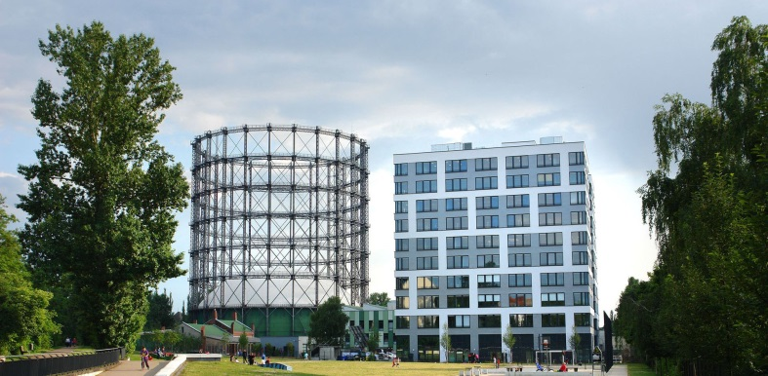
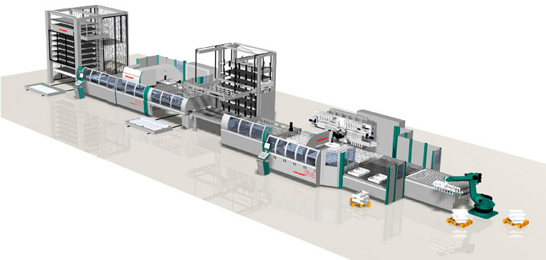
When must the baseline be adjusted if necessary?
Static Factors
These are factors that influence energy consumption but do not routinely change.
→ Production of new products.
→ Natural disasters
If the static factors change, a new regression model must be calculated, otherwise the results are no longer comparable!
Fuente: http://www.oekotec.de
Fuente: http://www.directindustry.de

Slide 35
When must the baseline be adjusted if necessary?
ISO 50006: Indication that a baseline must be corrected if necessary for a static factor. But no statement as to how this should be done.
Static Factor
“Incident”
“Permanent Change”
If possible: correction of the dataset by replacement value
a) "Inventory": How much energy has been saved so far?
Or: hide the measurement period
b) Development of new baselines (with new influence variables if necessary)
c) Continued follow-up

Slide 36
When must the baseline be adjusted if necessary?
Further causes for baseline adjustment
Other Energy Sources
Better availability (more measuring points) and frequency of the data
Energy targets relating to a year other than that of the baseline
Verweis: ISO 50006:2014 (E) 4.6
Notes:
Wie geht man vor?
Anpassung des Zeitraums für die Baseline (Referenzzeitraum)
„Backcasting“ → statistisches Modell mit Energiedaten aus Berichtszeitraum abbilden und mit Daten aus Referenzzeitraum vergleichen
Modell aus Standard Bedingungen und Leistung mit Energiedaten und relevanten Variablen aus Referenz- und Berichtszeitraum

Slide 37
ISO 50001:2018 is commented by ISO 50006:
Collection of Relevant Information on Energy-Related Performance
Define System Limits
Defining and quantifying energy flows
Defining and quantifying the relevant variables and static factors
Collecting data
Identification of Energy Performance Indicators (EnPI)
Identify users of indicators
Select suitable method
Continuous Improvement Process
Formation of the energy baseline EnB
Determine appropriate baseline period
Determination and testing of the energy baseline
Application of EnPI and EnB
Determine when normalization is required
Calculation of the energy efficiency change
Communicating the changes in energy efficiency
Maintenance and Adjustment of the EnPI and the EnB
Reference: ISO 50006:2014 (E) 4.1.4

Slide 38
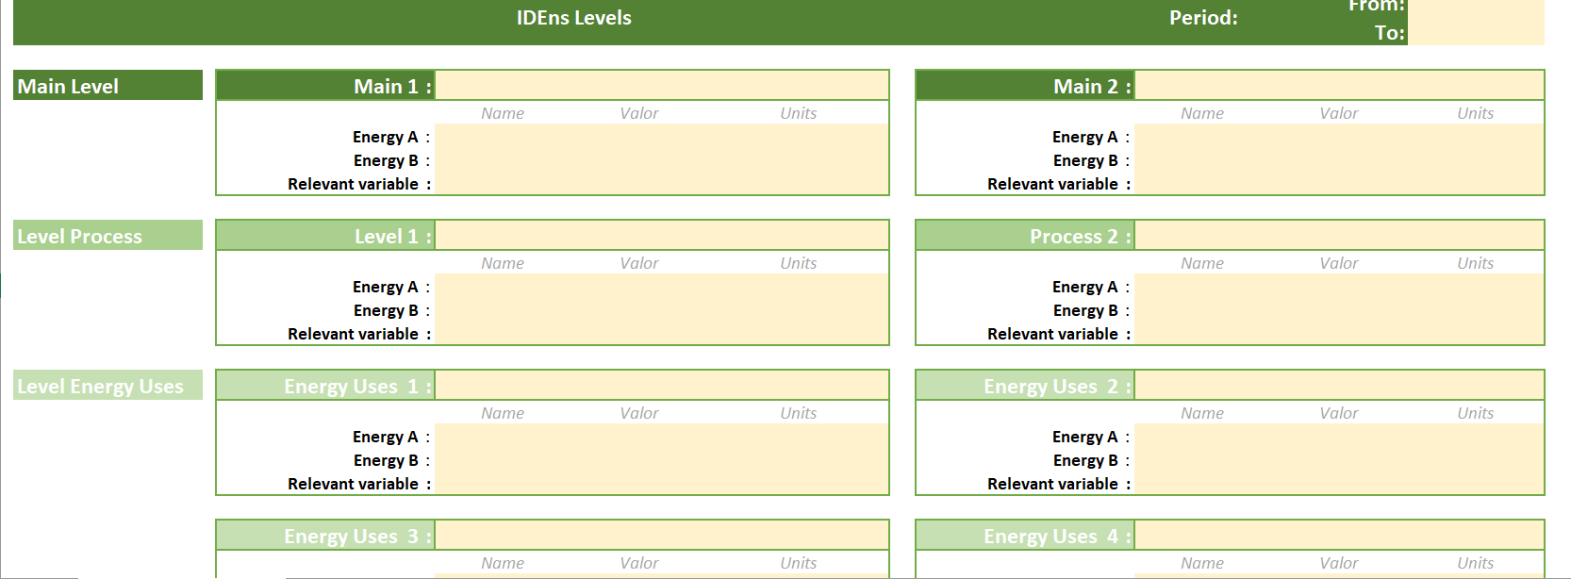
EnPI Calculation

Slide 39
Towards a sustainable agro-food industry. Capacity building programmes in energy efficiency.

