Slide 1












Workshop
Best practices (Best Practice How to present measures)
Towards a Sustainable Agro-Food Industry.
Capacity Building Programmes in Energy Efficiency.
This project has received funding from the European Union’s H2020 Coordination Support Action under Grant Agreement No.785047.

Slide 2
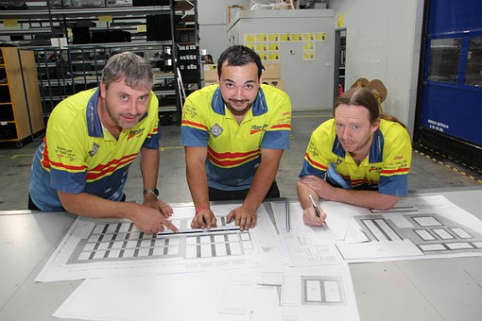
Example: Optimisation of a cycle washing plant
We developed a measure for the Washing Plant
Initial Situation: 5.000 MWh
  Electricity per year: 5.000 MWh
  Electricity Price: 200 €/MWh
  Natural Gas per year: 3.500 MWh
  Natural Gas Price: 50 €/MWh
Efficiency Measure (Heat Regeneration, High Efficiency Pumps,…)
  Investment: 230.000 €
  Electricity Consumtion after Measure 4.945 MWh
  Gas Consumtion after Measure 2.485 MWh
  Technical live cycle: 10 years
  Cost Savings per year: 61.750 €
Fuente: CCO open picture

Slide 3
Pay-back Calculation
85% of the companies only evaluate Savings on behalf of pay back time
Source: Fraunhofer ISI

Slide 4


Example: Optimisation of a cycle washing plant.
Not advisable to argue with technical details
Better speak their language
But the measure is really good!
Wait, we show you the detailed technical evaluations
Source: CCO open picture
Leave me alone with those technical details, I want an Investment Calculation
Source: CCO open picture

Slide 5
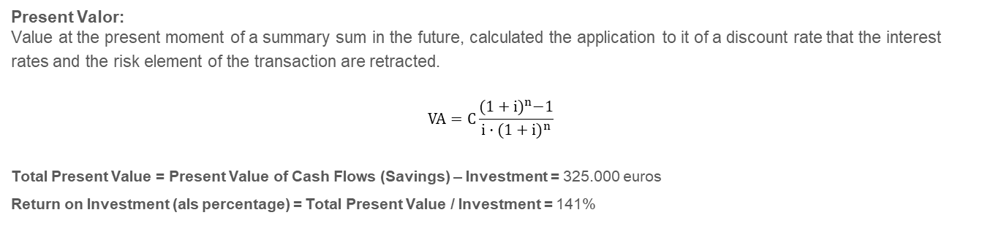
Total Present Value of an Investment
Present Valor:
Value at the present moment of a summary sum in the future, calculated the application to it of a discount rate that the interest rates and the risk element of the transaction are retracted.
$$VA=C\frac{{(1+i)}^{n}−1}{i·{(1+i)}^{n}}$$
Total Present Value = Present Value of Cash Flows (Savings) – Investment = 325.000 euros
Return on Investment (als percentage) = Total Present Value / Investment = 141%

Slide 6

Valor presente total de una inversión
Deducted by calculatory yield: 2% p.a.
Present Valor:
Value at the present moment of a summary sum in the future, calculated the application to it of a discount rate that the interest rates and the risk element of the transaction are retracted.
$$VA=C\frac{{(1+i)}^{n}−1}{i·{(1+i)}^{n}}$$
Total Present Value = Present Value of Cash Flows (Savings) – Investment = 325.000 euros
Return on Investment (als percentage) = Total Present Value / Investment = 141%

Slide 7
Valor presente total de una inversión
24% p.a.
Yield, where Investment - Total Present Value
Internal Rate of Revenue: comparable with a “repayment credit”.

Slide 8
Example: Optimisation of a cycle washing plant
But this machine is standard equipment and we will use it for over 10 years for sure.
The Cash Flows over 10 y. are worth 325.000 € today, even considering 2% inflation
You would need an investment of 24% yield p. a. to be equally profitable.
Source: CCO open picture
Why not get a credit from the bank for 2% p. a. interest rate?
Arguing like this is easy: with the INDUCE profitability calculator

Slide 9
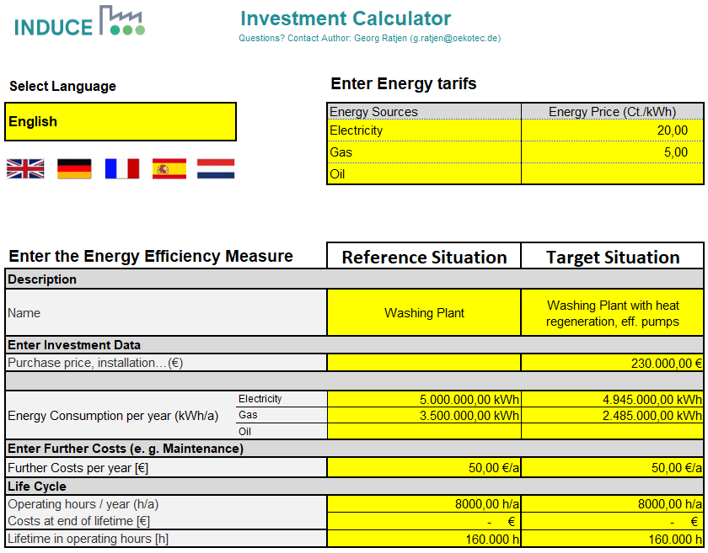
Ejemplo: Optimización de una planta de ciclo de lavado.

Slide 10
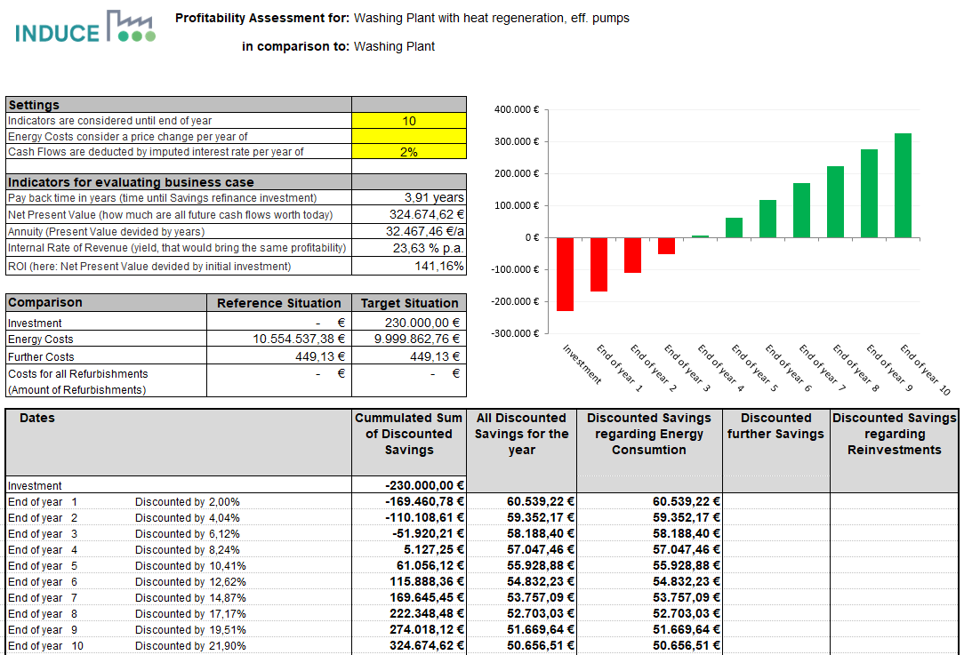
Example: Optimisation of a cycle washing plant.

Slide 11
Towards a sustainable agro-food industry. Capacity building programmes in energy efficiency.

