Slide 1
Workshop
Energy Management (Requirements and Basic Approach)
Towards a Sustainable Agro-Food Industry. Capacity Building Programmes in Energy Efficiency.
This project has received funding from the European Union’s H2020 Coordination Support Action under Grant Agreement No.785047.

Slide 2
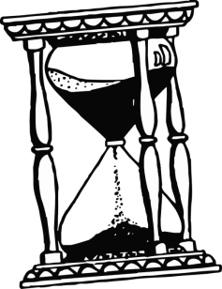
Transitional Regulation
Transition period: 3 years
21.08.2018
Publication of the 50001:2018
Expiration date for certificates acoording to old standard
20.08.2021
Afterwards only audits
(initial/recertification and monitoring) according to new standard
20.02.2020

Slide 3
Significant changes to 50001:2018
Adoption to the " High-Level-Structure ".
Greater responsibility and involvement of Top Management.
Stronger integration into strategic management processes,
in particular:
Context and risk analysis.
Securing achievement of objectives.
Determination of competence and communication.
Resource planning.
Introduction of the concept of the normalization of key figures and starting points for more concrete evidence management.
Amendments to the Energy Data Collection Plan.
Clarification of concepts and updating of definitions.

Slide 4
Task Focus Top Management

Slide 5
Integration in Strategic Manegement Processes
Input
Planning
Results
Context & stakeholder analysis
Risk & Opportunities
Determination
Identifying measures from Opportunities & Risks
Strategic Planning
Management
Plan Táctico
Energy source
Energy input
Energy consumers
Energetic evaluation
Determination of the SEU incl.:
Relevant variables
Energy-related performance
Relevant staff
Prioritisation of efficiency measures
Evaluation of energy use & consumption
consumption prognosis
efficiency measures
Main consumer (SEU)
key figures
Energy targets
Energy data collection plan
Energy Team
Quelle: Eigene Darstellung basierend auf DIN ISO 50001:2018, Bild A.2

Slide 6
Integration into strategic management processes.
Include existing in the company
Notes:
Si el tiempo es abundante, puede hacer una lluvia de ideas con la alta dirección en relación con el contexto y las partes interesadas.
De lo contrario, muestre y explique ejemplos seleccionados de la tabla anterior.

Slide 7
Integration into strategic management processes.
Include stakeholder analysis, risks and opportunities if they had
Notes:
Véase más arriba

Slide 8
Integration in Strategic Manegement Processes
Input
Planning
Results
Context & stakeholder analysis
Risk & Opportunities
Determination
Identifying measures from Opportunities & Risks
Strategic Planning
Management
Plan Táctico
Energy source
Energy input
Energy consumers
Energetic evaluation
Determination of the SEU incl.:
Relevant variables
Energy-related performance
Relevant staff
Prioritisation of efficiency measures
Evaluation of energy use & consumption
consumption prognosis
efficiency measures
Main consumer (SEU)
key figures
Energy targets
Energy data collection plan
Energy Team
Quelle: Eigene Darstellung basierend auf DIN ISO 50001:2018, Bild A.2

Slide 9
Integration in Strategic Management Processes
Risk & Opportunity Assessment - Examples
 | Stakeholder | Requirements | Relevance (1-5) | Control / Application points | Risk / Opportunity
1 | Purchasing / Controlling | Stability / Reduction of energy costs | 4 | Investments in green technologies and processes with subsidies | Opportunity
2 | Employees | Attractive Employer Resources and Training / further education concerning Influence on energy efficiency | 3 | Resource Management Training and motivation concept for energy efficiency | Opportunity
3 | Management | EEG exemption, tax refund image | 5 | Implementation of the EnM / ISO 50001 with the necessary resources | Opportunity
4 | Clients | Requirements Precise data on CO₂ values Products Climate protection | 4 | CO₂ certificate products, measurement, reporting | Risk
5 | Politics / Legislation | Compliance with energy and climate targets for companies (Germany / EU) | 5 | Introduction of operation ISO 50001 and/or execution of energy audits according to EDL-G compliance compliance | Risk
Notes:
Una posibilidad de calificación de riesgos y recompensas (evaluación de relevancia simple)

Slide 10
Integration in Strategic Management Processes
Risk & Opportunity Assessment - Examples
 | Risk / Opportunity | Source | Cause | Asses-sment Risk | Asses-sment Oppor-tunity | Measures | Priority
1 | Non-compliance with obligations | Lawmakers | Laws and deadlines are forgotten | 5 |  | Continuous updating of legal cadastre, adherence to delivery deadlines through cooperation with news service | 5
2 | Energy price/ CO₂ reduction | Technology EnMS | Potential to refine overcapacities from wind energy (sector coupling) |  | 4 | Concept and efficiency audit Conversion of hydrogen production (natural gas) to electricity via electrolysis. | 3
3 | Employees | EnMS | Resources required to achieve energy goals and obtain certificate | 3 |  | Execution of resource audit to plan the necessary and necessary steps up to certification. | 2
4 | Employees | EnMS | Training new employees in the company. Inefficient plant management. |  | 3 | Training for plant managers and weekly posting of energy consumption & key figures. | 3
5 | Water availability Corporate image in the region | Water supply | High water consumption for steam generation. Water scarcity in summer months. | 4 |  | Creation of alternative energy concepts | 4
Notes:
Enfoque más avanzado con evaluación de riesgos.

Slide 11
Integration in Strategic Management Processes
Result: Identification and definition of objectives
Results
Target System
System-Target
Energy Target
Management
Identification of measures from opportunities & risks
Evaluation of energy use & consumption
consumption prognosis
efficiency measures
Main consumer (SEU)
key figures
Energy targets
Energy data collection plan
Energy Team
¿
Are there already “Sistem Targets”
Notes:
Paso final: tome en cuenta las acciones de evaluación de riesgos y recompensas al definir los objetivos.
Explique, que junto a los objetivos de energía también se requieren objetivos de gestión que pueden obtenerse fácilmente a partir del análisis de riesgos

Slide 12
Responsibility Top Management
Changed Organizational Structure
Focus on energy team instead of individual management managers.
Identification of competence requirements and communication.
¿
How do your role looks like
Notes:
Second Main Focus es la difusión de la responsabilidad en la empresa
Requisito es garantía de habilidad y comunicación

Slide 13
Skills identification and communication

Awareness-raising:
Energy policy Contribution to the effectiveness of the SGEn, including the achievement of energy targets and targets
Impact of activities or behaviour with respect to energy performance Benefits of better energy performance
Implications of not being compliant with the requirements of the SGEn
¿
SGEn's competency requirements have already been considered

Slide 14
Identification of competence and communication
How can we reach that colleagues and employees?
Behavioural competence
Experience Competences Techniques
Personality
I want to
I can
Achieving motivation
It's possible
?!

Slide 15
Employee competence and motivation are based on one concept
What is the overriding goal in the company?
Which ones are the subordinates?
Tip: Set Smart Destinations
Which target group(s) should I consider?
Management, Executives
Technical / commercial employees
skilled worker,...
Which measures, rotation, formats, communication are suitable?
What do I want to achieve with the e.g. measures ?
Which obstacles could arise?
How do I control effectiveness?
Which departments can support?
Integrating a holistic concept into the CIP
¿
Is there already a communication concept

Slide 16
Approaches and Examples
Motivate
Feedback
Participate
Suggestion system
Energy Scouts
Inform
Contents
Meetings
Working groups
ProNak
Target agreement
Incentive systems
Benchmark
Contests
Energy Days
Media
Materials
Notices
Enable
Win
Protect
Service
E-Learning
Checklists specialist areas
Knowledge
Error culture
Check lists
Automate
PDCA
Coaching
Corporate culture
Change Management
Models
Stories
Rituals, Continuity
Advanced training

Slide 17
Measurement and Verification

Slide 18
Significant changes to 50001:2018
Adoption to the " High-Level-Structure ".
Greater responsibility and involvement of Top Management
Stronger integration into strategic management processes, in particular:
Context and risk analysis
Securing achievement of objectives
Determination of competence and communication
Resource planning
Introduction of the concept of the normalization of key figures and starting points for more concrete evidence management
Amendments to the Energy Data Collection Plan
Clarification of concepts and updating of definitions
Focus Topics for Energy Manager

Slide 19
Common Problems
Common Practice in Monitoring
Problems
No energy targets at system level (areas of responsibility)
External influences (weather, product properties etc.) not eliminated
Energetic balance of intermediate products not taken into account
Low EnPIs Top-Down for the whole company
Baseline as a pure ratio between production and energy
EnPIs only record directly consumed energy
Notes:
All Pictures: Creative Commons COO Licence (open Source)

Slide 20
Solutions
Topics of ISO 50001:2018/50006
Systematical development of EnPIs and EnBs for Energy Applications
Application for Monitoring
Aggregation of EnPIs and EnBs in Supply Chains / Supply Networks
Monitoring Improvement e.g.:
Quantitative targets according to responsibility areas of people
Precice Monitoring usable for many applications (efficiency surveilence,…)
Efforts of Systems reflect the full energy related „backpack“
Notes:
Alle Bilder sind Creative Commons COO Lizenz (open Source)

Slide 21
Focus of Standardization on EnPI and EnB
The goal of all Energy Management Systems according to ISO 50001 is the continuous improvement of energy-related performance.
Planning (PLAN) - Definition of "essential energy use areas" and formation of EnBs depending on "relevant variables
Implementation (DO) - Monitoring of savings as comparison between current and expected energy consumption according to EnB
Check (CHECK) - Regular check of EnB for suitability
Management review (ACT) - Adjustment of EnB where appropriate
Some standard definitions from the ISO 50000 series
“Improvement of energy performance".
"Improvement through measurable results in terms of energy efficiency, energy use or energy consumption compared to the baseline energy base ".
“Energetic Baseline (EnB)”
“quantitative reference point(s) may be normalised by variables that have an influence on energy input and/or energy consumption, such as production levels, degree days (outdoor temperature), etc.".
Energy Performance Indicator (EnPI)“
"quantitative value or measure of energy related performance as defined by the organisation".
Notes:
Da der Nutzen immer eine relevante Variable ist, ist die Effizienz immer wichtig

Slide 22
Understanding of Energy Applications
BMU EnPI-Method
Guide used for the following Trainings contents: Methodology on Energy Performance Indicators EnPIs from the Federal Ministry for the Environment in Germany (BMU)
To establish monitoring it is helpful to think of Energy Applications as Systems
System
Efforts
Benefits
External influences
Systems:
use efforts to generate benefits
are exposed to external influences that cannot be sensefully adjusted
For Monitoring: Efforts, Benefits and External influences must be correctly defined and measured to establish suitable statistical models.
Notes:
Da der Nutzen immer eine relevante Variable ist, ist die Effizienz immer wichtig

Slide 23
Key Performance Indicator Methodology: Classification in the Standard Language
on basis of BMU EnPI-Methodology (Federal Ministry for the Environment, Germany)
$$Efforts Baseline$$
$$=f(N, ext.EfG)$$
External influences
Terms in ISO 50001: | Terms in EnPI-Methodology
"Areas of Significant Energy use (SEUs)" | Systems (supply engineering, processes, buildings) for which a company would like to carry out precise monitoring
"Energy consumption" | Efforts, which accumulates in the system and is associated with energy (e.g. use of electricity in a refrigeration system)
"Relevant Variables" | Benefits, generated by a system (e.g. cold) External Influencing Variables, that affect the system from the outside, have a relevant influence on the effort and cannot be sensibly controlled (e.g. outside temperatures)
Notes:
Da der Nutzen immer eine relevante Variable ist, ist die Effizienz immer wichtig

Slide 24
Step by Step Implementation Plan for Monitoring & Verification
on basis of BMU EnPI-Methodology (Federal Ministry for the Environment, Germany)
Step 1: Definition of the Boundaries and Application Areas per System (plant, process and building technology)
Selection of Systems for Recording Actual Values
Selection of Systems for Monitoring
Selection of Systems for Benchmarking
Mapping of Systems and Responsibilities
Step 2: Conception of the Data Collection and Specification of the Measuring Points
Energy and Mass Flow Scheme
Effort-benefit diagram
Supplement E-B Diagram with Ext. Influencing Factors
Measurement concept for data acquisition of benefit, effort, ext. influencing variables
Step 3: Planning the Desired Visualization and Design of the EnPIs (Energy Indicators)
Definition of valuation types for different expenses
(e.g. costs, primary energy, CO2)
Design of the EnPIs to be mapped
EnPI as Effort
EnPI as Efficiency
EnPI as intensity
Step 4: Implementation in Energy Controlling
Implementation of measuring points
Implementation of interfaces
Maintenance of systems according to E-B diagrams
Supplementing systems with ext. influencing variables
Maintaining and, if necessary, networking the EnPIs
Step 5: Recording, monitoring and benchmarking using the EnPIs
Recording
Monitoring
Actual values
Creation of Baseline
Target-Actual Comparison
Successful Use for Operational Practice
Energy cost controlling in the cost units
Proof of savings (ISO 50001)
Predictive main-tenance
Verification of efficiency measures
Efficiency maintenance with early warning system
= Basis application: Recording of actual values
= Advanced application: Monitoring
Notes:
Da der Nutzen immer eine relevante Variable ist, ist die Effizienz immer wichtig

Slide 25
Step 1: Define System Boundaries & Application Areas
on basis of BMU EnPI-Methodology (Federal Ministry for the Environment, Germany)
Define System Boundary: Cold Station
Identify the Person in Charge:
Cooling Compressor
Free Cooler
cco public domain
Corinna Schmidt:
In charge of refrigeration
Define Application Areas:
Savings proof according to ISO 50001:2018
Efficiency Monitoring (for early fault detection)
Notes:
Da der Nutzen immer eine relevante Variable ist, ist die Effizienz immer wichtig

Slide 26
Step by Step Implementation Plan for Monitoring & Verification
on basis of BMU EnPI-Methodology (Federal Ministry for the Environment, Germany)
Step 1: Definition of the Boundaries and Application Areas per System (plant, process and building technology)
Selection of Systems for Recording Actual Values
Selection of Systems for Monitoring
Selection of Systems for Benchmarking
Mapping of Systems and Responsibilities
Step 2: Conception of the Data Collection and Specification of the Measuring Points
Energy and Mass Flow Scheme
Effort-benefit diagram
Supplement E-B Diagram with Ext. Influencing Factors
Measurement concept for data acquisition of benefit, effort, ext. influencing variables
Step 3: Planning the Desired Visualization and Design of the EnPIs (Energy Indicators)
Definition of valuation types for different expenses
(e.g. costs, primary energy, CO2)
Design of the EnPIs to be mapped
EnPI as Effort
EnPI as Efficiency
EnPI as intensity
Step 4: Implementation in Energy Controlling
Implementation of measuring points
Implementation of interfaces
Maintenance of systems according to E-B diagrams
Supplementing systems with ext. influencing variables
Maintaining and, if necessary, networking the EnPIs
Step 5: Recording, monitoring and benchmarking using the EnPIs
Recording
Monitoring
Actual values
Creation of Baseline
Target-Actual Comparison
Successful Use for Operational Practice
Energy cost controlling in the cost units
Proof of savings (ISO 50001)
Predictive main-tenance
Verification of efficiency measures
Efficiency maintenance with early warning system
= Basis application: Recording of actual values
= Advanced application: Monitoring
Notes:
Da der Nutzen immer eine relevante Variable ist, ist die Effizienz immer wichtig

Slide 27
Step 2: Develop Data and Measurement Concept
on basis of BMU EnPI-Methodology (Federal Ministry for the Environment, Germany)
Drawing Energy and Mass Flow Diagrams
Input
Output
Refrigerant
Refrigerant
Kälte-kompressor
Waste heat (unused)
Free Cooler
Cold water
Electricity
Cold water
Intake Air
Exhaust air
(unused)
Analyse
Electricity
Air Intake and Exhaust
Refrigerant Inlet Flow
Refrigerant Outlet Flow
Define
Efforts
Electricity
Benefits
Cooling
Notes:
Da der Nutzen immer eine relevante Variable ist, ist die Effizienz immer wichtig

Slide 28
Step 2: Develop Data and Measurement Concept
on basis of BMU EnPI-Methodology (Federal Ministry for the Environment, Germany)
Drawing Effort-Benefit Diagram
Effort
Benefit
Cooling compressor
Cooling [kWh(th)]
Free Cooler
Pre- cooling
[kWh(th)]
Electricity [kWh(el)]
External Influence : Ambient Temperature[°C]
Notes:
Da der Nutzen immer eine relevante Variable ist, ist die Effizienz immer wichtig

Slide 29
Step 2: Develop Data and Measurement Concept
on basis of BMU EnPI-Methodology (Federal Ministry for the Environment, Germany)
Definition of which data are to be recorded for benefits, effort, external influencing variables (measured directly or calculated by measurement)
Effort
Benefit
Cooling compressor
D
Free Cooler
Pre- cooling
[kWh(th)]
D
Electricity [kWh(el)]
Cooling [kWh(th)]
External Influence : Ambient Temperature[°C]
Electricity : Measurement for free cooler and refrigeration compressor total in kWh(el) Cooling quantity: Measurement from refrigeration compressor in kWh(th)
Ambient temperature: Measurement at free cooler in °C
D
D
D
D
Notes:
Da der Nutzen immer eine relevante Variable ist, ist die Effizienz immer wichtig

Slide 30
Step 2: Develop Data and Measurement Concept
on basis of BMU EnPI-Methodology (Federal Ministry for the Environment, Germany)
Planning of the measuring points in the Energy and Mass flow Diagram , with which the data for benefit, effort, ext. influencing variables can be recorded
m³
°C
m³
°C
Input
Output
M
Cold Generation
M
Kältemittel
Kältemittel
Kälte-kompressor
kWh
Abwärme (ungenutzt)
M
Freikühler
Kühlwasser
Strom
Kühlwasser
Außenluft
Fortluft
(ungenutzt)
°C
M
Electricity: Measurement for free cooler and refrigeration compressor total in kWh
Refrigerant: Measurement of material data of refrigerant flow and return in m³ and °C
Outdoor temperature: Measurement at free cooler in °C
M
M
M
Notes:
Da der Nutzen immer eine relevante Variable ist, ist die Effizienz immer wichtig

Slide 31
Step by Step Implementation Plan for Monitoring & Verification
on basis of BMU EnPI-Methodology (Federal Ministry for the Environment, Germany)
Step 1: Definition of the Boundaries and Application Areas per System (plant, process and building technology)
Selection of Systems for Recording Actual Values
Selection of Systems for Monitoring
Selection of Systems for Benchmarking
Mapping of Systems and Responsibilities
Step 2: Conception of the Data Collection and Specification of the Measuring Points
Energy and Mass Flow Scheme
Effort-benefit diagram
Supplement E-B Diagram with Ext. Influencing Factors
Measurement concept for data acquisition of benefit, effort, ext. influencing variables
Step 3: Planning the Desired Visualization and Design of the EnPIs (Energy Indicators)
Definition of valuation types for different expenses
(e.g. costs, primary energy, CO2)
Design of the EnPIs to be mapped
EnPI as Effort
EnPI as Efficiency
EnPI as intensity
Step 4: Implementation in Energy Controlling
Implementation of measuring points
Implementation of interfaces
Maintenance of systems according to E-B diagrams
Supplementing systems with ext. influencing variables
Maintaining and, if necessary, networking the EnPIs
Step 5: Recording, monitoring and benchmarking using the EnPIs
Recording
Monitoring
Actual values
Creation of Baseline
Target-Actual Comparison
Successful Use for Operational Practice
Energy cost controlling in the cost units
Proof of savings (ISO 50001)
Predictive main-tenance
Verification of efficiency measures
Efficiency maintenance with early warning system
= Basis application: Recording of actual values
= Advanced application: Monitoring
Notes:
Da der Nutzen immer eine relevante Variable ist, ist die Effizienz immer wichtig

Slide 32
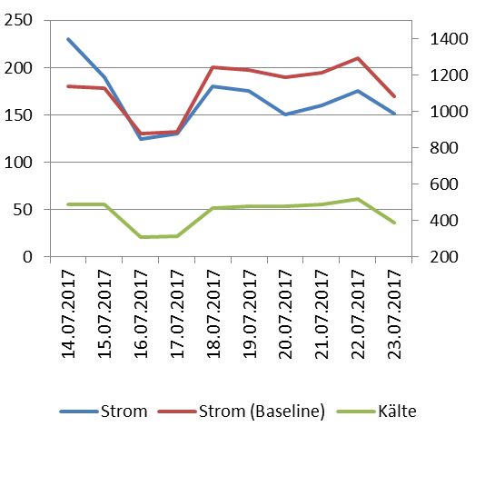
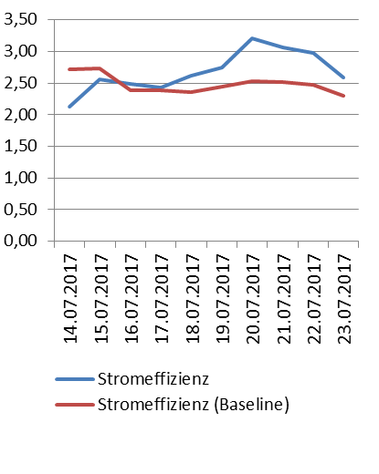
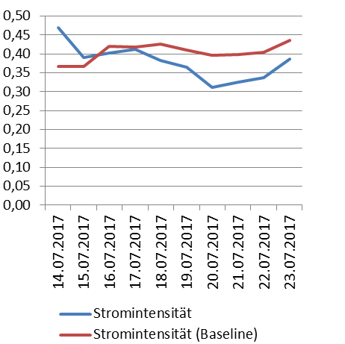
Step 3: Plan the desired Visualisations and Specify the Corresponding EnPIs
on basis of BMU EnPI-Methodology (Federal Ministry for the Environment, Germany)
EnPI como consumos | EnPI como eficiencia | EnPI como intensidad
Consumo $$\text{(}\text{Y} \text{beneficios} \text{informativos} \text{en} \text{diagrama}\text{.}\text{)}$$ | $$\frac{Salida}{Entrada}$$ | $$\frac{\text{Salida} }{Entrada}$$
kW Electricidad
kW frío
kW frio / kW Electricidad
kW Electricidad / kW frio
kW cold / kW electricity
kW Electricity
*
Notes:
Da der Nutzen immer eine relevante Variable ist, ist die Effizienz immer wichtig

Slide 33
Step by Step Implementation Plan for Monitoring & Verification
on basis of BMU EnPI-Methodology (Federal Ministry for the Environment, Germany)
Step 1: Definition of the Boundaries and Application Areas per System (plant, process and building technology)
Selection of Systems for Recording Actual Values
Selection of Systems for Monitoring
Selection of Systems for Benchmarking
Mapping of Systems and Responsibilities
Step 2: Conception of the Data Collection and Specification of the Measuring Points
Energy and Mass Flow Scheme
Effort-benefit diagram
Supplement E-B Diagram with Ext. Influencing Factors
Measurement concept for data acquisition of benefit, effort, ext. influencing variables
Step 3: Planning the Desired Visualization and Design of the EnPIs (Energy Indicators)
Definition of valuation types for different expenses
(e.g. costs, primary energy, CO2)
Design of the EnPIs to be mapped
EnPI as Effort
EnPI as Efficiency
EnPI as intensity
Step 4: Implementation in Energy Controlling
Implementation of measuring points
Implementation of interfaces
Maintenance of systems according to E-B diagrams
Supplementing systems with ext. influencing variables
Maintaining and, if necessary, networking the EnPIs
Step 5: Recording, monitoring and benchmarking using the EnPIs
Recording
Monitoring
Actual values
Creation of Baseline
Target-Actual Comparison
Successful Use for Operational Practice
Energy cost controlling in the cost units
Proof of savings (ISO 50001)
Predictive main-tenance
Verification of efficiency measures
Efficiency maintenance with early warning system
= Basis application: Recording of actual values
= Advanced application: Monitoring
Notes:
Da der Nutzen immer eine relevante Variable ist, ist die Effizienz immer wichtig

Slide 34
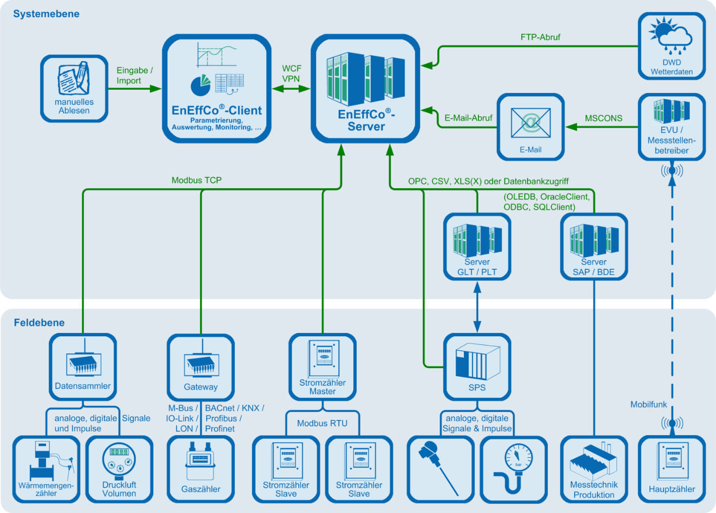
Step 4: Implement Measurement Concept, Interfaces and Key Figures in Energy Controlling
on basis of BMU EnPI-Methodology (Federal Ministry for the Environment, Germany)
Implement Required Interfaces to Energy Efficiency Controlling Software
Source: ÖKOTEC

Slide 35
Step 4: Implement Measurement Concept, Interfaces and Key Figures in Energy Controlling
on basis of BMU EnPI-Methodology (Federal Ministry for the Environment, Germany)
Store EnPIs in the Energy Efficiency Controlling software
EnPI as Efforts | EnPI as Efficiency | EnPI als Intensity
Efforts $$\text{(}\text{and} \text{benefits} \text{informative} \text{in} \text{diagram}\text{)}$$ | $$\frac{Benefits}{Efforts}$$ | $$\frac{\text{Benefits} }{Efforts}$$
kW Electricidad
kW frío
kW frio / kW Electricidad
kW Electricidad / kW frio
kW cold / kW electricity
kW Electricity
*
Notes:
Bildquellen: CC0 Creative Commons Freie kommerzielle Nutzung; Kein Bildnachweis nötig

Slide 36
Step by Step Implementation Plan for Monitoring & Verification
on basis of BMU EnPI-Methodology (Federal Ministry for the Environment, Germany)
Step 1: Definition of the Boundaries and Application Areas per System (plant, process and building technology)
Selection of Systems for Recording Actual Values
Selection of Systems for Monitoring
Selection of Systems for Benchmarking
Mapping of Systems and Responsibilities
Step 2: Conception of the Data Collection and Specification of the Measuring Points
Energy and Mass Flow Scheme
Effort-benefit diagram
Supplement E-B Diagram with Ext. Influencing Factors
Measurement concept for data acquisition of benefit, effort, ext. influencing variables
Step 3: Planning the Desired Visualization and Design of the EnPIs (Energy Indicators)
Definition of valuation types for different expenses
(e.g. costs, primary energy, CO2)
Design of the EnPIs to be mapped
EnPI as Effort
EnPI as Efficiency
EnPI as intensity
Step 4: Implementation in Energy Controlling
Implementation of measuring points
Implementation of interfaces
Maintenance of systems according to E-B diagrams
Supplementing systems with ext. influencing variables
Maintaining and, if necessary, networking the EnPIs
Step 5: Recording, monitoring and benchmarking using the EnPIs
Recording
Monitoring
Actual values
Creation of Baseline
Target-Actual Comparison
Successful Use for Operational Practice
Energy cost controlling in the cost units
Proof of savings (ISO 50001)
Predictive main-tenance
Verification of efficiency measures
Efficiency maintenance with early warning system
= Basis application: Recording of actual values
= Advanced application: Monitoring
Notes:
Da der Nutzen immer eine relevante Variable ist, ist die Effizienz immer wichtig

Slide 37
Step 5: Monitoring
on basis of BMU EnPI-Methodology (Federal Ministry for the Environment, Germany)
Calculate baseline with Energy Efficiency Controlling Software
Period: Hour to | Electricity [kWh] | Cooling [kWh] | Ambeient temp. [ °C]
01.07.2017, 10:00 | 212 | 1221 | 24
01.07.2017, 11:00 | 219 | 1296 | 26
01.07.2017, 12:00 | 243 | 1483 | 28
… | … | … | …
31.01.2018, 2:00 | 45 | 492 | -6
31.01.2018, 3:00 | 46 | 504 | -4
Electricity $Baseline$
$$=f(Cooling, Amb.temp)$$
Notes:
Da der Nutzen immer eine relevante Variable ist, ist die Effizienz immer wichtig

Slide 38
Step 5: Monitoring
on basis of BMU EnPI-Methodology (Federal Ministry for the Environment, Germany)
Energy Consumption shall be reduced by 30%
Reference Period: Jan to July 2017
Measures to accomplish that target:
Adjusting Temperature Levels of Cooling station
Variable Frequency drives
Notes:
Da der Nutzen immer eine relevante Variable ist, ist die Effizienz immer wichtig

Slide 39
Step 5: Monitoring
on basis of BMU EnPI-Methodology (Federal Ministry for the Environment, Germany)
Optimisation of controls and temperatures on a cooling compressor
How high would have been the effort without measures (Baseline)
How high was the effort really (after mesures)?
Cumulated Savings (CUSUM)
Quelle: EnEffCo®
Notes:
Da der Nutzen immer eine relevante Variable ist, ist die Effizienz immer wichtig

Slide 40
Step 5: Monitoring
on basis of BMU EnPI-Methodology (Federal Ministry for the Environment, Germany)
The measures led to a reduction in Energy Efforts
In 2018 the Energy Effort was 700 MWh
According to the Baseline, the Energy Effort would have been 1100 MWh without Energy Efficiency measures
The savings achieved were 400 MWh (>35%)
Notes:
Da der Nutzen immer eine relevante Variable ist, ist die Effizienz immer wichtig

Slide 41
Step by Step Implementation Plan for Monitoring & Verification
on basis of BMU EnPI-Methodology (Federal Ministry for the Environment, Germany)
Step 1: Definition of the Boundaries and Application Areas per System (plant, process and building technology)
Selection of Systems for Recording Actual Values
Selection of Systems for Monitoring
Selection of Systems for Benchmarking
Mapping of Systems and Responsibilities
Step 2: Conception of the Data Collection and Specification of the Measuring Points
Energy and Mass Flow Scheme
Effort-benefit diagram
Supplement E-B Diagram with Ext. Influencing Factors
Measurement concept for data acquisition of benefit, effort, ext. influencing variables
Step 3: Planning the Desired Visualization and Design of the EnPIs (Energy Indicators)
Definition of valuation types for different expenses
(e.g. costs, primary energy, CO2)
Design of the EnPIs to be mapped
EnPI as Effort
EnPI as Efficiency
EnPI as intensity
Step 4: Implementation in Energy Controlling
Implementation of measuring points
Implementation of interfaces
Maintenance of systems according to E-B diagrams
Supplementing systems with ext. influencing variables
Maintaining and, if necessary, networking the EnPIs
Step 5: Recording, monitoring and benchmarking using the EnPIs
Recording
Monitoring
Actual values
Creation of Baseline
Target-Actual Comparison
Successful Use for Operational Practice
Energy cost controlling in the cost units
Proof of savings (ISO 50001)
Predictive main-tenance
Verification of efficiency measures
Efficiency maintenance with early warning system
= Basis application: Recording of actual values
= Advanced application: Monitoring
Notes:
Da der Nutzen immer eine relevante Variable ist, ist die Effizienz immer wichtig

Slide 42
Towards a sustainable agro-food industry. Capacity building programmes in energy efficiency.

