Slide 1
Workshop
Energy Management (Requirements and Basic Approach)
Towards a Sustainable Agro-Food Industry. Capacity Building Programmes in Energy Efficiency.
This project has received funding from the European Union’s H2020 Coordination Support Action under Grant Agreement No.785047.

Slide 2
2.3.1.EN.2_Energy Managers - Energy Management Requirements and Basic Approach
Version of: 2.3.1.EN. _Energy Managers - Energy Management Requirements and Basic Approach
Description of the changes: This presentation includes only the first two parts of the original version.
List of resources used: 3.2.EN_Awareness in Energy Efficiency.

Slide 3
Agenda
Introduction and overview
Task Focus Top Management
GAP Analysis & Results
P
Plan
A
Act
Management
Do
H
Check
V

Slide 4
Introduction and Overview

Slide 5
50000 family of standards - Overview
Energy management systems: guidance for the application, maintenance and improvement of the EnMS
EN ISO 50001:2018 Energy Management Systems - Requirements with application guidance
ISO 50003:2014
ISO 50004:2014
Requirements for bodies that audit and certify energy management systems.
(mandatory for accredited bodies, this indirectly results in requirements for companies as well)
Energy Management Systems - Guidance for the application, maintenance and improvement of the EnMS.
ISO 50015:2014
ISO 50006:2014
Energy Management Systems - Measurement and verification of the energy performance of organisations - General principles and guidance.
(Guideline for systematic verification measurements of the implemented measures, preparation of measurement and verification plan).
Measurement of energy related performance using energy output bases (EnB) and energy performance indicators (EnPI) - General principles and guidelines.
(Guide for users with methodological approaches & practical examples on energy performance indicators, application aid for identifying influencing variables & creation of EnP)

Slide 6
Transitional Regulation
Transition period: 3 years
21.08.2018
Publication of the 50001:2018
Expiration date for certificates acoording to old standard
20.08.2021
Afterwards only audits
(initial/recertification and monitoring) according to new standard
20.02.2020

Slide 7
Significant changes to 50001:2018
Adoption to the " High-Level-Structure ".
Greater responsibility and involvement of Top Management.
Stronger integration into strategic management processes,
in particular:
Context and risk analysis.
Securing achievement of objectives.
Determination of competence and communication.
Resource planning.
Introduction of the concept of the normalization of key figures and starting points for more concrete evidence management.
Amendments to the Energy Data Collection Plan.
Clarification of concepts and updating of definitions.

Slide 8
Task Focus Top Management

Slide 9
Leadership and Commitment
“Top management has overall responsibility for meeting the requirements of this document. […]
In the course of communication within the organisation, top management may emphasise the importance of energy management mediante actividades de participación de los empleados como el empoderamiento, la motivación, el reconocimiento, la formación, las recompensas y la participación".
UNE EN ISO 50004:2018, A.5

Slide 10
Responsibility Top Management
Commitment of Top Management (Section 5.1)
Increased responsibility of “Top Management”
Definition of scope and limits.
Training EnMS – Team and support/qualification of relevant actors.
Integration of the EnMS into the business process.
Definition of energy policy, objectives and targets.
Ensuring approval and implementation of action plans.
Ensuring that necessary resources are available.
Communicating Significance of the EnMS.
Ensuring that results are achived EnMS, in particular, improvement of EnMS organisation and Energy-Related Performance.
Ensuring suitable ENPlS with regard to Energy-Related Performance.
Ensuring processes to identify and manage changes.

Slide 11
Integration in Strategic Manegement Processes
Input
Planning
Results
Context & stakeholder analysis
Risk & Opportunities
Determination
Identifying measures from Opportunities & Risks
Strategic Planning
Management
Plan Táctico
Energy source
Energy input
Energy consumers
Energetic evaluation
Determination of the SEU incl.:
Relevant variables
Energy-related performance
Relevant staff
Prioritisation of efficiency measures
Evaluation of energy use & consumption
consumption prognosis
efficiency measures
Main consumer (SEU)
key figures
Energy targets
Energy data collection plan
Energy Team
Quelle: Eigene Darstellung basierend auf DIN ISO 50001:2018, Bild A.2

Slide 12
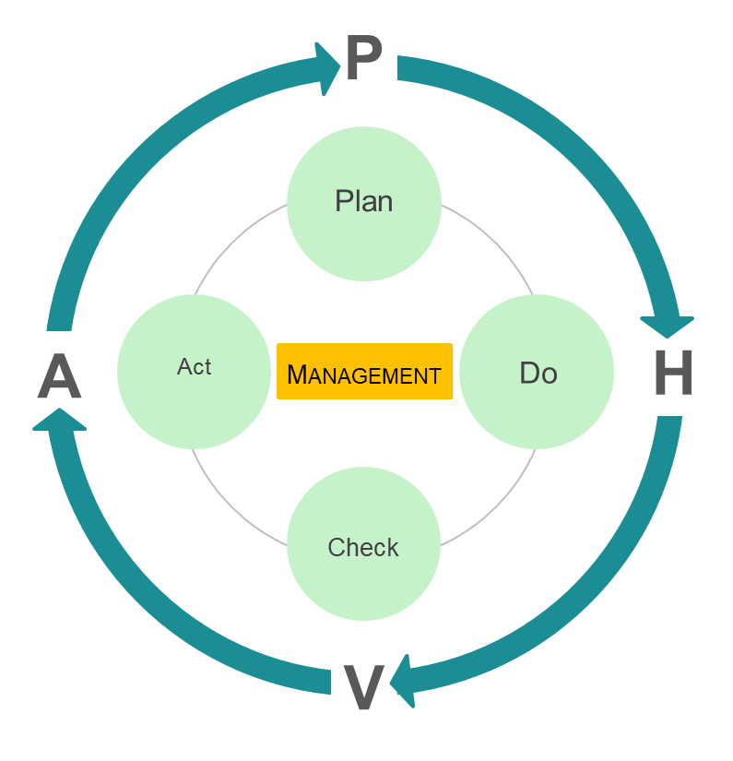
Integration in Strategic Management Processes
Inputs for planning
Contexte and Stakeholder Analysis.
Determine internal & external topics that have an influence on the EnMS and the energy related performances (environment / context analysis).
Determine interested parties with influence on energy related performances and EnMS.
Determine relevant requirements and expectations of the parties and how to deal with the points identified.
Expected Documentation
Context analysis
Stakeholder analysis (topics, parties, requirements), possibly as part of the context analysis.

Is a context stakeholder analysis already being carried out
¿
Notes:
Describir los nuevos requisitos de los Capítulos (4.1, 4.2,).
Explicar nuevo vocabulario
Explicar el hacer real:
Identifique los temas relevantes relacionados con SGEn / ebL, por ejemplo, Innovaciones técnicas, nuevos requerimientos del cliente, modificaciones legales, etc.
Uso del análisis PESTEL (político, económico, social, técnico, ecológico, legal)
Luego verifique si hay partes interesadas.
Compruebe si la integración en el IMS existente es posible, ya que el análisis de las partes interesadas se realiza con frecuencia en otras personas.

Slide 13
Integration in Strategic Management Processes
Context Analysis Example
Political Factors
Economic Factors
Social Factors
2° degree target
Climate protection at German and European level
NAPE
Changes in tax policy
Corporate policy
Business policy
Energy price development
Commodity prices
Tax refund (SpAefV)
Energy saving
Sales growth / production capacity utilization
Subsidies (state, country)
Resources for EnM
Education and training Employees Energy efficiency
Employee participation regarding energy in the company
Responsibility in the region
Technical Factors
Legal Factors
Ecological Factors
Energy Technology Development
Sector coupling
Storage technologies
Renewable Energies
E-Mobility
Digitization Infrastructure, software, GLT,...
Compliance with all legal requirements (e.g. StromStG, EnergieStG, EEG)
ETS
Audit/reporting obligation
CSR
ISO 50001/16247-1
Environmental Constraints
Exhaust Emissions
Water consumption
Energetic building modernisation (e.g. thermal insulation)
Requirements of customers with regard to CO2
Green electricity
Notes:
Si el tiempo es abundante, puede hacer una lluvia de ideas con la alta dirección en relación con el contexto y las partes interesadas.
De lo contrario, muestre y explique ejemplos seleccionados de la tabla anterior.

Slide 14
Integration in Strategic Management Processes
Stockholder Analysis Example
Examples of Interested Parties
Capital providers/investors Corporate management Controlling Employees Lawmakers The public Climate Partnership Clients
Examples Expectation/Requirement
High return on capital Adherence to corporate goals Securing energy tax effects Innovative & safe workplace Compliance with energy legislation Energy-saving production Compliance with climate targets Prices/Availability
Notes:
Véase más arriba

Slide 15
Integration in Strategic Manegement Processes
Input
Planning
Results
Context & stakeholder analysis
Risk & Opportunities
Determination
Identifying measures from Opportunities & Risks
Strategic Planning
Management
Plan Táctico
Energy source
Energy input
Energy consumers
Energetic evaluation
Determination of the SEU incl.:
Relevant variables
Energy-related performance
Relevant staff
Prioritisation of efficiency measures
Evaluation of energy use & consumption
consumption prognosis
efficiency measures
Main consumer (SEU)
key figures
Energy targets
Energy data collection plan
Energy Team
Quelle: Eigene Darstellung basierend auf DIN ISO 50001:2018, Bild A.2

Slide 16
Integration in Strategic Management Processes
Planning Process
Risk and Opportunity Analysis
Determination of opportunities and risks for Energy Related Performances and EnMS
Define measures for dealing with opportunities and risks
Evaluate the effectiveness of the measures
Documentación esperada
Opportunities and risk analysis (if necessary within the context of context analysis)
Measures for dealing with opportunities and risks (if necessary in action plans, corrective and preventive action plans or EnMS action plans)

¿
Is a risk análisis already being carried out

Slide 17
Integration in Strategic Management Processes
Result: Identification and definition of objectives
Results
Target System
System-Target
Energy Target
Management
Identification of measures from opportunities & risks
Evaluation of energy use & consumption
consumption prognosis
efficiency measures
Main consumer (SEU)
key figures
Energy targets
Energy data collection plan
Energy Team
¿
Are there already “Sistem Targets”
Notes:
Paso final: tome en cuenta las acciones de evaluación de riesgos y recompensas al definir los objetivos.
Explique, que junto a los objetivos de energía también se requieren objetivos de gestión que pueden obtenerse fácilmente a partir del análisis de riesgos

Slide 18
Responsibility Top Management
Changed Organizational Structure
Focus on energy team instead of individual management managers.
Identification of competence requirements and communication.
¿
How do your role looks like
Notes:
Second Main Focus es la difusión de la responsabilidad en la empresa
Requisito es garantía de habilidad y comunicación

Slide 19
Identification of competence and communication
New standard requirements:
Determination of the required competence for persons (also external!) with influence on ebL or EnMS
Introduction to Acquiring the Required Competence and Testing Effectiveness
Determination of internal and external communication (what, when, how, who with whom)
Ensuring reliable and EnMS-compliant content
Expected Documentation:
e.g. competence matrix, competence requirement in the job description, etc.
Process for regulating communication incl. Communication matrix
Process for submitting suggestions for improvement, including a decision as to whether suggestions for improvement should be retained

¿
Are competence requirement from EnMS already considered

Slide 20
Towards a sustainable agro-food industry. Capacity building programmes in energy efficiency.

