Slide 1
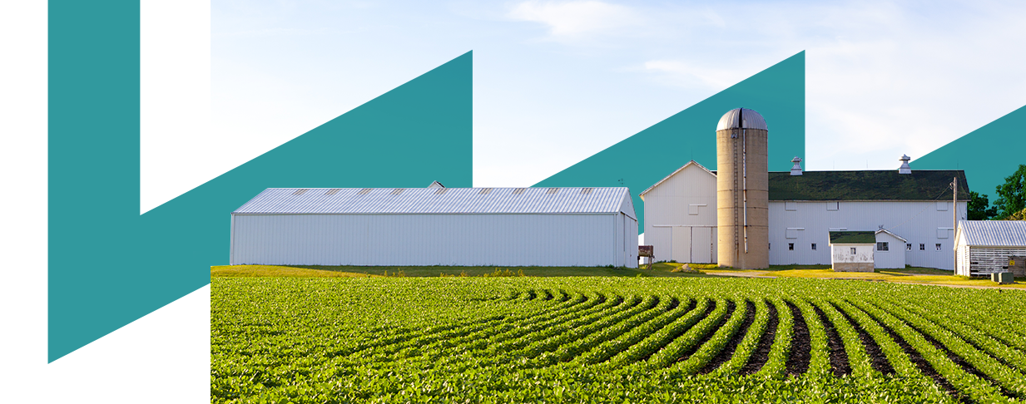











Energy Efficiency in
Horizontal Utilities
Gema Millán
Inmaculada Fraj
Towards a Sustainable Agro-Food Industry.
Capacity Building Programmes in Energy Efficiency.
This project has received funding from the European Union’s H2020 Coordination Support Action under Grant Agreement No.785047.

Slide 2

Energy Efficiency in lighting
Energy Efficiency in compressed air
Measurement devices
CONTENTS
01
02
03

Slide 3

01
Eficiencia Energética en Iluminación
1
Energy efficiency in installations.
Improvement of installed equipment.
Installation of energy saving devices.
Switch on and switch off devices.
2
3
4

Slide 4

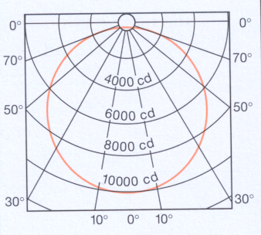
01
Energy Efficiency in lighting
Lighting: the measure of the power of electromagnetic radiation related to visible light.
Luminous flux: objective measure of the useful light emitted by a light source.
Symbol: F
Units: lumen (lm)
Luminous intensity: the flux that is radiated by a light source in a determinate direction.
Symbol: I
Units: candela (cd)
Luminous flux
I
Luminous intensity
Notes:
First, we need to know the main concepts about lighting, in order to know what parameters we need to measure if we want to analyse and verify the performance and efficiency of the lighting system. So, what is lighting?
Watts
We will have to take into account all the lights that are installed in this room, each one has a power of lighting, so we will equal them, in order to know the total power of lighting that is installed in this room. Then, the lighting system will provide a luminous flux. About the luminous flux, not all kind of lights have the same characteristics and depends on the type, the luminous flux will be different. So, in this case we have x number of lights, with a x kW to provide a particular luminous flux to have a good lighting level, but if we wanted to modify this installation using another kind of lights, we would have to know the quantity of lumens that the new lights have in order to know the exact number of them that we would need, because if the new lights had less luminous flux than the current ones, then we would need more number, or more lighting power, and it will means more energy consumption.

Slide 5

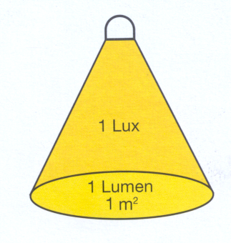
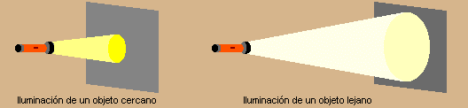
01
Eficiencia Energética en Iluminación
Luminous efficacy: It is the ratio of luminous flux to power (usually electric power)
Unidad: lm/W
Illuminance: Relationship between the luminous flux (lumens) and the area.
Units: lux (lx) = 1lx = 1lm/m²
VISIBLE LIGHT
ELECTRICAL POWER CONSUMED
LOSSES FOR INVISIBLE RADIATION
w
lm
LOSSES
BY HEAT
Notes:
So, apart from the luminous flux, it is important to know the following concept, the luminous efficacy, that is the ratio of luminous flux to power lighting. Lumens divides by Watts. Our intention in energy efficiency is to provide the same lighting level, the same luminous flux or even more than currently, using less electricity, with less electric power. Why do not we use incandescent light bulb? Because more than the 80% of the power are lost, most of the losses are due to the heat losses. So, they produce more energy consumption, and also the increase of the Air conditioning, because you imagine in summer, here in Zaragoza, if you have a room with a certain number of incandescent lights….
Other parameter that you need to know to evaluate the lighting is the area you need to light up.
So there are three important parameters, the lighting power (Watts), the luminous flux (lumens) and the square meters of the area you need to light up.

Slide 6
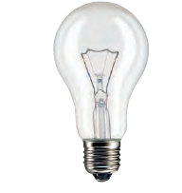
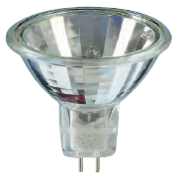
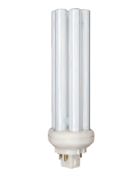
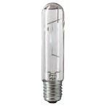
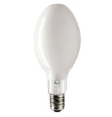
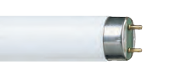
01
Energy Efficiency in lighting
Lamps classification
Ligh emiting diode (LED)
Thermoresistence
Gas discharge
Incandescent
Halogen
Compact Fluorescent
Fluorescent pipe
High-intensity discharge

Slide 7
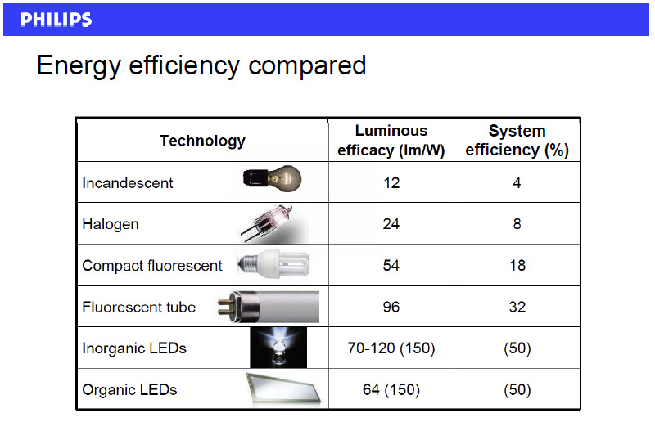
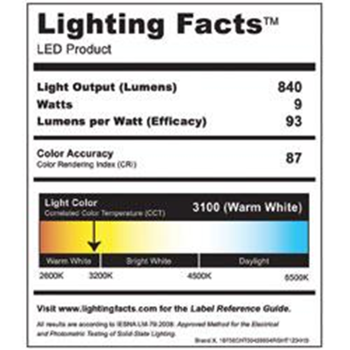
01
Energy Efficiency in lighting
Luminous Efficacy and Luminous Efficiency
Light bulb label
The luminous efficiency is expressed as a value between zero and one.
1 corresponding to an efficacy of 683lm/W
Notes:
As you can see the difference of the efficiency between the different kind of lamps is important, and that is why in all countries in Europe, the use of them is forbidden, or at least in almost all.
The efficacy and efficiency is a different concept, for one hand the luminous efficacy is a number of lumens divided by Watts, and in the other hand the efficiency is a certain percentage.
1 is 683 lm/W and this is the value that conects efficacy and efficiency.

Slide 8
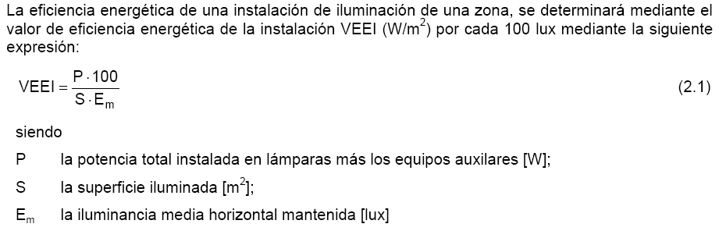
01
Energy Efficiency in lighting
VEEI: Energy Efficiency Value in Lighting systems
The energy efficiency of the lighting system in a particular zone is determined by the VEEI value (W/m2) for each 100 lux.
Ratio of the lighting density in an area.
  P, the total power of light taking into account the auxiliary devices (W)
  S, illuminated surface (m²)
  Em, horizontal average of illuminance (lux)
[W/m²]
Notes:
In Spain, if you design a new lighting system for a building, or you want to modify an existing one, you will have to use this equation which connect all the parameters that you have seen before, power, area, and illuminance o lighting level. So in Spain you have to chose the lighting system that achieves a value below the VEEI established by the regulation. You have to achieve a good ligthing level using the less power as possible.

Slide 9
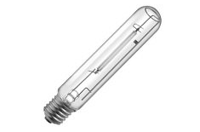
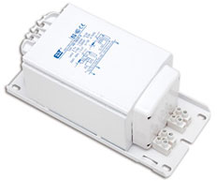
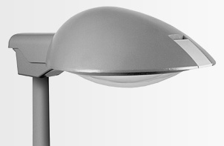
01
Energy Efficiency in lighting
Improvement of installed equipment
Lamps
Ballast or reactance
Luminary

Slide 10
01
Energy Efficiency in lighting
Improvement of installed equipment
Profits:
1.- Power installed is reduced with the same lighting.
  Mercury vapour 250 W → high pressure sodium 150 W
  Mercury vapour 125 W → high pressure sodium 70 W
2.- Lifespan is higher so it reduces the cost to replace lamps.
  Mercury vapour 10.000 h → high pressure sodium 20.000 h

Slide 11
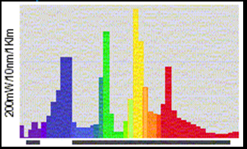
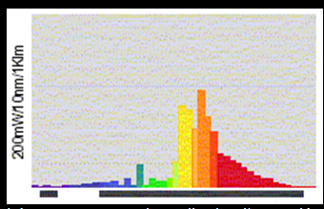
01
Eficiencia Energética en Iluminación
Improvement of installed equipment:
Problems:
1.- The quality of light can be worse because the chromatic index is not the
same and it depends on the lighting type.
    Mercury vapor > 50 high pressure sodium 25
2.- It is necessary to install auxiliary devices.
    Ballast and starter

Slide 12
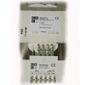
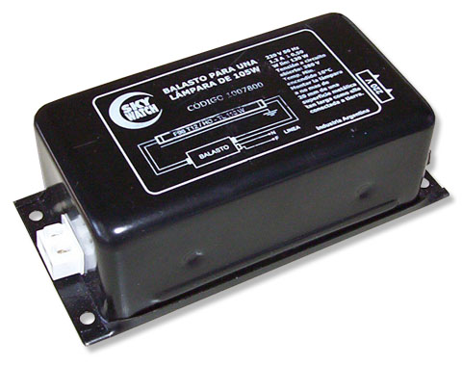
01
Energy Efficiency in lighting
Improvement of installed equipment:
Replacement of the electromagnetic ballast by electronic ones.

Slide 13
01
Energy Efficiency in lighting
Improvement of installed equipment: replace the ballast
Problems:
Operation problems in high temperatures.
Due to there are electronic components in them it is necessary to remove heat to guarantee operation temperatures lower than 70ºC
Improve of installed equipment: replace luminary
Profits:
Improve the energy efficiency in lighting system by means to direct lighting flow to the area that is necessary to be illuminated
With the use of high efficiency reflectors it is possible to decrease the electric power of lamps
It includes systems with IP protection that improve the maintenance operations
Problems
It is necessary to adapt the system (supporter)

Slide 14

01
Energy Efficiency in lighting
Installation of saving devices:
To obtain energy savings in lighting systems it is possible installing equipment that reduce lighting flow and operation hours.
  Lighting flow regulators
  Double level line installation
  Regulated electronic ballast

Slide 15
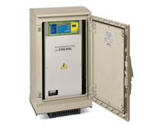
01
Energy Efficiency in lighting
Installation of saving devices: lighting flow balancers
They reduces input voltages in lamps during determinate time. It is possible to achieve energy savings up to 40%.
Lower voltages can change according to different type of installations but, due to the safety conditions it is recommended to discharge lamps following these values:
  Nominal value: 230 V F + N.
  Reduced value in sodium: 184 V F + N.
  Reduced value in mercury: 207 V F + N.
Due to the voltage losses in the line it is not recommended to adjust too much theses values.

Slide 16
01
Energy Efficiency in lighting
Installation of double level ballast in each lamp:
The function is very easy, the system allows to level of lighting and a regulator should to turn on or off each one.
Relay
Double-tier edbalt
Lamp
The energy consumption is very reduced.

Slide 17
01
Energy Efficiency in lighting
Installation of double level ballast in each lamp:
Profits:
  There are very high energy savings.
  It is an economic system, but only in the case of a double level line installation.
Problems:
  It needs a double line level in each light point.
  It reduces power factor, so it is necessary an auxiliary capacitor.
  It needs devices that can switch on and off the line (clock, photocell).

Slide 18
01
Energy Efficiency in lighting
Lighting system with LEDs:
Characteristics:
  Efficiency: very high, around 90 lm/W
  Lifespan: Long (100.000 -50.000 h)
  Cost reduction in operation and maintenance
  Colour: High spectrum of colours
  IRC: high RA = 80
  It is recommended for installations which have too many switches on and off (example → cooling chambers)
Applications:
  Traffic lighting
  Information displays
  Exterior lighting of low power
  All applications for interior lighting (lamps, pipes)

Slide 19
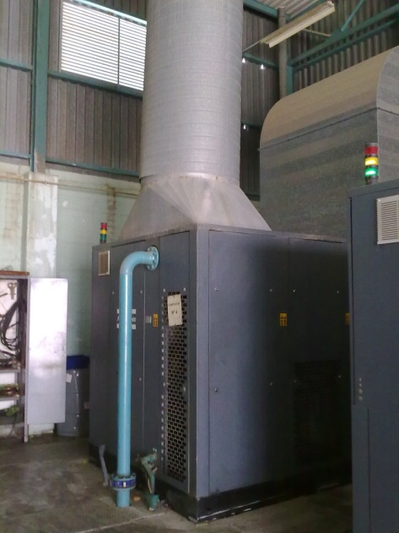
02
Energy Efficiency in compressed air
In standard installation, it is possible that compressed air consumes approximately between 10 % and 20% of electricity consumption. In most of the industrial installations, this is an horizontal installation in relation to the production processes.
No optimized installations waste on average of a 30% of used energy of its life. For this reason, energy savings could be high.
Investment
Maintenance
In LCC analysis, the highest percentage of these systems, is the consumed energy.
80%
Energy

Slide 20
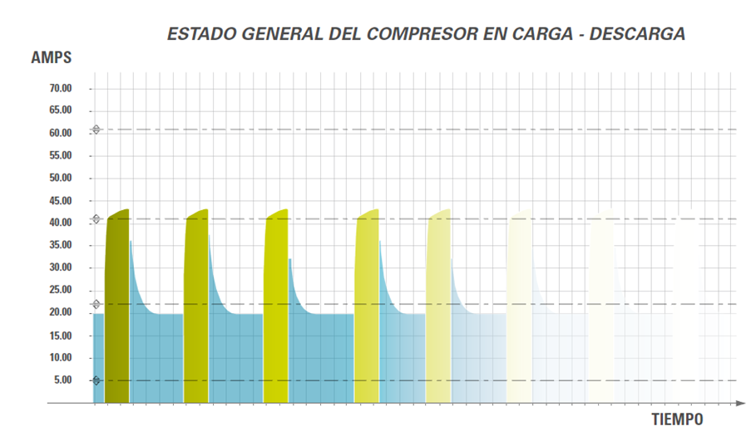
Operation compressor All/Nothing (Loading and unloading)
02
Energy Efficiency in compressed air
General condition of the compressor in loading and unloading
Time
Compressor working
Load. Compressor demands nominal power and injects nominal flow to compressed air circuit.
Unload. Compressor demands between 30 and 20 % of nominal power without injecting compressed air to circuit.

Slide 21
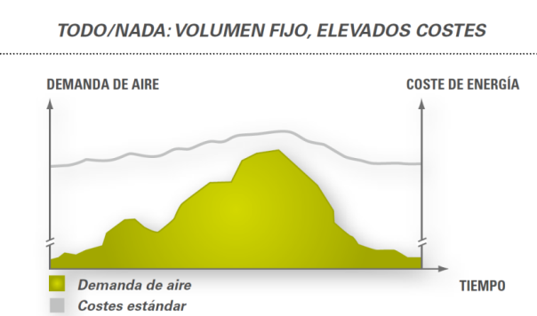
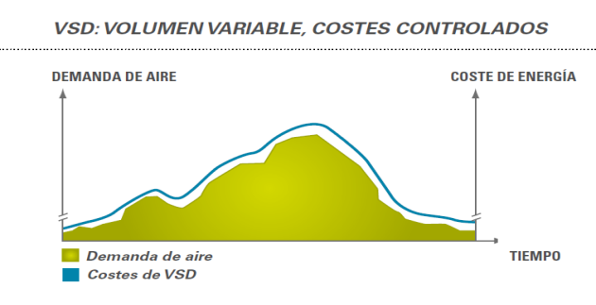
Variable Speed Compressor
02
Energy Efficiency in compressed air
A compressor without variable speed can only control its pressure through loading or unloading.
For this reason, these compressors, in demand periods, consume an average of 30% of energy without producing compressed air.
Proposed Improvement:
Installation of a variable speed compressor will allow controlling periods of the variable demand and reduce the energy consumption.

Slide 22
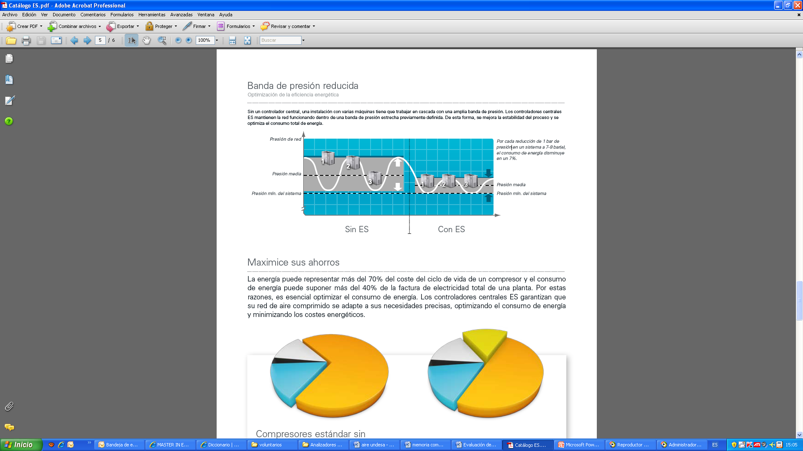
A control System
02
Energy Efficiency in compressed air
An automatic control is very important if there are several compressors in the same installation
Advantages:
Priorities management, giving preference to the most efficient compressors and adapting the work load.
Possibility of programming different points of pressure.
Fix a reduced pressure band. (For each 1bar of pressure reduced in a system of 7-8 bar, the energy consumption decreases 7%).

Slide 23

02
Energy Efficiency in compressed air
Recommendations:
Air Leak detection in compressed air net and creation of a leak control and maintenance plan.
Divide the air compressor net in different areas of production.
Fix adequate working pressure. (a reduction by 20% of pressure produces a reduction by 15% energy consumption in air compressor).
Heat recovery: Removed heat can be recovered producing energy saving.
Notes:
HVAC systems!!!

Slide 24

03
Measurement Devices
Lux Meter
Thermographic camera
U-Value Meter
Combustion Gas Analyser - Flue Gas Analyser
Grid Analyzer

Slide 25
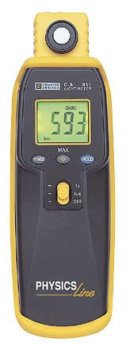
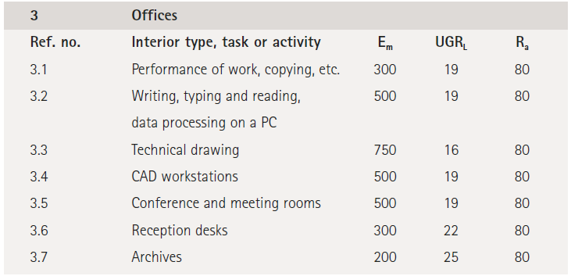
LUX METE
The Lux Meter allows the measurement of luminous flux (lumen) per unit area (m²) that provides a lighting value in lux, the illuminance level.
European Standards exist covering minimum lighting levels depending on the activity.
EN 12464-1 Lighting of work places – Indoor work places
EN 12464-2 Lighting of work places – Outdoor work places
EN 15193 Energy Performance of Buildings – Energy requirements for lighting
EN 12193 Sports lighting level
However, the standards also specify that sometimes “more” is required depending on the situation.
Notes:
EN 12464-1 Lighting of work places – Indoor work places
This European Standard specifies requirements for lighting solutions for most indoor work places and their associated areas in terms of quantity and quality of illumination. In addition recommendations are given for good lighting practice.
This European Standard neither provides specific solutions, nor restricts the designers´ freedom from exploring new techniques nor restricts the use of innovative equipment. The illumination can be provided by daylight, artificial lighting or a combination of both.

Slide 26
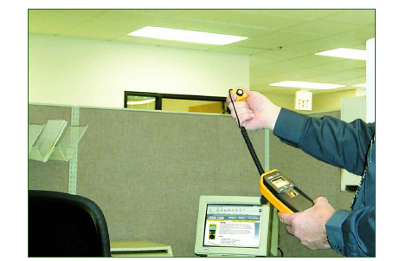
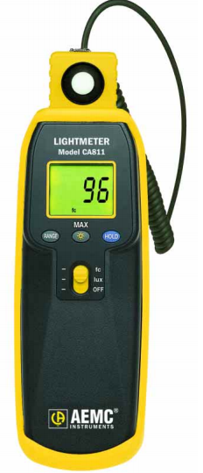
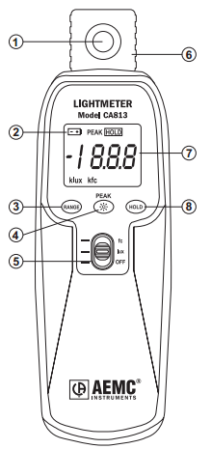
LUX METER
Sensor – Silicon photodiode
Low battery indication
Range selector
Peak function (813) or max function (811)
Measures of foot-candles or lux or off (power selector)
Removable sensor for remote reading
Display
Hold function
The lux meter must be calibrate by an authorised laboratory

Slide 27
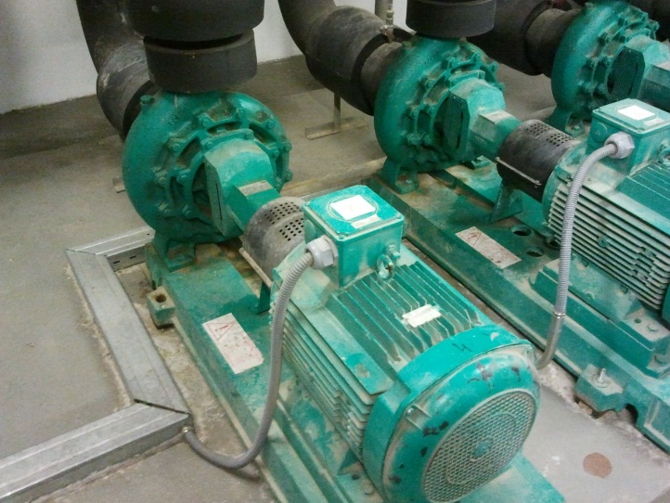
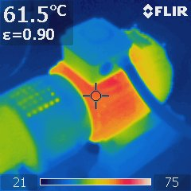
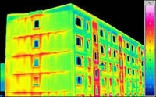
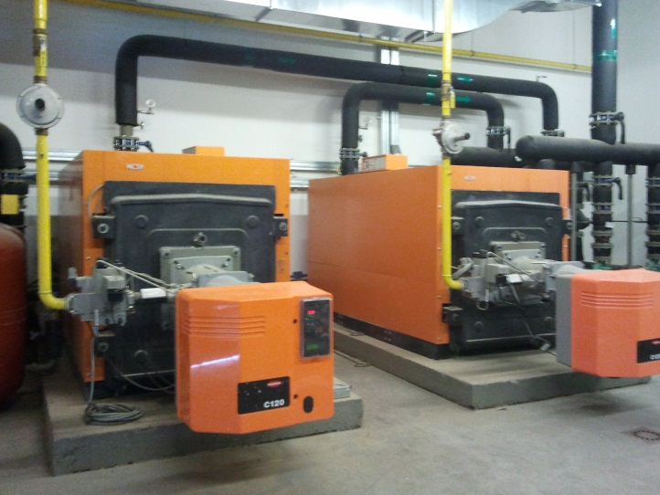
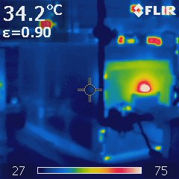
THERMOGRAPHY
Notes:
In energy audits, this equipment is used as a detection equipment. You can also use it to measure and have a more accurate analysis, but in particular cases when you detect a problem. But normally it is used to detect problems through a visual inspection.

Slide 28
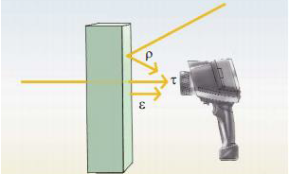
Thermography basis
THERMOGRAPHY
Emission + Reflection + Transmission = TEMPERATURE
Every object whose temperature is higher than absolute zero (0 Kelvin = -273,15ºC), sends out infrared radiation, which is invisible by humans.
In order to know the superficial temperature, is necessary to take into account these parameters:
Emissivity (ε), is the measurement of the capacity, which one material has, to send out (spread) infrared radiation.
Reflection (ρ), is the measurement of the capacity’s object to reflect the infrared radiation. (Polished surfaces reflect much more than those irregulars or the same material without polish).
Transmission (τ), is the measurement of the capacity’s material to transmit the infrared radiation.
Notes:
There are three temperature directions, emission, reflection a transmission.

Slide 29
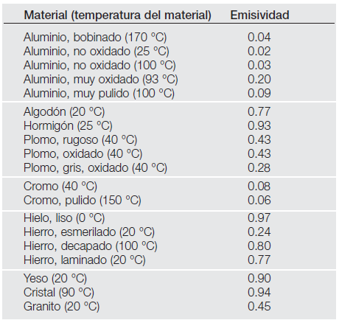
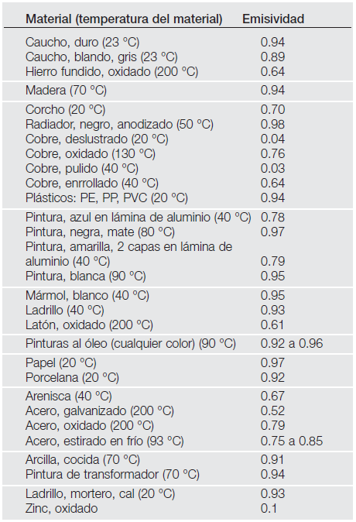
Parameters to configure a thermographic camera
THERMOGRAPHY
The configuration of a thermographic camera is possible depending on the characteristics of the surface. It is necessary to define the emissivity and reflection of the material.
Most of the thermographic camera’s software have included a material data base.
There are also cameras with automatic regulation.
Notes:
Aluminum, concrete, steel, cotton, glass, copper, wood….
In the example that we are going to do now, we are just going to do a visual inspection to detect possible problems in the building envelope, in case we wanted to do a measurement, depending on the construction materials, we should do different measurements in the windows and in the different parts of the wall, because the emissivity is different for each material. Ok? Or if we are doing an energy review in an enterprise, we would have to modify the configuration according to the material, the steel of a motor, plastic of pipes….

Slide 30
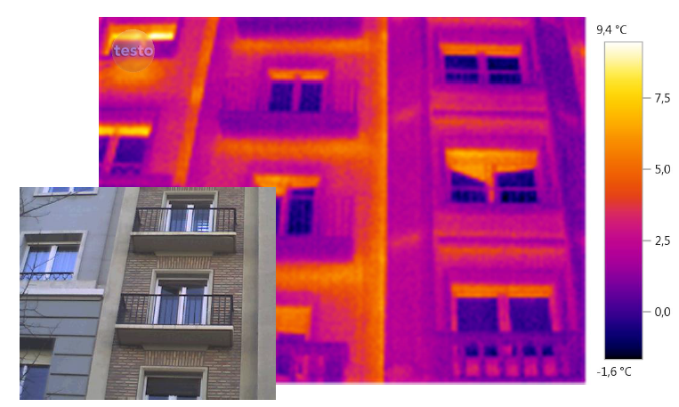
Keep some ideas in mind
THERMOGRAPHY
Adjustable colour scale according to the measurement range
Focusing the camera and fit the measurement distance.
Avoid radiation from the sun, lights, etc. they can provide disturbances.
It is important to take a photograph
Notes:
It is important to take a real photograph to identify the thermografy after the inspection. Try to avoid sun light or lights that can provide disturbances…. You also need to adjust the scale according to the measurement range, it is not the same the temperatures that you measure in a boiler or engine than in a building. The shorter the distance is the better measurement you have.

Slide 31
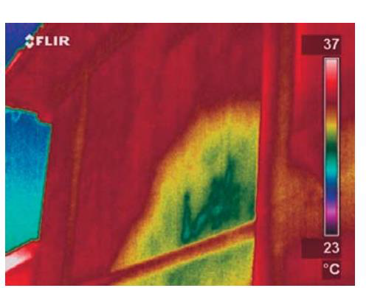
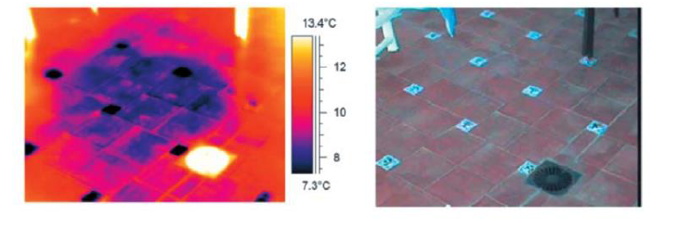
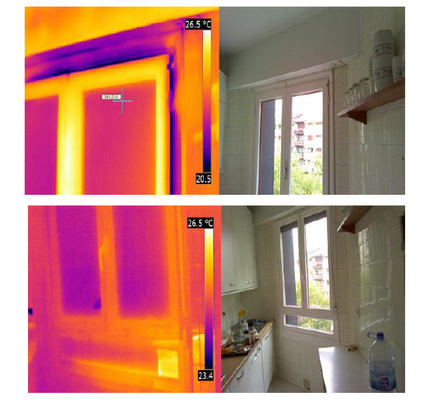
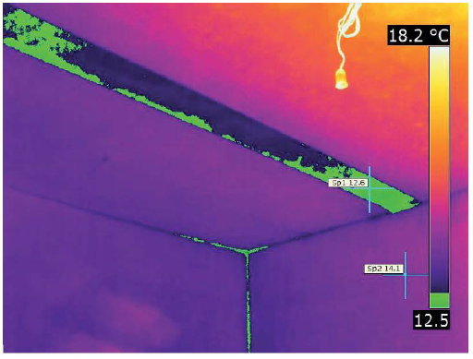
Why thermography is useful?
THERMOGRAPHY
Termites detection
Humidity detection
Condensations
Infiltration detection

Slide 32
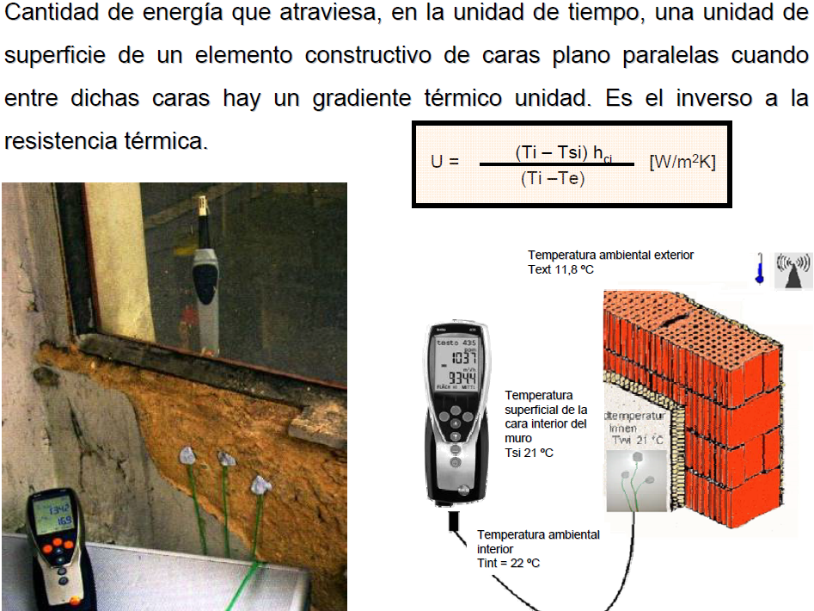
U-THERMAL METER

Slide 33
Thermal transmittance
U-THERMAL METER
The Thermal transmittance or U-Value, is the rate of transfer of heat through one square metre of a structure, divided by the difference in temperature across the structure. W/m²K.

Slide 34
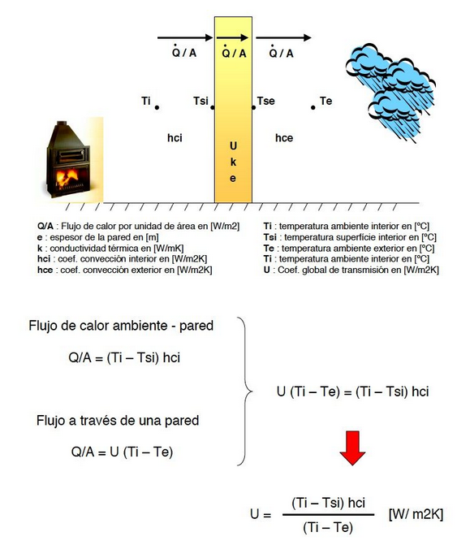
Basis of calculation
U-THERMAL METER
The thermal transmittances of most walls and roofs can be calculated using ISO 6946.
For most ground floors it can be calculated using ISO 13370.
For most windows the thermal transmittance can be calculated using ISO 10077 or ISO 15099.
ISO 9869 describes how to measure the thermal transmittance of a structure experimentally.
Notes:
We can calculate U-Value by hand if we know the different layers that make up a wall and also if we know the thermal characteristics of each material, conductivity and thickness.

Slide 35
Basis of calculation
U-THERMAL METER
Q/A: The rate of heat and surface [W/m²]
e: thickness [m]
k: heat conductivity [W/mK]
hci: indoor convection coefficient [W/m²K]
hce: external convection coefficient [W/m²K]
Ti: indoor temperature [ºC]
Tsi: indoor surface temperature [ºC]
Te: outdoor temperature [ºC]
Tse: outdoor surface temperature [ºC]
U: U-Value of transfer of heat [W/m²K]
Ambient heat flow - wall
Flow through a wall
Notes:
We have a wall, and we have three different heat flux, indoor, through the wall and outdoor. If we want to do the calculation by hand we will need to know the material composition of the wall. If not, we will use a U-Value meter. And the U-value meter uses this equation.

Slide 36
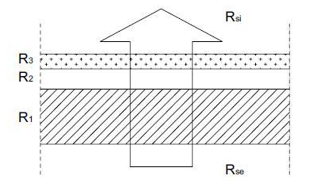
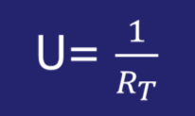
Basis of calculation
U-THERMAL METER
Thermal Resistance:
R_{T} = R_{si} + R₁ + R₂ + ··· +R_{N} + R_{se}
[m²K/W]
R = e (m)/k (W/mK)
Notes:
We have a wall, and we have three different heat flux, indoor, through the wall and outdoor. If we want to do the calculation by hand we will need to know the material composition of the wall. If not, we will use a U-Value meter. And the U-value meter uses this equation.

Slide 37
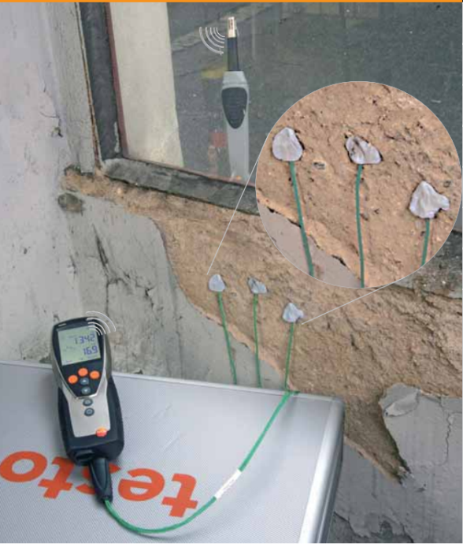
How is the measurement?
U-THERMAL METER
ISO 9869 describes how to measure the thermal transmittance of a roof or a wall by using heat flux meters. These heat flux meters usually consist of thermopiles which provide an electrical signal.
For most wall and roof constructions the heat flux meter needs to monitor heat flows continuously for a period of 72 hours to be conform the ISO 9869 standard.
The external conditions influence:
The difference in temperature between the inside and outside of the building is at least 5°C.
The weather is cloudy rather than sunny
There is good thermal contact between the heat flux meter and the wall or roof being tested.
The monitoring of heat flow and temperatures is carried out over at least 72 hours.
Different spots on a building element are measured or a thermographic camera is used to secure the homogeneity of the building element.
Notes:
The external conditions influence:
The difference in temperature between the inside and outside of the building is at least 5°C.
The weather is cloudy rather than sunny (this makes accurate measurement of temperature easier).
There is good thermal contact between the heat flux meter and the wall or roof being tested.
The monitoring of heat flow and temperatures is carried out over at least 72 hours.
Different spots on a building element are measured or a thermographic camera is used to secure the homogeneity of the building element.

Slide 38

U-Value Meter
U-THERMAL METER
E.g. Testo 635-2 U-value set and thermohygrometer
Wireless measurement data transmission via radio;
Both indoors and outdoors temperature measurements can be carried out simultaneously;
To calculate the U-Value is possible thanks of three sensors or thermopiles in contact with the wall. These sensors measure the indoor conditions;
The U-Value Meter registers all the values and calculates the U-Value;
This equipment measures both temperature and humidity.
Notes:
I’ve brought the equipment that the energy efficiency area has.
The testo 635-2 thermohygrometer then calculates the U-value automatically and indicates this on the display. Thanks to the integrated reading memory, you can store the measurement data in the instrument and subsequently evaluate it on the PC using the software.

Slide 39
U-Value Meter
U-THERMAL METER
Testo 635-2 U-value set and thermohygrometer
The difference in temperature between the inside and outside of the building is at least 15°C;
Measurement in stable zones of the walls; Avoid thermal bridges and unions;
The external surface should be protected from the snow, wind, rain or sun radiation;
Indoor temperature should be constant during the measurement period.
Notes:
North orienation is better than others to do the measurement when all the walls are the same with the same composition of materials.
https://www.youtube.com/watch?v=QJ0bK4HrRp4
https://www.youtube.com/watch?v=I671gfYb9ko

Slide 40
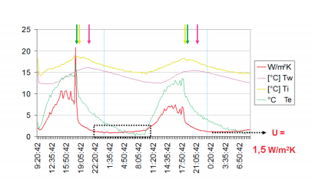
The Results
U-THERMAL MET
It is important to know how to analyse the results, because the value fluctuates a lot during the measurement period.
Notes:
We are going to install our equipment in the wall of this room, but we won’t achieve good results because the measurement time is very short.

Slide 41



Combustion reaction in a boiler
COMBUSTION GAS ANALYZER – FLUE GAS ANALYZER
Notes:
the combustion gas analyzer allow us the measurment of how is the combustion reaction in a boiler. The boiler has a burner where fuel and air react, and the results of this combustion reaction is the heat that is tranfered to provide hot water or stream, flue gasses and sometimes, emission gases. The efficiency depends on the fuel and the combustion reaction.

Slide 42


Energy Efficiency of a Boiler
COMBUSTION GAS ANALYZER – FLUE GAS ANALYZER
To verify the energy performance of a boiler:
Direct Method
Indirect Method: The evaluation of the different losses in a boiler.
Heat loss in flue gases
Bad fuel combustion
Radiant and convection losses
Heat loss in blowdown
Notes:
Direct Method. The parameters you need to calculate the efficiency are the water flow, the specific heat capacity of water, the gap of water temperature between the input and output of the boiler, and the quantity of fuel and its lower or net calorific value. If we want to use this method we need to measure three parameters, the water flow with a flow meter, temperatures with sensors, and also the fuel flow with another flow meter. The result will be a short measurement.
For the other hand, there is another method, the indirect method that evaluates the different losses. Not all the energy of fuel is transformed into hot water, in this case between the 75 and 77%, currently at least in Spain the regulation establishes 90%. So there are four kind of losses. Losses due to heat loss in flue gases, bad fuel combustion, radiant and convection losses and finally heat loss in blowdown (to discharge the possible air in the boiler in case of stream boilers)

Slide 43

Energy Efficiency of a Boiler
COMBUSTION GAS ANALYZER – FLUE GAS ANALYZER
Heat loss in flue gases
Bad fuel combustion
Radiant and convection losses
Heat loss in blowdown
Notes:
Regarding the radiant and convection losses, we apreciate high temperature in the boiler room but also we can detect the problem using a thermographic camera as we have seen before. In this case, rememeber to choose the apropiate material to configure the thermographic camera, because the emissivity have influence in the temperature readings. Obviously this loss have influence in the efficiency, but it is not possible to measure this influence, it is only possible the detection of the problem and provide recommendations. This problem is usually due to the bad state of the boiler’s insulation.

Slide 44

Flue gas analyser
COMBUSTION GAS ANALYZER – FLUE GAS ANALYZER
The combustion efficiency is measured by the combustion gas analyser.
Heat loss in flue gases
Bad fuel combustion
Radiant and convection losses
Heat loss in blowdown
Notes:
If we need to measure the efficiency using the indirect method, we will need the combustion gas analyser, which measure the losses generated by heat loss in flue gases and bad fuel combustion, which are the main losses and have more influence in the efficiency.
To use this equipment, You have to put the sounding line into the chimney, and the equipment take the readings and then it provides you the results.

Slide 45


Flue gas analyser
COMBUSTION GAS ANALYZER – FLUE GAS ANALYZER
Seasonal changes in temperature and barometric pressure can cause the excess air in a boiler fluctuate 5%-10%.
O₂ represents percent oxygen in the flue gas. Excess air measured by sampling the O₂ in the flue gas. If 15% excess air exists, the oxygen analyser would measure the O2 in the excess air and show a 3% measurement.

Slide 46

Flue gas analyser
COMBUSTION GAS ANALYZER – FLUE GAS ANALYZER
e combustion gas analyser, measures, display, store and print combustion efficiency, O2, CO, CO2, along with all of the necessary temperature, draft, and pressure measurements.
Notes:
The efficiency value depends on the concentration of O2, carbon monoxide, carbon dioxide. For example, a low excess air levels can result in high CO.
We have seen a video of a maker
https://www.youtube.com/watch?v=_g47eLn6GHQ

Slide 47

GRID ANALYZER
An analyzer allows you to measure all the necessary: voltage, current and power parameters for a full diagnosis of an electrical installation. It provides you capture and record all the parameters, transients, alarms and wave forms simultaneously to have a complete knowledge of the installation or equipment under study with a simple and easy use.
Notes:
The efficiency value depends on the concentration of O2, carbon monoxide, carbon dioxide. For example, a low excess air levels can result in high CO.
We have seen a video of a maker
https://www.youtube.com/watch?v=_g47eLn6GHQ

Slide 48
GRID ANALYZER
How to switch on the an?
The analyzer has two different kinds of connection:
  Connection to the network: to charge the intern battery of the equipment for being allowed to use it in the field.
  USB connection to PC: to download the information registered from analyzer to the computer.
There are several sorts of sensor you can use depending on what you need to measure:
  You have 4 current inputs where you have to connect the current sensors. The most important ones are:
    Clamp meter for measuring moderate intensity (up to 400 A) in AC, no cables very large section. You have 4 voltage inputs where you have to connect the voltage sensors.
    Amflex for measuring high intensity (up to 6.000 A) in AC, cables of very large section.
    Clamp meter DC: for measuring intensity in direct current.
You have 4 voltage inputs where you have to connect the voltage sensors.
Notes:
The efficiency value depends on the concentration of O2, carbon monoxide, carbon dioxide. For example, a low excess air levels can result in high CO.
We have seen a video of a maker
https://www.youtube.com/watch?v=_g47eLn6GHQ

Slide 49

Grid analyser
GRID ANALYZER
Notes:
The efficiency value depends on the concentration of O2, carbon monoxide, carbon dioxide. For example, a low excess air levels can result in high CO.
We have seen a video of a maker
https://www.youtube.com/watch?v=_g47eLn6GHQ

Slide 50
GRID ANALYZER
Configuration parameters
Notes:
The efficiency value depends on the concentration of O2, carbon monoxide, carbon dioxide. For example, a low excess air levels can result in high CO.
We have seen a video of a maker
https://www.youtube.com/watch?v=_g47eLn6GHQ

Slide 51
Grid analyser
GRID ANALYZER
Within the SETUP Screen you can modify the following basic parameters:
DATE/TIME: Adjust if is necessary the time and the date of the instrument. To know when a certain event happens when you analyze the data in the whole period of measurements.
COLOURS: Select different options about the colour assigned to the power lines in both current and voltage.
ELECTRICAL CONNECTION: This is one of the most important steps. You have to choose the type of electrical configuration you need to make according to the kind of installation you have: a single-phase or triphase voltage measure. The selected option is displayed in bold, if you wanted to change it you´ll have to use the cursors to choose other one.
SENSORS AND RATIOS: After select the configuration of the net of your installation, done in the previous item, you have to select which sensors you have connected to the analyzer.
Notes:
The efficiency value depends on the concentration of O2, carbon monoxide, carbon dioxide. For example, a low excess air levels can result in high CO.
We have seen a video of a maker
https://www.youtube.com/watch?v=_g47eLn6GHQ

Slide 52
GRID ANALYZER
GRAPH” button: You can check the different voltages measure which appear in the right side of the screen. Obviously, if the network configuration was single-phase you’ll only have one value of voltage. In this mode, three types of representations are possible: graphic, table and vector:
  3U: Line voltage
  3V: Phase voltage
  3A: Current
  L1, L2 and L3: The three power lines with all the values measurable.
  N: neuter line
“POWER” button: You can check the power and energy, and check if you have installed in the right direction the current clamp meters, too. There is an arrow drawn in the current clamp indicating the direction in which the clamp should be placed, which is in the current flow. If you had negative values in one or more of the lines, you’ll have to change the direction of the clamp of each line which has negative value.
Notes:
The efficiency value depends on the concentration of O2, carbon monoxide, carbon dioxide. For example, a low excess air levels can result in high CO.
We have seen a video of a maker
https://www.youtube.com/watch?v=_g47eLn6GHQ

Slide 53

GRID ANALYZER
Saved data:
To save de data you have just recorded is necessary, or to switch off the analyzer or to wait for the recording is finished. Before consider finished the process, restart the machine and check that the recording is actually made.
Notes:
The efficiency value depends on the concentration of O2, carbon monoxide, carbon dioxide. For example, a low excess air levels can result in high CO.
We have seen a video of a maker
https://www.youtube.com/watch?v=_g47eLn6GHQ

Slide 54
GRID ANALYZER
1º STEP: Identify process, systems, and equipment.
2º STEP: Do an inventory of electric equipment and thermal equipment
Electric equipment:
Identify the equipment and the associated process (pumping, ventilation, drives…)
  Engines
  Lighting
  Heat pump
  Chiller
  Cold compressor
  Evaporators, condenser
Identify the electric characteristics: Power, demand current, voltage, power factor, operation regime.
To know how many hours operate ?
Load Factor
Maintenance program
Consumption if it is possible (meter or grid analyzer)
Notes:
The efficiency value depends on the concentration of O2, carbon monoxide, carbon dioxide. For example, a low excess air levels can result in high CO.
We have seen a video of a maker
https://www.youtube.com/watch?v=_g47eLn6GHQ

Slide 55
GRID ANALYZER
Thermal equipment:
Identify the equipment and the associated process
  Boilers
  Dryers
  Burners
Identify the thermal characteristics: Power, demand , kind combustible, exhausted gas temperatures,
To know how many hours operate?
Load Factor
Maintenance program
Consumption if it is possible (meter and flue combustion analyzer)
Notes:
The efficiency value depends on the concentration of O2, carbon monoxide, carbon dioxide. For example, a low excess air levels can result in high CO.
We have seen a video of a maker
https://www.youtube.com/watch?v=_g47eLn6GHQ

Slide 56

Thanks For Your Attention!
Inmaculada Fraj
Gema Millán
ifraj@fcirce.es
gmillan@fcirce.es
This project has received funding from the European Union’s H2020 Coordination Support Action under Grant Agreement No.785047.

Slide 57
Towards a sustainable agro-food industry. Capacity building programmes in energy efficiency.

