Slide 1
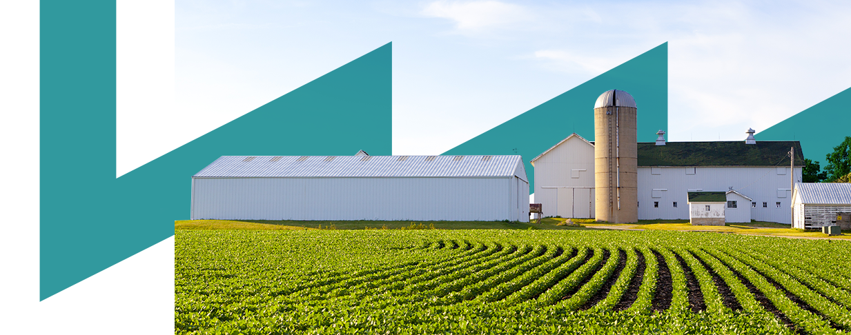











Energy Efficiency in
Thermal processes
Gema Millán
Inmaculada Fraj
Towards a Sustainable Agro-Food Industry
Capacity Building Programmes in Energy Efficiency
This project has received funding from the European Union’s H2020 Coordination Support Action under Grant Agreement No.785047.

Slide 2
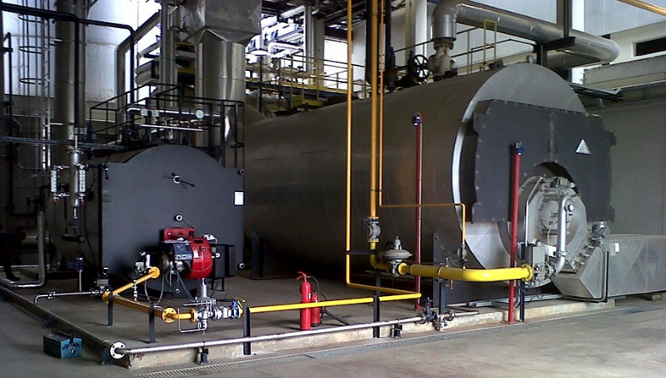
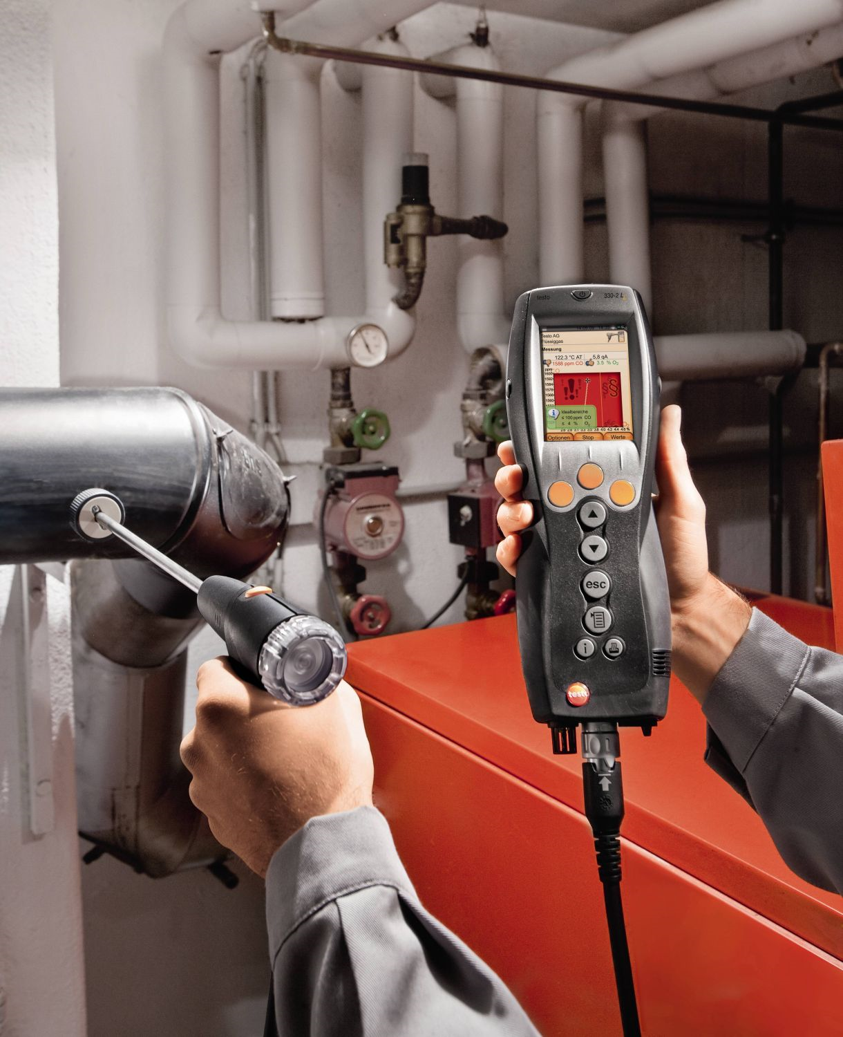
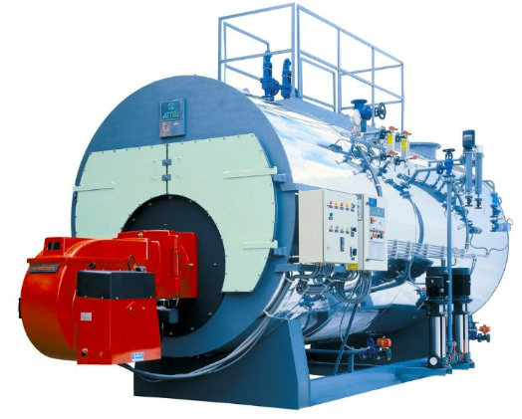
Energy Efficiency in boilers
Energy Efficiency in dryers
CONTENTS
01
02

Slide 3

01
Energy Efficiency in Boilers

Slide 4
01
Energy Efficiency in Boilers
Different types of boilers can be classified by the following characteristics:
Type of combustion chamber
Type of heat exchanger device
Efficiency rate
Type of fuel
atmospheric pressure
watertight or airtight
water pipe
gas pipe
Conventional
Low temperature
Condensation
Solid fuels: biomass or coal
Liquid fuels: fueloil or diesel
Gaseous fuels: natural gas, propane, butane

Slide 5
01
Energy Efficiency in Boilers
Analyzing the combustion chamber, these are the main differences between both type of boilers:
In steam boilers: - Aquotubular - Pyrotubular | atmospheric | watertight or airtight
Description | - The combustion chamber is opened. - The air, that is necessary for the combustion, is taken from the space where the boiler is installed. | - The combustion chamber is watertight and airtight. - The air is obtained by means of a concentric pipe located in the top. - These pipe are also used to expel flue gases.
Security | - These boilers are less safe. - The combustion chamber is not insulated. | - These boilers are safer
Legislation | Since 1st January 2010 the installation of these boilers is forbidden in European Countries.

Slide 6
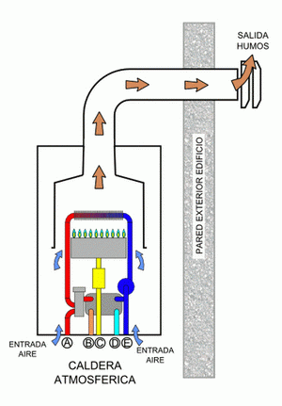
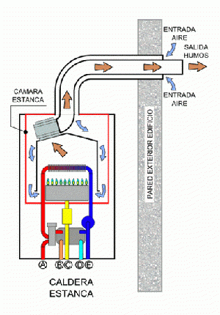
01
Energy Efficiency in Boilers
Analyzing the combustion chamber these are the main differences in boilers:
watertight and airtight
atmospheric
Notes:
The atmospheric boilers take the air for the combustion from the same place where are installed, and the airtight boiler takes the air from outside, there is an extractor that forces air inlet and outlet.

Slide 7
01
Energy Efficiency in Boilers
Analyzing the way to exchange heat, there are the following types:
Water pipe
Gas pipe
The fluid to be heated flows through several pipes that surround the combustion chamber.
Exhaust gases flow through a grid of pipes that are in direct contact with the flow of water.

Slide 8
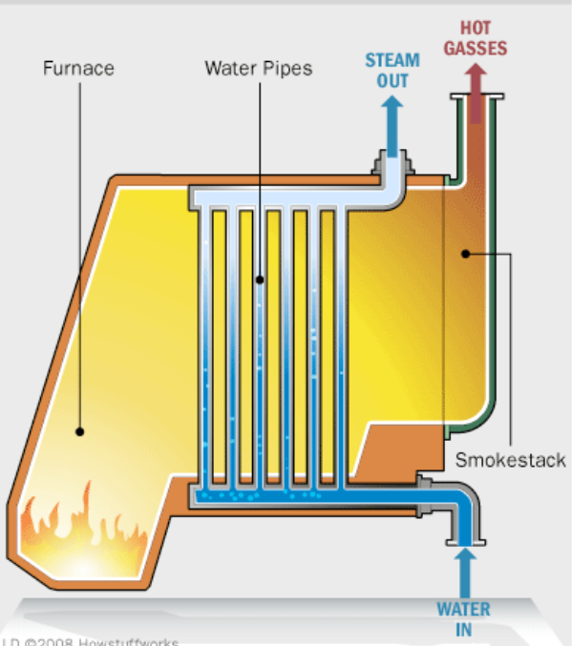
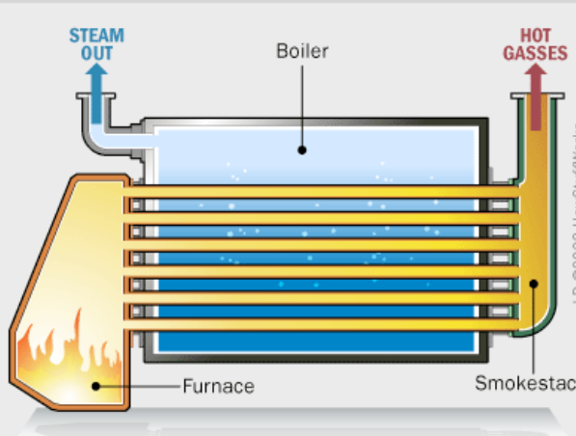
01
Energy Efficiency in Boilers
Analyzing the way to exchange heat, there are the following types:
Water pipe
Gas pipe

Slide 9
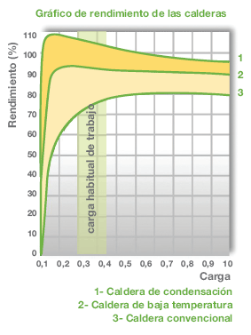
01
Energy Efficiency in Boilers
Analyzing the type of efficiency
European Directive 92/42 CEE classify boilers according to the minimum temperature boilers can operate and the efficiency.
Standard (3): are commonly use to produce hot water at a constant temperature from 70ºC to 90ºC
Low temperature (2): the return water temperature is from 35ºC to 40ºC. The lower the temperature, the higher the efficiency.
Condensation (1): they are designed to condense water vapor found in the exhaust gases. It takes advantage of the heat of condensation.
Type of boiler | Fuel safe (%)
Standard | ---
Low temperature | 8-10%
Condensation | 18-20%

Slide 10
01
Energy Efficiency in Boilers
Analyzing the type of efficiency
 | Standard | Low temperature | Condensation
Fuel type | Diesel, propane, natural gas | Diesel, propane, natural gas | Only natural gas
Characteristics | It operates at high temperatures | Input water temperature is lower than in a standard | It condensates the water from the exhaust gases
Efficiency | 80-85% | 90-95% | 100-105%
Energy savings |  | Aprox. 15% | Aprox. 25%

Slide 11
01
Energy Efficiency in Boilers
Low temperature boilers
The return temperature is from 35ºC to 40ºC,
These boilers can adjust the operation temperature according to the demand,
With respect to the standard boilers, the savings can be reached 15 %.
Condensing boilers
Is similar to a low temperature boiler but it is prepared to condense most of the water contained in the flue gases (water also has energy and this quantity is very high in the process of condensation),
It can only run on natural gas because it has no sulfur in exhaust gas,
These are the most efficient with values higher than 100 % in case the condensation energy is used.

Slide 12
01
Energy Efficiency in Boilers
Some concepts about condensation boilers:
What is the energy of the water?
The specific heat of water at atmospheric pressure is: 4.18 kJ/kg ºC
This means that is necessary 4.18 kJ to increase
1ºC a quantity of 1 kg of water
However, the latent heat of vaporization is defined as the amount of heat that is required to pass from the liquid phase to the vapor at a constant temperature at the point of phase change.
At this point, the water at atmospheric pressure needs 2257 kJ/kg to increase only 1ºC. In the case of changing steam to liquid, the steam gives 2257 kJ/kg, so the boilers that can use this energy are very efficient.

Slide 13
01
Energy Efficiency in Boilers
analyzing fuels: (lower calorific value and CO₂ emissions)
Natural gas = 9.545 kcal/kg
Olive pomace = 4.282 kcal/kg
Petrol = 10.514 kcal/kg
Propane = 11.082 kcal/kg
Grape pomace = 4.575 kcal/kg
Diesel = 10.200 kcal/kg
Butane = 10.938 kcal/kg
Pellet = 4,357 kcal/kg
Querosene = 10.382 kcal/kg
CO₂ emissions in several fuels
Natural gas = 2,15 kgCO₂/Nm₃
Petrol = 2,38 kgCO₂/l
Propane = 2,94 kgCO₂/kg
Diesel = 2,79 kgCO₂/l
Butane = 2,96 kgCO₂/kg
Biomass = 0 kgCO₂/kg

Slide 14
01
Energy Efficiency in Boilers
In the combustion process, the following characteristics take part:
1.- The most used fuels are the organic materials that are formed mainly by Carbon and Hydrogen,
2.- The higher the proportion of hydrogen, the cleaner the combustion will be and the higher the calorific value of the fuel,
3.- The better the mixture between fuel and oxygen, the more efficient combustion will be.
The most important chemical reactions that take place in the combustion are the following:
C + O₂ → CO₂ + 32,8 MJ/kg
H₂ + ½ O₂ → H₂O + 142 MJ/kg
S + O₂ → SO₂ + 165 MJ/kg

Slide 15
01
Energy Efficiency in Boilers
Operation flow scheme of a boiler
Fuel
Exhaust gases
air
boiler
air
Hot water or steam
Cold water

Slide 16
01
Energy Efficiency in Boilers
In the operation of a boiler there are two independent circuits: one from water and other for gases.
burner
Hot water
Cool water
gases output
fuel input
Gas circuit

Slide 17
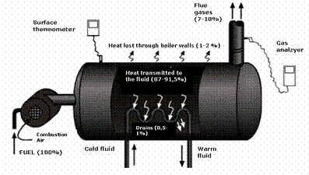
01
Energy Efficiency in Boilers
Performance evaluation of a boiler
The heat that can be obtained in a combustion corresponds to the calorific value of the fuel (and also to the water content in the air in the case of condensing boilers).
When combustion takes place, part of the heat is lost through the boiler and the exhaust gases.

Slide 18

01
Energy Efficiency in Boilers
Evaluation of the performance of a boiler
Performance (%) = 100 - losses
The main losses are:
Heat losses in combustion gases
Losses because the fuel is not completely burned
Radiation losses
Heat losses due to air existence in the water circuit

Slide 19

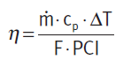
01
Energy Efficiency in Boilers
Performance evaluation of a boiler
Case 1: heating boiler
By means of this procedure, it is necessary to measure the water flow rate inside the boiler, its input and output temperatures and fuel consumption.
η = performance
m = water flow (kg/s)
Cp = specific heat capacity of water (kJ/kgºC)
ΔT = T out – T in
F = fuel consumption (Nm³/s)
PCI = fuel lower heat power (kJ/Mm³)

Slide 20
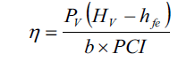
01
Eficiencia energética en calderas
Performance evaluation of a boiler
Case 2: steam boiler
In this case the boiler produces a flow of steam, so that its pressure or temperature, the input temperature and the fuel consumption influence the performance
η = performance
Pv = steam production (kg/h)
Hv = steam enthalpy (kJ/kg)
Hfe = input enthalpy to the fluid (kJ/kg)
b = fuel flow input (kg/h or Nm³/h)
PCI = lower calorific value of fuel (kJ/Nm³)

Slide 21
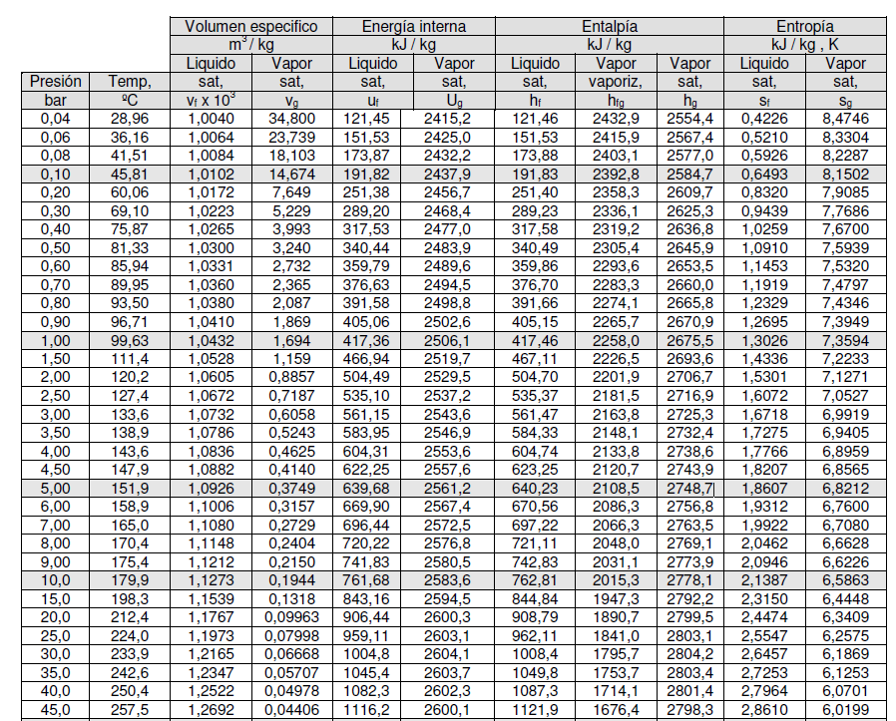
01
Energy Efficiency in Boilers
The thermodynamic properties of water depends on the state.
This state can be defined from temperature and pressure.
The enthalpy depends on the thermodynamic state and therefore influences the production of heat.
Water steam at 1 bar and 99,63 ºC → steam enthalpy = 2675 kJ/kg
Water steam at 7 bar and 165 ºC → steam enthalpy = 2763,5 kJ/kg

Slide 22
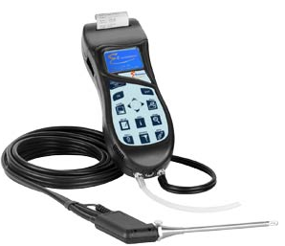
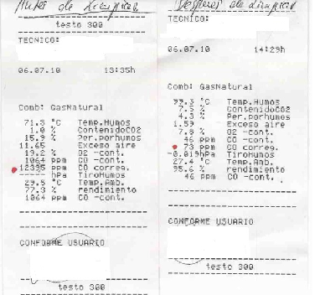

01
Energy Efficiency in Boilers
Determine the performance of a boiler
$$Performance (\%) = 100 - losses$$
The gas analyzer measures the energy efficiency and the quality of the exhaust
heat loss in the exhaust gas
losses for fuel that has not been burned

Slide 23
01
Energy Efficiency in Boilers
What parameters can be measured with the gases analyzer?
Oxygen (O₂)
The oxygen that has not been used in the combustion is due to the fact that in the reaction there is an excess of oxygen and, therefore, it is expelled through the exhaust gases.
Oxygen measurement provides very useful information about combustion performance.
Typical values of oxygen concentration in the exhaust gases:
  Diesel boiler = 2 % - 5 %
  Natural gas boiler = 2 % - 6 %

Slide 24
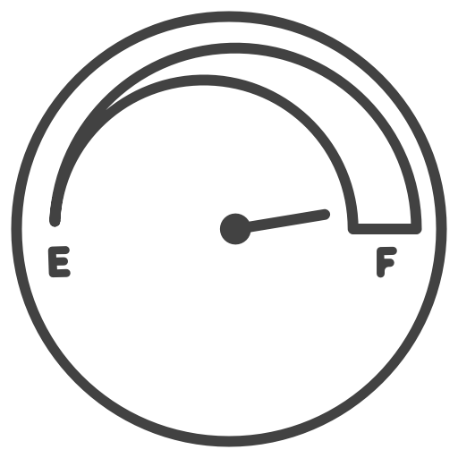
01
Eficiencia energética en calderas
What parameters can be measured with the gases analyzer?
Carbon monoxide (CO)
Carbon monoxide is a toxic gas, it is also odorless and invisible and is produced as a result of incomplete combustion.
Typical values of CO concentration in the exhaust gases:
  Diesel boiler = 80 – 150 ppm
  Natural gas boiler = 80 – 100 ppm

Slide 25
01
Energy Efficiency in Boilers
What parameters can be measured with the gases analyzer?
Temperature of flue gases:
A high temperature of the exhaust gases can be as a consequence of:
Too much air velocity at the entrance, which makes the contact time of the gases with the surfaces of the heat exchanger difficult,
Dirt on the surfaces of the heat exchanger that makes heat exchange difficult,
Incorrect operation of the burner
Poor boiler design, inadequate way of expelling fumes
Typical values are: temperature of the flue gases < fluid temperature + 65ºC
1
2
3
4

Slide 26
01
Energy Efficiency in Boilers
What parameters can be measured with the gases analyzer?
Excess of air
The amount of stoichiometric oxygen (minimum value) is not enough to make a complete combustion, because the mixture of fuel and oxygen is not perfect. Therefore, it is necessary to provide more combustion air.
This additional amount of air is known as “excess air”, the ratio of the actual amount of air to the stoichiometric amount needed is known as the excess air coefficient (λ).
The highest combustion efficiency is obtained when there is a minimum “excess air” because it is necessary to heat less air mass.
A high excess of air reduces the temperature of combustion and needs more energy from the fuels because there is more volume of gas.
However, an adequate excess of aire is necessary, because if the excess of air is too low, there will be a deficient performance in the use of fuel and there will be more unburned fuel in the exhaust gases with the associated negative environmental impact.

Slide 27
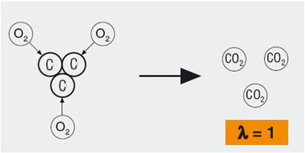
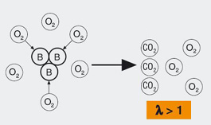
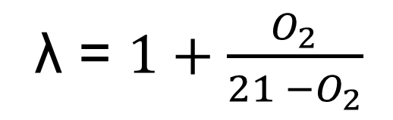
01
Energy Efficiency in Boilers
What parameters can be measured with the gases analyzer?
Excess of air
a) The excess of air can be directly measured with the gas analyzer
b) The excess of air can be calculated following an equation
λ = $1+\frac{O_{2}}{21 −O_{2}}$
Percentage of oxygen in the fumes.
Percentage oxygen in the air.

Slide 28
01
Energy Efficiency in Boilers
What parameters can be measured with the gas analyzer?
Analyze values | Cause | Solution
High CO level Low O₂ level | Cause | Solution
Low CO₂ level High O₂ level | Insufficient air is introduced into the boiler | Increase the air flow that crosses the burner
Low CO₂ level High O₂ level | Excess air | Reduce airflow through the intake valve to the burner
High CO level High O₂ level | Inadequate mix air – fuel | Clean the burner injector
Walls temperatures > room temperature | Old boiler with insufficient isolation | Replace insulation
Exhaust gases temperature > 230 ºC | Inadequate heat exchanger | Clean the inner of the boiler

Slide 29

01
Energy Efficiency in Boilers
Heat losses in the combustion gases:
Losses = fumes flow (kg/Nm3comb) x (fumes enthalpy (kcal/kg fumes)

Slide 30
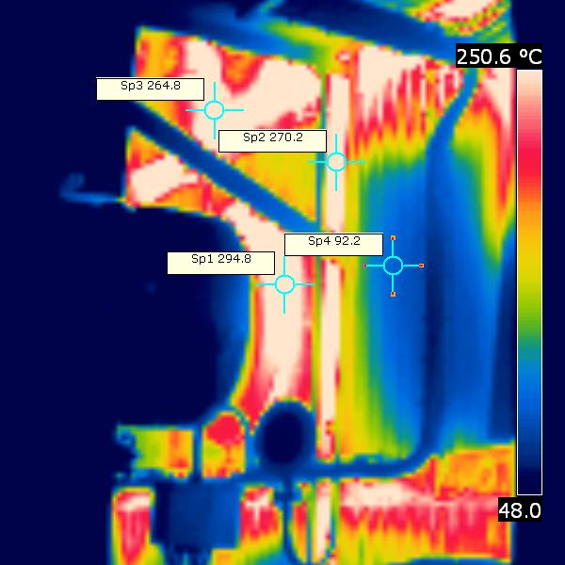
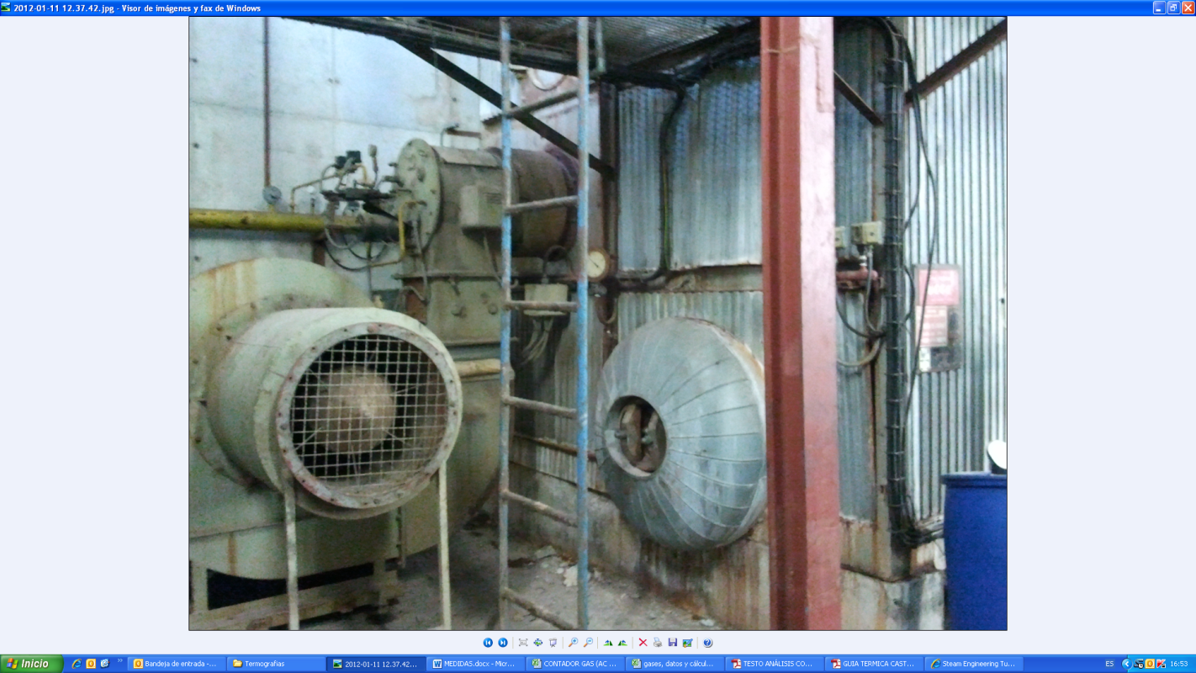
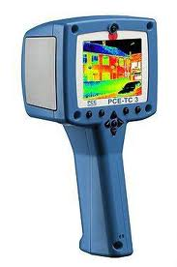
01
Energy Efficiency in Boilers
These losses are very easy to detect, but it is difficult to determine how much heat is lost.
Radiation losses:

Slide 31
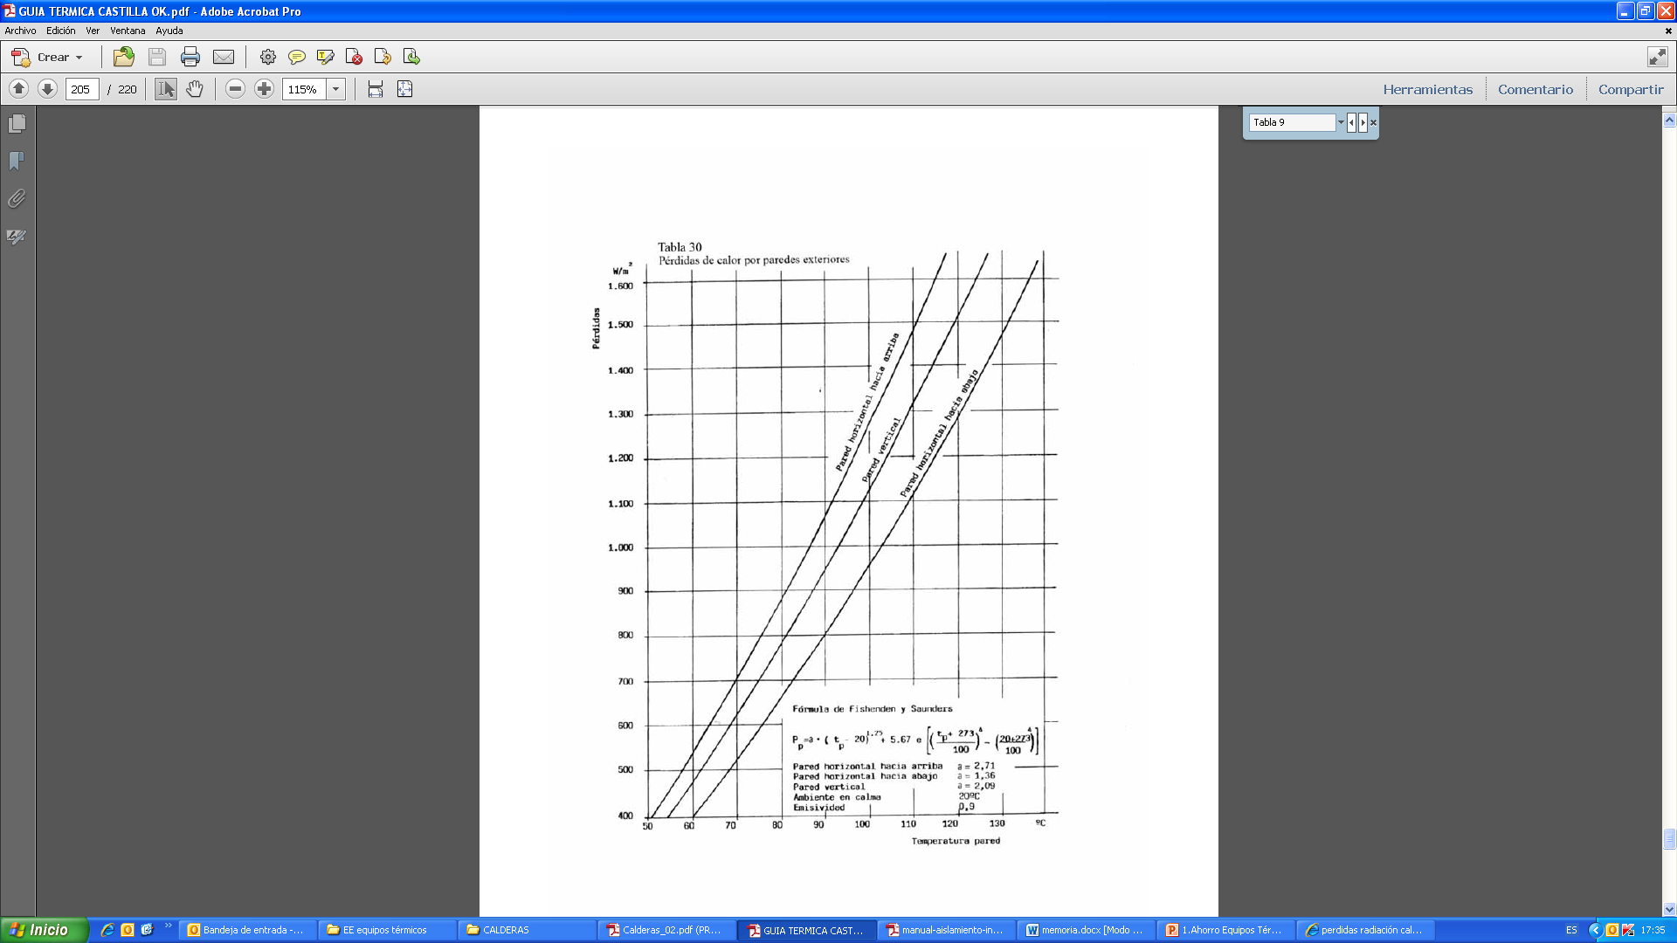
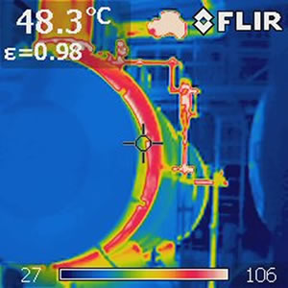
01
Energy Efficiency in Boilers
Radiation losses:
Pérdidas por radicación (w/m²)
Diferencia de temperatura (interior - exterior)

Slide 32

01
Energy Efficiency in Boilers
Measures that can be taken to improve energy efficiency in boilers:
  Regulation of combustion
  Flue gas heat recovery
  Insulation of pipes
  Condensate heat recovery
  Heat recovery from boiler purges
1
2
3
4
5

Slide 33
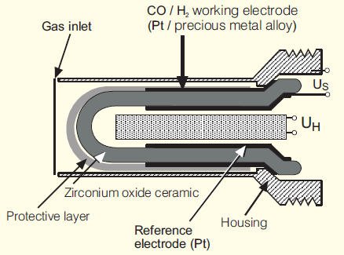
01
Energy Efficiency in Boilers
Regulation of combustion:
It is the control of the air/fuel mixture, it is crucial to obtain a high performance in the boiler. It is necessary to have enough air for a total combustion, but being careful, because too much air will produce losses.
The optimum amount of excess air changes according to the operation conditions so it is necessary to have an automatic regulation.
1
Regulation controlling O₂
Regulation controlling CO/H₂
Through the lambda sensor:
In 15 sec it adjusts the air excess.
This sensor analyzes the exhaust gases and adjusts excess air through the air intake to the burner.
It affects the fuel and air mixture by controlling the CO₂

Slide 34
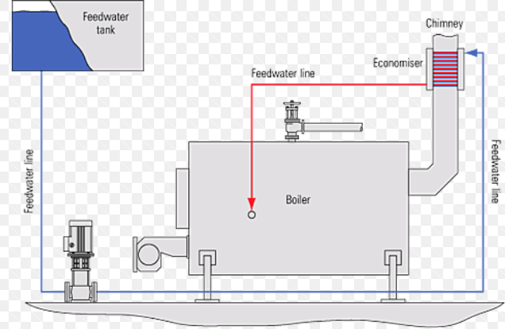
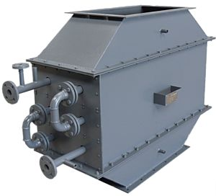
01
Energy Efficiency in Boilers
2
Flue gas heat recovery - economizer:
One of the most used devices to increase the performance is to preheat the incoming water by means of an “economizer”.
Its function is to use the temperature of the exhaust gases to preheat the incoming water, saving the energy needed to heat this amount of water and reduce losses.
It is not possible to reduce as much as we want the temperature of the exhaust gases because problems can occur due to corrosion in case of condensation as a consequence of the sulfur content in the fuel.

Slide 35
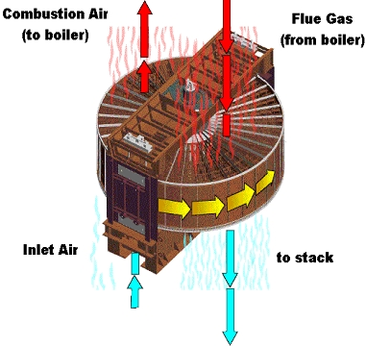
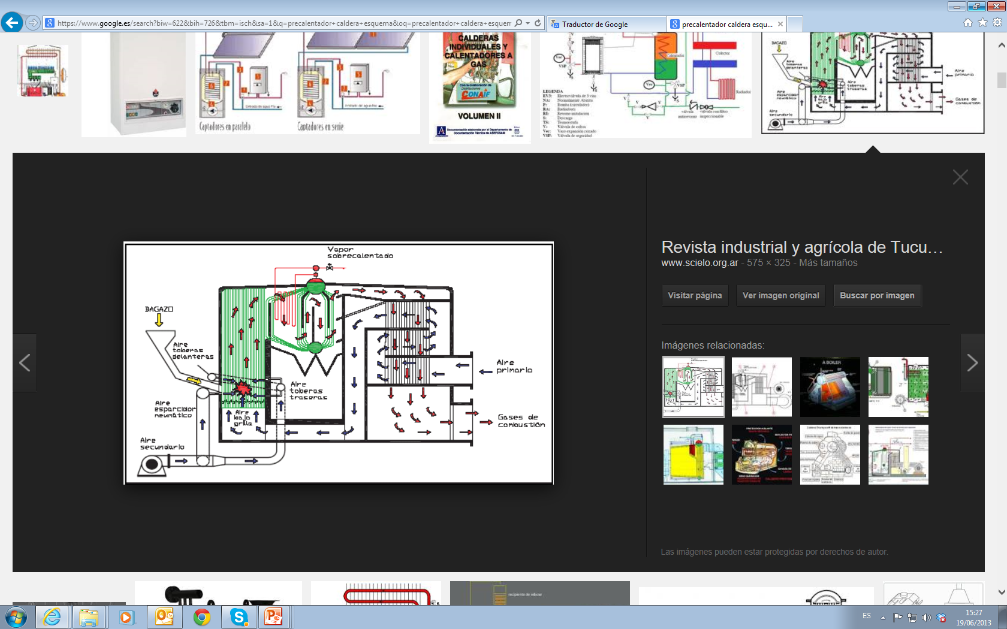
01
Eficiencia energética en calderas
Recovery of heat from exhaust gases - preheater:
The air flowing to carry out the combustion is preheated, so in this case the water in the boiler circuit is not heated, the air used for combustion is heated.
More heat exchange surface is needed.
2

Slide 36
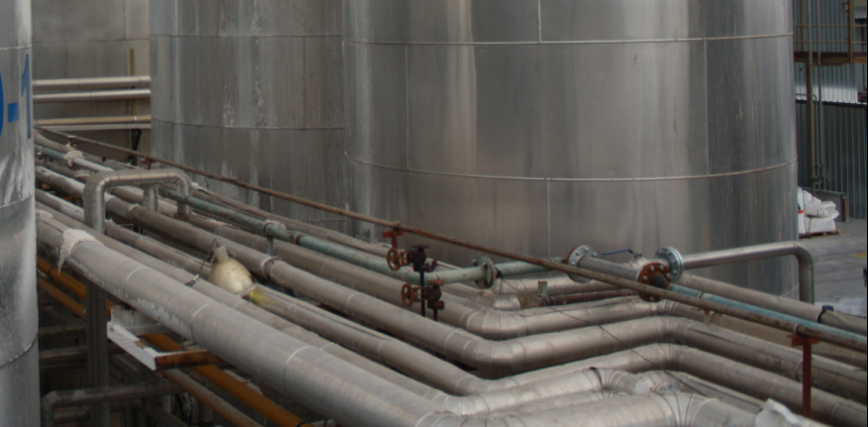
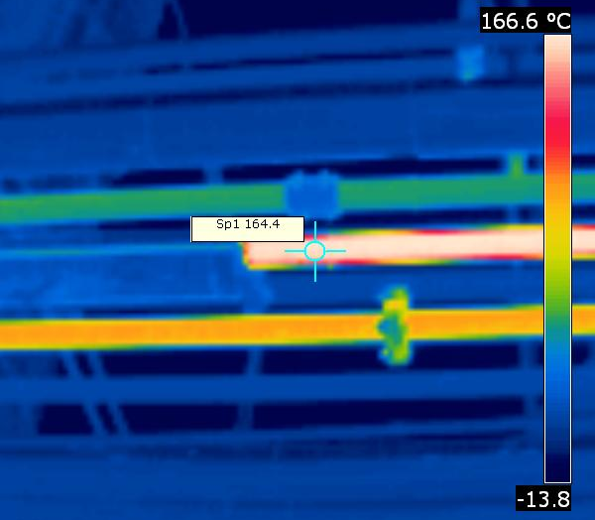
01
Energy Efficiency in Boilers
3
Pipes isolation:

Slide 37
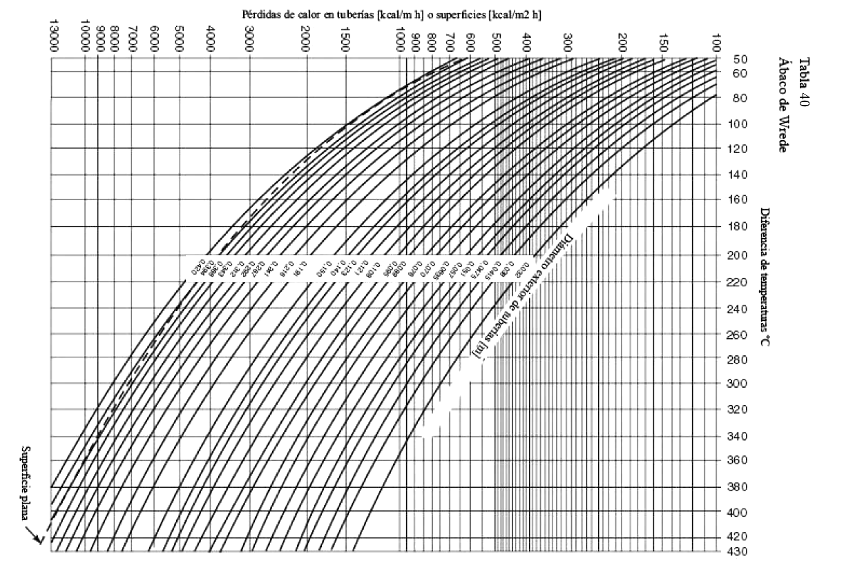
01
Energy Efficiency in Boilers
3
Pipes isolation:
It is possible to detect problems through thermographies, but it is difficult to obtain an exact value of the losses.

Slide 38
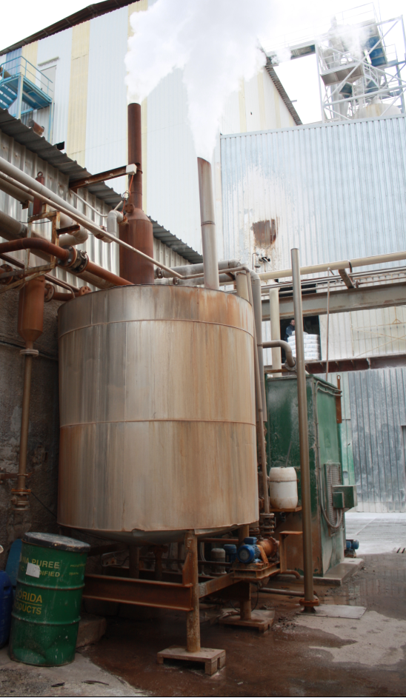
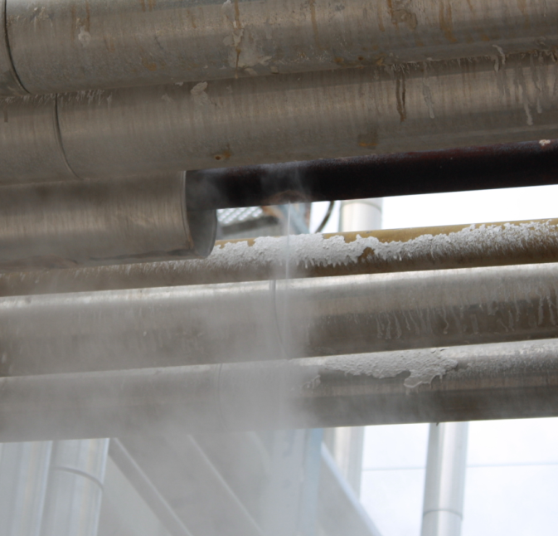
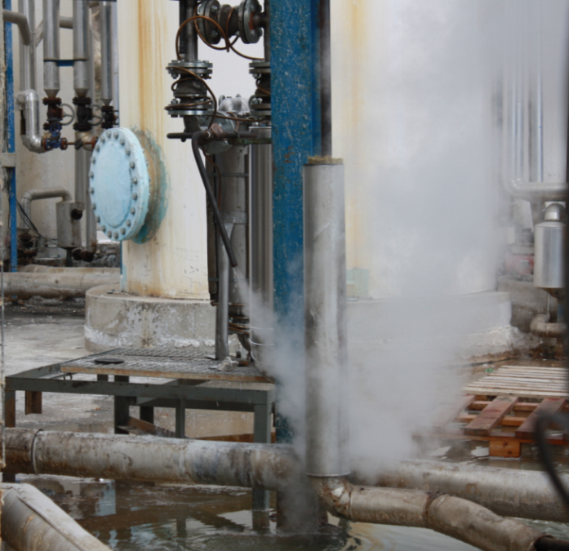
01
Energy Efficiency in Boilers
4
Condensate heat recovery:
For every kg of condensate that does not return to the inlet tank, it must be replaced with a new 1 kg of water at room temperature, which must be heated again with energy.

Slide 39
01
Energy Efficiency in Boilers
4
Condensate heat recovery:
EXAMPLE-.
Calculation of savings by recovering 1000 kg/h of condensate from the purges at 4bar.
Information:
A- Condensate pressure | 4 bar
B- Enthalpy of the condensate | 605 kJ/kg
C- Energy losses in the return | 20%
D- Enthalpy of the contribution water to the boiler (20ºC) | 84 kJ/kg
E- Condensate flow | 1.000 kg/h
F- Fuel cost | 0,03 €/kWh
G- Water cost and treatment | 0,80 €/m³
H- Hours of operation | 4.000 h/year
I- Boiler performance | 90%
Calculations:
J- Recovered Energy: ((B x 0,80)-D) x E x H | 1.600.000.000 kJ/year
K- Energy saving: (J/I) / 3.600 kJ/kWh | 493.800 kWh/year
M- Energy and economic savings (K x F) | 14.800 €/year
N- Water cost savings and treatment (E/1.000) x G x H | 3.200 €/year
TOTAL SAVINGS: M + N | 18.000 €/year

Slide 40
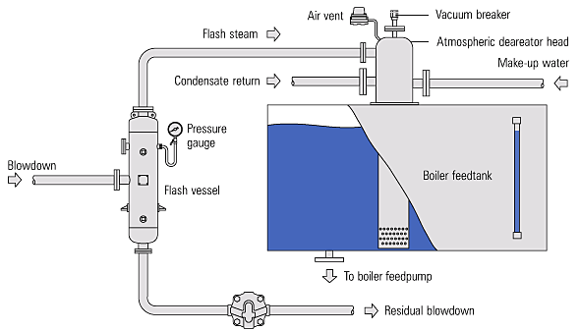
01
Energy Efficiency in Boilers
  Heat recovery from boiler purges:
5
BOILER

Slide 41
01
Eficiencia energética en calderas
  Heat recovery from boiler purges:
5
EXAMPLE.
For a boiler that produces steam at 15 bar, it is proposed to take advantage of the purges (662 kg/h) in a flash tank at 1,5 bar. Calculate the kg/h that would be produced by flash steam.
Entalpía 15 b = 845 kJ/kg
BOILER
15 bar
Entalpía 1,5 b = 467 kJ/kg
1,5 bar
Excess enthalpy (845 - 467) = 336 kJ/kg → partial vaporization
How much flash vapor? Excess enthalpy / Enthalpy vaporization water 1,5b · 100 = 336/2226,5 ·100 = 15% → 0,15 · 662kg/h = 100kg/h
How much energy does it contain? 100kg/h · 2693,6kJ/kg (steam enthalpy 1,5b) = 269.360 kJ/h

Slide 42
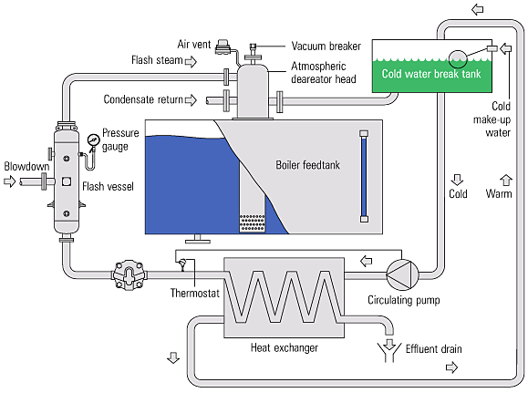
01
Energy Efficiency in Boilers
  Heat recovery from boiler purges:
5
BOILER

Slide 43
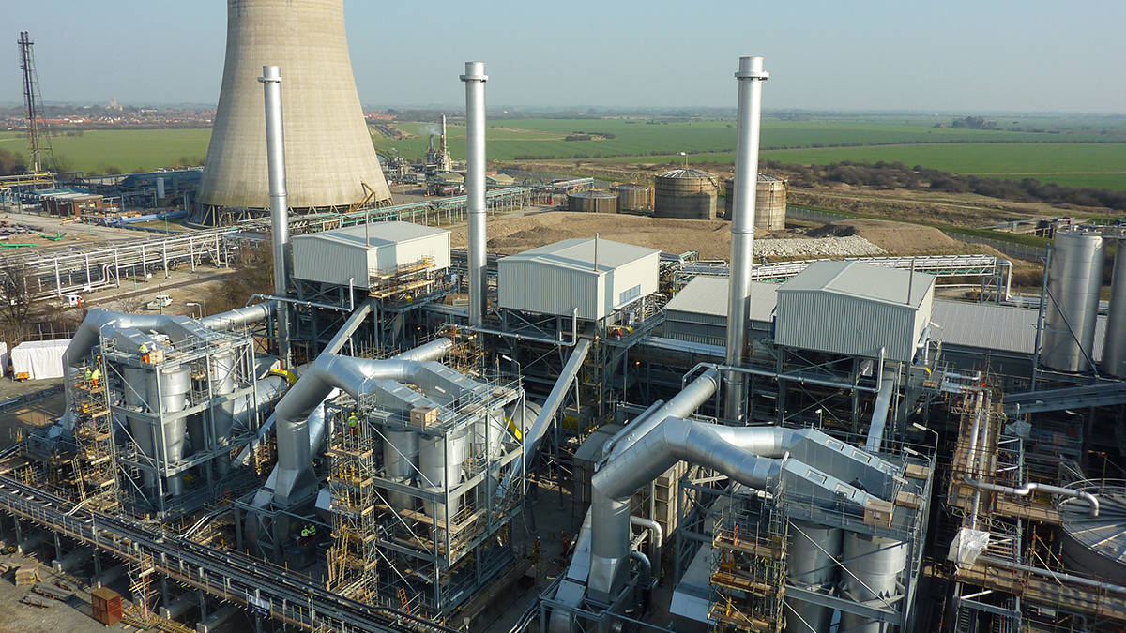
02
Eficiencia energética en secadores

Slide 44
02
Energy Efficiency in Dryers
Drying is defined as the removal of small amounts of water from a material through the application of heat.
This process can be carried out mainly by thermal methods.
The fluid used to dry normally is air. Water is usually removed by the circulation of air over the material.
There is a wide variety of dryers according to different parameters:
  Heat Transfer System
  Pressure
  Heat Transfer Mechanisms (convection, radiation, conduction)

Slide 45
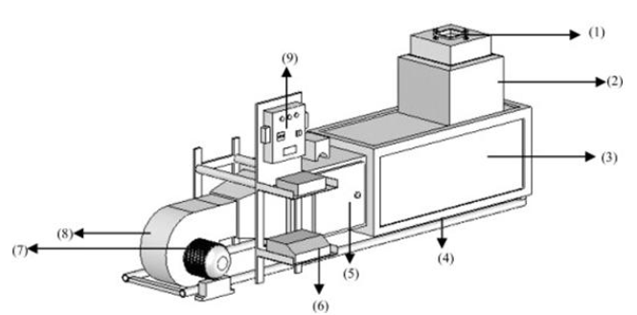

02
Energy Efficiency in Dryers
(1) salida de aire
(2) sensor
(3) cámara de secado
(4) base
(5) calentador
(6) inversor
(7) motor
(8) ventilador
(9) control
Q = air mass (kg)*(h_{i} (kJ/kgºC) · T_{input}(ºC) – h_{o} (kJ/kgºC) · T_{output}(ºC))
η = performance
Q= heat generated
b = inlet fuel flow (kg/h or Nm³/h)
PCI = lower heat value of fuel (kJ/Nm³)

Slide 46
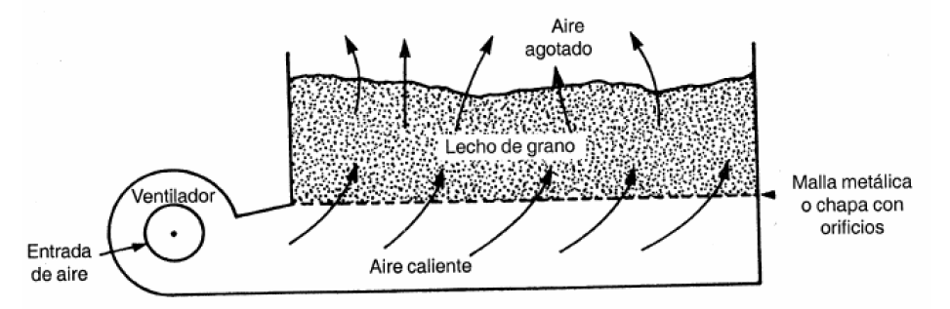

02
Energy Efficiency in Dryers
Exhausted Air
Fan
Grain bed
Perforated Sheet
Incoming air
Air hot
Discontinuous dryers (Dendy, 2001)
Inefficient solution

Slide 47
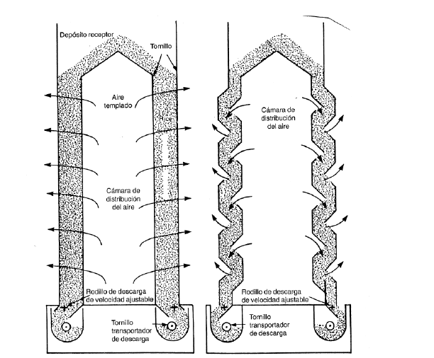
02
Energy Efficiency in Dryers
Receiving deposit
Screw
Warm air
Air distribution chamber
Column Dryer without mixing
Air distribution chamber
Column Dryer with mixing
Continuous dryers (Dendy, 2001)
Discharge roll with adaptable Speed
Discharge roll with adaptable Speed
Screw conveyor
Screw conveyor

Slide 48
02
Energy Efficiency in Dryers
GENERAL SAVING MEASURES
The efficiency will be better the higher the temperature at the entrance,
The waste heat produced by other equipment can be used for this purpose,
It is important to try to dry naturally before using the dryer,
It is important not to dry above the storage temperature,
The drying time will be shorter, the smaller the size of the product,
Regulation of combustion (explained in previous slides),
Recovery of heat from combustion fumes,
Isolation of dryers to minimize losses (drying chamber, external surface such as walls or ceiling).

Slide 49
02
Energy Efficiency in Dryers
ENERGY SAVING MEASURES
Modification of operating conditions.
  Heat the drying gases as much as possible
  Increase the high moisture content in exhausted gasses.
  Use sensible and latent heat from the exhaust vapors to preheat the combustion air.
  Recover the sensible residual heat of the dry product.
  Pre-dry the product through natural or forced atmospheric flows.
  Recover another residual heat from the factory to warm the incoming air for better drying.
  Use the furnace or boiler gases.
Minimize drying
  Dry as little as possible. Do not reduce the humidity of product below what is necessary.
  Dry as little as possible. The product must be dried before putting it in the dryers.
Check the degree of drying
  It is necessary to study the drying curve of the product to ensure the balance between humidity and ambient temperature.

Slide 50
02
Energy Efficiency in Dryers
MAXIMUM VALUES OF RELATIVE HUMIDITY TO STORE
These data depend on the weather conditions.
CEREAL | MAXIMUM RELATIVE HUMIDITY %
Wheat | 13,5%
Corn | 13,5%
Paddy Rice | 15%
Rice | 13%

Slide 51

02
Energy Efficiency in Dryers
What parameters can be adjusted?
Air temperature
Air speed
Air humidity
Product size
1
2
3
4

Slide 52
Towards a sustainable agro-food industry. Capacity building programmes in energy efficiency.

