Slide 1
Energy efficiency in industries:
Stage 1: Kick-off training / General employees
Yvan DELOCHE
Critt Agroalimentaire PACA
Towards a Sustainable Agro-Food Industry. Capacity Building Programmes in Energy Efficiency.
This project has received funding from the European Union’s H2020 Coordination Support Action under Grant Agreement No.785047.

Slide 2
Contents
1 PART
- Several definitions
- Energy efficiency in different fields
- Energy transition law for the European green growth
2 PART
Energy efficiency in industrial energetic uses:
- Industrial refrigeration
- Compressed air
- Steam
- The fatal heat recovery
- Pumping
3 PART
- Energy indicators
- Energy performance diagnosis

Slide 3
Objectives
Understanding energy efficiency issues
Acquire technical skills necessary in the industrial sector
Monitor and measure energy indicators
Add energy efficiency measurement and verification within day-to-day working practices

Slide 4
Introduction: A rising concern
Generation capacities and grids
Deregulation
Huge investment ($16 trillion worldwide) is needed involving an increase in price of both gas and electricity.
Deregulation of both production and supply of gas and electricity implies to build new business models significantly different from traditional ones.
Demand is booming
Because of the lack of electricity generation capacity, peak prices are becoming very high and volatile.
Energy Efficiency
Policy and environmen
Natural resources (oil & gas)
are declining
Kyoto protocol implementation involves new constraints to be integrated in today’s utility business models
In the consumption regions such as Europe, energy sourcing is becoming crucial and focuses major attention of key energy players

Slide 5
Part 1 – Several definitions
What does energy efficiency mean?
Efficient energy use, sometimes simply called energy efficiency, is an index that measures the use-efficiency of final energy. It is the ratio between energy consumption and a relevant unit of production within a set time period.
In the construction industry, we usually talk about energy intensity (kWh / year / m2).
Sector | Unit of production
Offices, Shopping centers and Supermarkets | Floor area (conditioned or not)
Warehouses | Floor area, Building volume
Hotels, Motels and Hospitals | Superficial floor rooms or occupied beds
Industries | Final products or raw materials quantity and mass
What is an energy conservation measure?
An ECM is any type of project conducted, or technology implemented, to reduce the consumption of energy in a building.
The types of projects implemented are usually designed to reduce utility costs: water, electricity and gas.
The aim of an ECM should be to achieve a savings, reducing the amount of energy used by a particular process, technology or facility.

Slide 6
Part 1 – Several definitions
What does energy conservation mean?
Energy conservation is the effort made to reduce the consumption of energy by using less of an energy service. It can not be measured directly. To evaluate it, we compare the consumption before and after the implantation of ECM, under equivalent conditions.

Slide 7
Part 1 – Energy efficiency in different fields
Transport
Changing mobility Urban planning
Infrastructure Changing prices
Fuels Irrigation Building insulation
Lighting
Agriculture
Industries
Industrial refrigeration Steam
Compressed air Pump system
Construction
Heating and air conditioning systems
Thermal insulation Smart technology systems
Zero-energy buildings

Slide 8
Part 1 – Energy transition law for the European green growth
Medium- and Long-term objectives
Cut greenhouse gas emissions to contribute to the target of a 40% decrease in EU emissions by 2030
Cut France’s consumption of fossil fuels of 30% by 2030;
Reduce the share of nuclear energy to 50% of electricity production by 2025 (for France);
Increase the share of renewables to 32% of final energy consumption by 2030 and to 40% of electricity production;
Halve France’s final energy consumption by 2050 (compared with 2012);
Cut waste going into landfills by 50% by 2050;
The Government has also set itself the target of pricing carbon at 56€ per tone by 2020 and at 100€ by 2023, for the carbon component of the tax on energy products consumption
For France

Slide 9
Part 1 – Energy transition law for the European green growth
Medium- and Long-term objectives
Cut greenhouse gas emissions to contribute to the target of a 40% decrease in EU emissions by 2030
In Spain, they exceed the targets that was approved by EU parliament and Increase the target to 35% of Renewable final energy by 2030
Increase the share of renewable electricity to 70% by 2030 and to 100% by 2050.
Zero emissions of CO2 by 2050;
The government decides to ban the sale and registration of diesel, petrol, gasoline or hybrid cars by 2040.
For Spain

Slide 10
Part 1 – Energy transition law for the European green growth
Medium- and Long-term objectives
Cut greenhouse gas emissions to contribute to the target of a 40% decrease in EU emissions by 2030
In Germany, they aim to Reduce gas emissions by 55% in 2030
Increase the share of renewable electricity to 50% by 2030 and to 80% by 2050.
Increase the use of renewable energies ( all consumptions combined) to 30% by 2030, 45% by 2040 and 60% by 2050
For Germany

Slide 11
Part 1 – Energy transition law for the European green growth
Medium- and Long-term objectives
Cut greenhouse gas emissions to contribute to the target of a 40% decrease in EU emissions by 2030
Increase the improvement of energy efficiency to 33% by 2020
For Netherlands

Slide 12
Part 2 – Energy efficiency in industrial energetic uses:
Industrial Refrigeration

Slide 13
Part 2 – Energy efficiency in industrial energetic uses:
Industrial Refrigeration
Speed variation
Storage
Distribution
Install speed variation on at least one of the compressors
For screw compressors, privilege the regulation of power by speed variation rather than by drawer.
Install a cold buffer storage if necessary. It is also possible to size the decoupling bottle so that she can eventually play a storage role.
Regulate the flow of refrigerant fluid by electronic speed variation on the secondary distribution pump.
Regulate the coolant flow on the primary circuit versus flow on the secondary circuit.
Compressors
Heat recovery
Insulation & Defrost
For low temperatures, use two-stage cycles or cycles to economizer.
Install power compressors judiciously tiered to cover better the whole range of powers called.
Install a recovery system heat on the cold group
For screw compressors: recover the heat on the oil circuit.
Up to 25% rejected heat can be valorized at a temperature of 50 - 60 ° C.
Check the state of the cold circuit insulation and repair if necessary.
Adopt a strategy adequate and powerful of defrosting.
Evaporator
Lightning
Cold room openings
Prefer large sized evaporators to reduce pinching.
10% more surface is 1°C won, so 2 to 3% of the energy consumed.
Set up protections effective openings (curtains with straps, air curtains, quick-open doors).
Set up buffer locks and decrease openings / closures of the area.
Inlets can be responsible for 20 to 40% of the balance sheet refrigeration system.
Lighting is a contribution of heat
Set up efficient lighting systems in the cold rooms

Slide 14
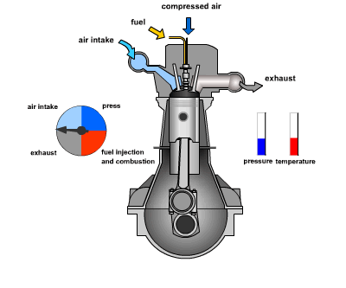
Part 2 – Energy efficiency in industrial energetic uses:
Compressed Air

Slide 15
Part 2 – Energy efficiency in industrial energetic uses:
Compressed Air
Dryer
Regulation
Install more dryers performing.
Check regularly the pressure drops of the driers.
Respect the periodicities of maintenance.
If necessary, call in a refrigeration specialist qualified for the maintenance of the cold circuit.
Avoid regulations by throttling of the suction air
Avoid the no-loads of air compressor.
Install an electronic variation speed to adapt production to the real need of compressed air.
Install a management system and regulation of compressors cascade according to the need of air
.
Heat recovery
Recover the rejected heat by the compressor for space heating or water production hot.
About 80% of electric power compressor is transformed into heat.
Red de aire comprimido
Cerrar la red para limitar la presión de las brechas al final de la red.
Pneumatic tools
Filters
Replace tools if possible pneumatic power tools. The price of the pneumatic kWh is 20 times higher than the price of the electric kWh.
Look for and seal leaks regular (at least once a year).
The leaks are responsible for a significant waste, frequently around 40 to 50% of the overall consumption.

Slide 16
Part 2 – Energy efficiency in industrial energetic uses:
Steam production
Thermodynamic
With float

Slide 17
Part 2 – Energy efficiency in industrial energetic uses:
Steam production
Heat recovery
Steam trap
Steam network
Install a recovery system heat lost during purges, you can save between 1 and 4% of energy.
Check the traps regularly.
In installations where the traps are not frequently checked, 30% of them can be defective and run away.
Regular monitoring can lower this rate to 5%.
Repair leaks regularly. A single leak of 3.18 mm diameter on a steam network at 7 bar causes a loss of € 3,900 / year.
Driving with insulation wet gives way 30 times more only when it is dry.
Supply of wate
Economizer
Pressure regulator
A supply of water not insulated can lose up to 70% of its thermal energy.
Install an economizer to preheat the water supply of a steam boiler.
Energy savings of 2 to 5% are possible.
If possible, reduce the pressure of the network. If there are regulators at the entrance of all consumers, a network high pressure is not necessary.

Slide 18
Part 2 – Energy efficiency in industrial energetic uses:
Fatal Heat recovery

Slide 19
Part 2 – Energy efficiency in industrial energetic uses:
Fatal Heat recovery
Origins and characteristics of thermal emissions in the food industry
Liquid effluents:
Very low temperatures (30°C) : Residential wastewater
Low temperatures ( 30 to 60°C) : Cooling water (air compressors, inductance furnace) and washing
Medium temperatures (70 to 100°C): Cooling water (rooms at high temperature, foundry mould, etc)
High temperature (100 to 130°C): Purges of boilers, steam condensate, etc,
Gas discharges:
Very low temperatures (30°C) : Air conditioning
Low temperatures ( 30 to 60°C) : hot air of: dryer, compressor and room’s cooling
Medium temperatures (70 to 100°C): Condensation
High temperature (100 to 130°C): Process steam
Diffuse Emissions
Insulation defects of pipes, walls and openings not closed.

Slide 20
Part 2 – Energy efficiency in industrial energetic uses:
Fatal Heat recovery
1 - Diagnostic
The fatal heat resulting from the thermal discharges of the processes and products varies from 30 to 90 °C for the agrofood industries.
The first step of the valorization process is to conduct an energy diagnosis of the plant.
2 - Optimization
Secondly, taking into account the needs, optimization of the settings (combustion), as well as the reduction of the losses (insulation) of the industrial installation make it possible to reduce the different emissions.
3 – Storage and internal valuation
The use of heat exchangers, hoods and, if necessary, storage devices can exploit the fatal heat internally to reuse it on the same process (preheating air for example), but also for a other process (drying) or room’s heating.
4 – External valuation
The fatal heat can also be valorized outside the site: use for other companies, networks of heat, and, possibly to produce the electricity via dedicated units.

Slide 21
Part 2 – Energy efficiency in industrial energetic uses:
Pumping
Pumps
Regulation
Replace or modify pumps oversized.
Choose the pump according to the needs of the system
Apply a coating that reduces friction inside the wheel and the volute centrifugal pumps
Restore internal tolerances shoes
Identify the pumps in cavitation
Install electronic speed variation when it allows to increase the energy efficiency of the pumping system.
Stop the pumps when they do not need to be Operating. Do not pump for nothing.
Motors
Consider also the cost of operation (energy) when buying equipment.
Do not oversize the motors.
Use high efficiency motors (class IE3 or IE4).
Respect the periodicities and engine maintenance instructions electrical
Use an approved workshop at rewinding to avoid degradation performance.
Valves
Close the not used network’s parts
Process
Put in place a monitoring system for the entire network

Slide 22
Part 3- Energy indicators
What is an energy indicator?
Energy use
Main drivers behind energy use
GDP/value added (constant prices)
Production value (constant prices)
Population
Passenger and freight transport
Income (households)
Residence and office buildings (heated floor area)
Energy intensity indicators
Energy per production value,
Energy per value added,
Energy per man-hours,
Energy per passenger-km
etc.

Slide 23
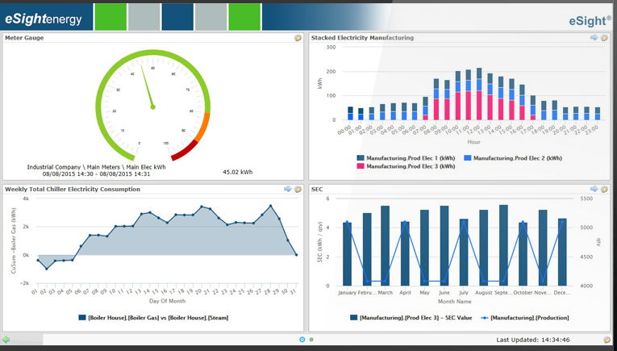
Part 3- Energy indicators
What is an energy indicator ?
Benefits of calculating energy indicators:
A detailed analysis of consumption by branch of activity of the company
Thanks to indicators, we can put in place a demanding reporting
Clearly define tasks and responsibilities of the action plan according to priorities and emergencies
Behavioral gains on the energy consumption

Slide 24
Part 3- Energy performance diagnosis
Definition:
The energy performance diagnosis (DPE in French) provides information on the energy performance of a
building, by evaluating its energy consumption and its impact in terms of greenhouse gas emissions.
A diagnosis allows the plant to optimize its energy consumption down to the very heart of your processes:
Technical recommendations and quotations for solutions, with estimated ROI.
Audit performed on site with a measurement campaign.
2- INVESTIGATION
4- RECOMMENDATION
1- INVENTORY
3- ANALYSIS
5- ASSISTANCE
Situation of the use of energy, utility systems and, above all, manufacturing processes and equipment.
Identification of the possibilities of saving on processes or equipment
Assistance for implementation and training

Slide 25
Part 3- Energy performance diagnosis
Following the energy performance diagnosis can help the company to:
Design low energy consuming solutions
Assess their feasibility
Select the equipment and perform acceptance testing
Implement a counting plan
Make personnel aware of energy saving, etc.

Slide 26
Thanks For Your Attention!
This project has received funding from the European Union’s H2020 Coordination Support Action under Grant Agreement No.785047.

Slide 27
Towards a sustainable agro-food industry. Capacity building programmes in energy efficiency.

