Slide 1












Best Practice Examples on Energy Efficiency Investments
Towards a Sustainable Agro-Food Industry.
Capacity Building Programmes in Energy Efficiency.
This project has received funding from the European Union’s H2020 Coordination Support Action under Grant Agreement No.785047.

Slide 2

Best Practice Example I: Chilled water distribution
Industry:
Medium-scale industry which produces instant coffee extracts
Yearly energy costs of ca. 8 million Euros
Status quo:
Three compression chillers generate chilled water at 5°C which is supplied via chilled water circuit to both production and air conditioning systems
Chillers switch frequently and sometimes only start for a few minutes.
Current average supply temperature lies at 3°C and return line temperature at 4°C, this temperature gradient is too small. Chilled water is pumped through the pumps even though there is no sufficient cooling demand from the consumers.
Efficiency measure:
Regulating chilled water flow to consumers based on actual demand by means of appropriate control valves
Reviewing load design values and actual chilled water demand
Using frequency control (FU) for chilled water pumps to increase the temperature gradient
Increasing temperature of chilled water generation from 3°C to 5°C by changing chiller parameters

Slide 3
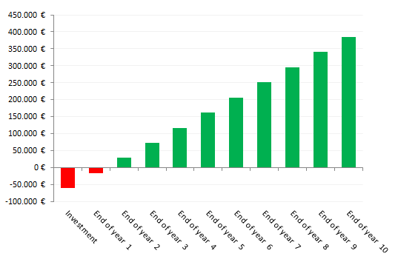
Best Practice Example I: Chilled water distribution
Benefits
Electricity savings of ca. 500 MWh/a due to…
  Reduced pumping energy demand because of reduced circulated chilled water volume flow
  Better utilization and less switching of compression chillers due to greater temperature gradient
  Reduced electricity demand of compression chillers due to increased chilled water temperature
Business case

Slide 4
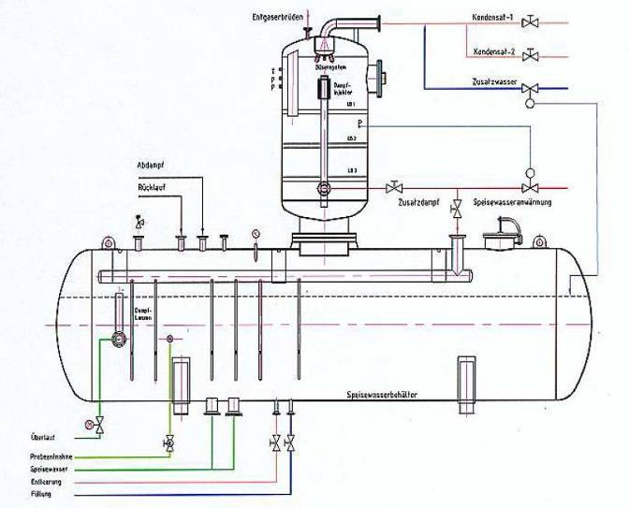
Best Practice Example II: Feed water treatment
Industry:
Medium-scale industry which produces instant food mix
Yearly energy costs of ca. 4 million Euros
Status quo:
Feed water to boiler is treated and degassed using thermal degassing
Degassing of feed water tank is unregulated, the exhaust vapor is discharged via the roof
It is estimated that exhaust vapor losses are about 1 % of total natural gas consumption
Efficiency measure:
Heat of condensation of exiting vapor can be recovered using surface condenser
A surface condenser is mounted in exhaust vapor and heat recovered can be instead used for preheating feed water or for space heating applications

Slide 5
Best Practice Example II: Feed water treatment
Benefits
Natural gas savings of ca. 800 MWh/a due to…
  Heat recovery at higher temperature from exhaust vapors
  Increased efficiency of feed water treatment
  Recovered heat can be directly used for steam generation or auxiliary systems
Business case

Slide 6
Best Practice Example III: Cold storage supply air
Industry:
Medium-scale meat processing industry
Yearly energy costs of ca. 15 million Euros
Status quo:
Meat cold storages are supplied with cold air with two HVAC –systems of 30000 m³/h capacity
The exhaust air system has no heat (or cold) recovery system
Efficiency measure:
In summer time heat can be extracted out of cold exhaust air, thereby saving refrigeration energy. In winter months heat can be recovered from warm exhaust air to heat supply air
Depending on the requirements an appropriate heat recovery system (closed-loop, heat pumps, thermal wheel, etc.) can be implemented

Slide 7
Best Practice Example III: Cold storage supply air
Benefits
Electricity savings on refrigeration system of ca. 200 MWh/a
Natural gas savings of ca. 300 MWh/a due to…
  Heat recovery at during both winter and summer
  Higher temperature of refrigeration system can be tolerated
  Recovered heat can be directly used without storage
Business case

Slide 8
Towards a sustainable agro-food industry. Capacity building programmes in energy efficiency.

